Slide 1
Global express
Notes:
Slide Title: Intro
Instructor Action: N/A
Content: N/A
References: N/A

Slide 2
Course Overview
SESSION 1
SESSION 2
SESSION 3
SESSION 4
Aircraft General
Differences
Electrical
Communications
Lighting
Emergency Equipment
Doors
Structures
Integrated Air Management System (IAMS)
Ice / Rain
Oxygen
Avionics
BEVS
Navigation
Autoflight
Indicating / Recording
Hydraulics
Flight Controls
Landing Gear/Brakes
APU
Fuel
Fire
Powerplant
GOS:
Performance
Weight & Balance
Notes:
Slide Title: Course Overview
Instructor Action:
Review the systems covered in this scenario.
Ask the Clients, “For the areas covered in this session, what particular system or operational scenarios would you like addressed?”
Summarize and record Client comments (e.g., on the whiteboard as a “parking lot”) to address during the session.
Content:
NA
References:
NA

Slide 3

APU CAS
APU FIRE
APU OVERSPEED
APU OVERTEMP
APU BLEED SYS FAIL
APU DOOR FAIL
APU EGT SENSORS
APU FUEL SOV
APU OIL HI TEMP
APU OIL LO PRESS
APU REVERSE FLOW
APU BLEED DISABLED
APU FADEC FAIL
APU FAULT
APU IN BITE
APU NOT AVAILABLE
APU OIL LO QTY
APU SHUTDOWN
APU BLEED OFF
APU BLEED ON
APU FUEL SOV CLSD
APU SOVS CLSD
APU fire
Annunciated when an APU overspeed protective shutdown occurs
Annunciated when an APU EGT overtemperature condition occurs
Annunciated when the APU LCV position does not match command, or Bleed leak detection has been lost and APU bleed is not to be used
Annunciated when the APU door position does not match command
Annunciated when WOW is not true and both EGT thermocouple rakes have failed
APU fuel shutoff valve failure
Annunciated when WOW is not true and a high oil temperature condition exists
Annunciated when WOW is not true and a low oil pressure condition exists
Annunciated when WOW is not true and a reverse flow condition exist
APU bleed selected ON and either the airplane is above the bleed limit (30,000 feet), or the 60 second warm-up period after APU start (ground only) is in progress. Invalid APU bleed configuration.
Annunciated when no data is received by data acquisition unit.
APU FADEC has determined that a minor fault exists.
Annunciated after RUN is selected until prestart BITE is complete and the APU inlet door is positioned (ground only).
The APU will not start.
APU oil level drops below 3.5 quarts (ground only)
An APU shutdown has occurred for other than an overspeed or an over-temp.
APU LCV is closed.
APU LCV is open.
APU fuel shut-off valve closed.
APU fuel and bleed air shut-off valves closed.
Notes:
Slide Title: APU CAS
Instructor Action:
Choose CAS messages that the instructor would like to emphasize if any. Use checklist as necessary.
CAS Messages:
APU FIRE – APU fire
APU OVERSPEED – Annunciated when an APU overspeed protective shutdown occurs
APU OVERTEMP – Annunciated when an APU EGT overtemperature condition occurs
APU BLEED SYS FAIL – Annunciated when the APU LCV position does not match command, or Bleed leak detection has been lost and APU bleed is not to be used
APU DOOR FAIL – Annunciated when the APU door position does not match command
APU EGT SENSORS – Annunciated when WOW is not true and both EGT thermocouple rakes have failed
APU FUEL SOV – APU fuel shutoff valve failure
APU OIL HI TEMP – Annunciated when WOW is not true and a high oil temperature condition exists
APU OIL LO PRESS – Annunciated when WOW is not true and a low oil pressure condition exists
APU REVERSE FLOW – Annunciated when WOW is not true and a reverse flow condition exist
APU BLEED DISABLED – APU bleed selected ON and either the airplane is above the bleed limit (30,000 feet), or the 60 second warm-up period after APU start (ground only) is in progress. Invalid APU bleed configuration.
APU FADEC FAIL – Annunciated when no data is received by data acquisition unit.
APU FAULT – APU FADEC has determined that a minor fault exists.
APU IN BITE – Annunciated after RUN is selected until prestart BITE is complete and the APU inlet door is positioned (ground only).
APU NOT AVAILABLE – The APU will not start.
APU OIL LO QTY – APU oil level drops below 3.5 quarts (ground only)
APU SHUTDOWN – An APU shutdown has occurred for other than an overspeed or an over-temp.
APU BLEED OFF – APU LCV is closed.
APU BLEED ON – APU LCV is open.
APU FUEL SOV CLSD – APU fuel shut-off valve closed.
APU SOVS CLSD – APU fuel and bleed air shut-off valves closed.
References:
QRH Vol 2

Slide 4
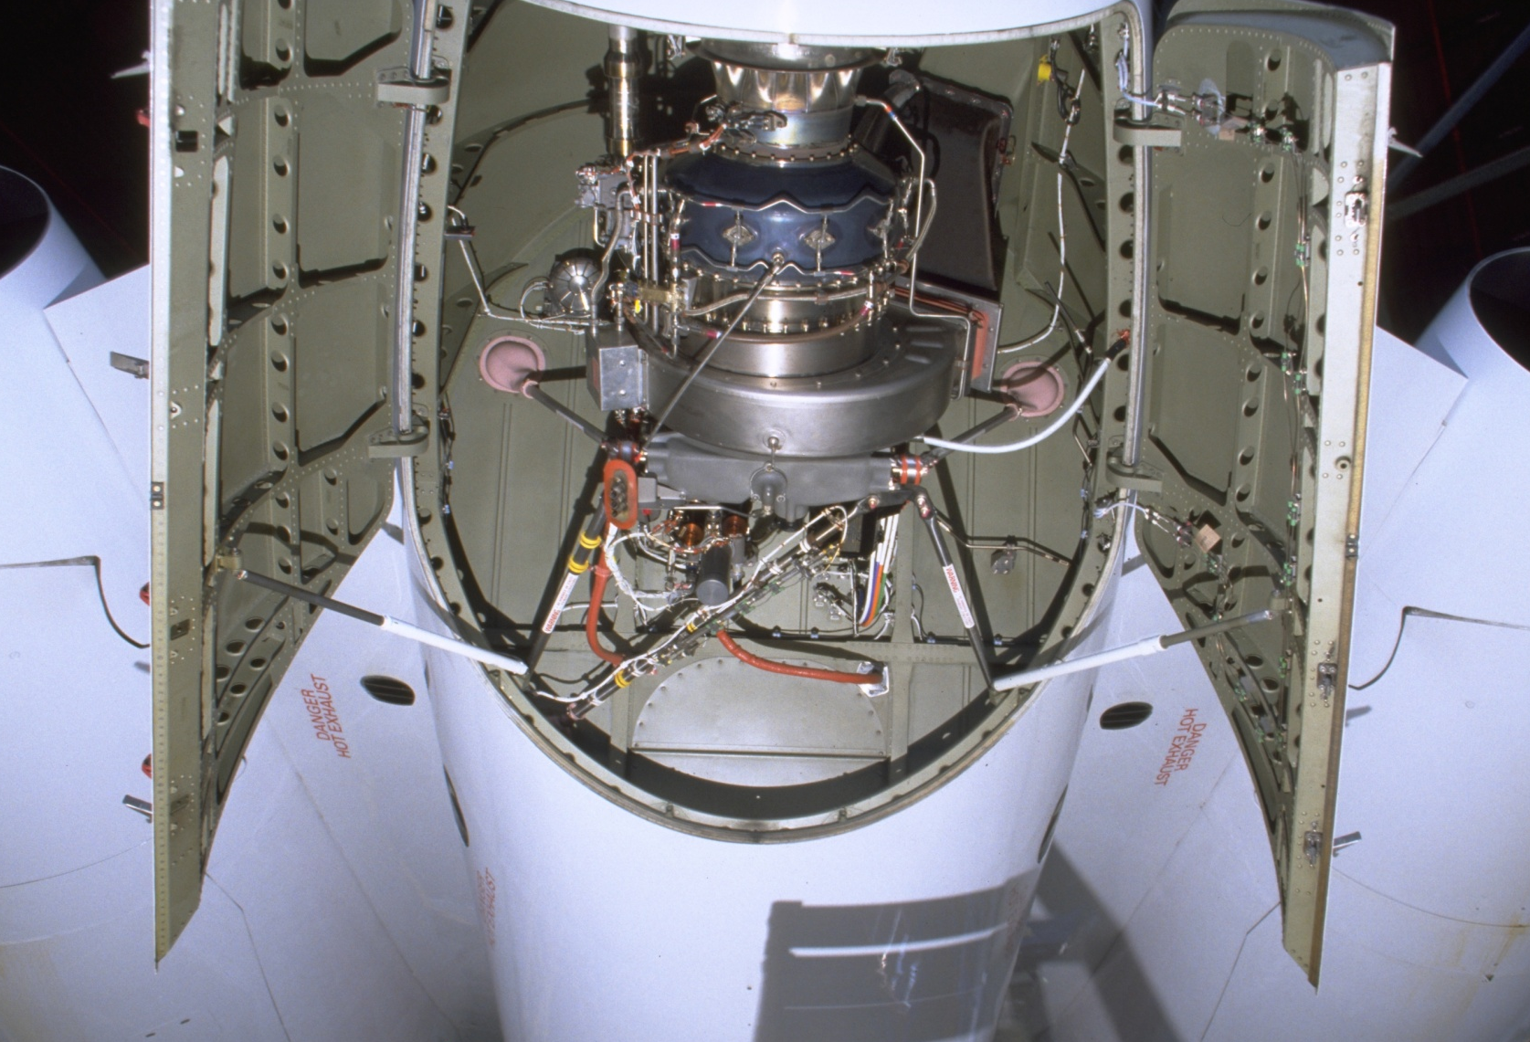







APU Limitations
QUESTION:
What are the maximum altitudes for starting and operating?
Answer:
37,000 ft. to start and 45,000 ft. to operate.
Notes:
Slide Title: APU Limitations
Instructor Action:
NA
Content Information:
What are the maximum altitudes for starting and operating?
37,000 ft. to start and 45,000 ft. to operate.
What is required if the APU is powering AC BUS 4 at 38,000 ft.?
Crew action: Turn off Hydraulic 3A Pump
What can the APU Generator power on the ground?
All buses, however restricted to 1 ACMP.
Why is the APU not approved for unattended operations?
Will shutdown for fire on the ground, but will not automatically discharge fire bottle.
Why does the FADEC need WOW signal?
Operates in non-essential mode on the ground. Fewer malfunctions will cause shutdown in flight.
APU Controls and Indications
Two speed sensors provide indicated speed for on-speed control and Overspeed APU protection during operation, the FADEC monitors the input and should either sensor fail, there will be an APU FAULT advisory message displayed on EICAS
A failure of either sensor will not cause an APU protective shut down to occur
APU is protected from over temperature (high EGT) during acceleration by the FADEC
The EGT system consists of a single temperature sensing unit with two (2) probes
The probes provide redundant signals to the FADEC for:
Fuel schedule trim
Turbine temperature monitoring
Load Control Valve (LCV) modulation
Loss of one probe will not affect APU operation on the ground (non-essential mode), failure of both probes will cause the FADEC to shut down the APU and inhibit start in flight (essential mode), failure of both probes will not cause a shut down
Instead, FADEC programs a preset signal to allow pneumatic loading and normal operation of electrical power
An hour meter is powered on at 95% RPM and records the running hours of the APU.
Deactivated when APU shutdown is initiated.
References:
QRH Vol 2

Slide 5
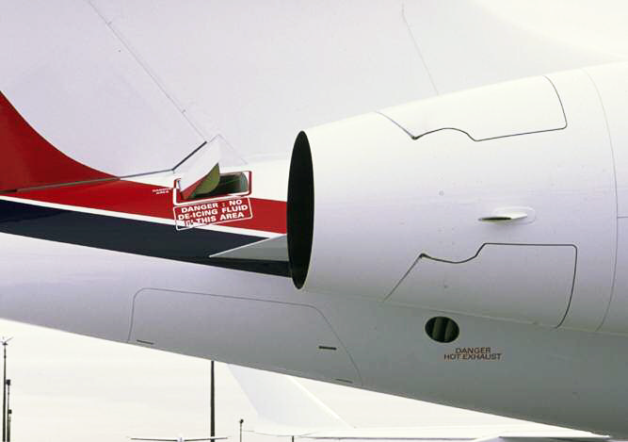
APU Door Dispatch Limitations
If the APU door has failed open:
The APU door can be manually closed
The APU must be continuously operated
The APU must not be allowed to windmill between 4 to 30% for greater than 5 minutes.
Notes:
Slide Title: APU Dispatch limitations
Instructor Action:
Review QRH procedures and MMEL items
Content Information:
Review APU door fail QRH procedures

Slide 6
APU Limitations
START ENVELOPE:
Surface to 37,000ft
BLEED LIMITATIONS:
Surface to 30,000ft
APU bleed extraction above 45 °C OAT for air-conditioning
operation is prohibited.
ELECTRICAL LOADS:
WOFFW to 37,000 ft. 40 KVA (0.7 Mach minimum)
37,001 to 45,000 ft. 28 KVA (excluding the ACMP)
For operations above 37,000 feet, if the APU generator is powering
a bus, the associated hydraulic pump must be selected off (1B − AC BUS 3; 2B − AC BUS 2; 3A − AC BUS 4; 3B − AC BUS 1).
Notes:
Slide Title: APU limitations
Instructor Action:
Review AFM limitations
Content Information:
Review limitations from current AFM

Slide 7
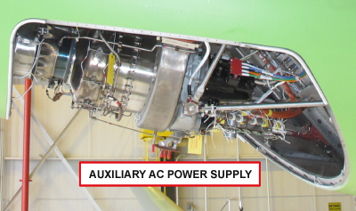
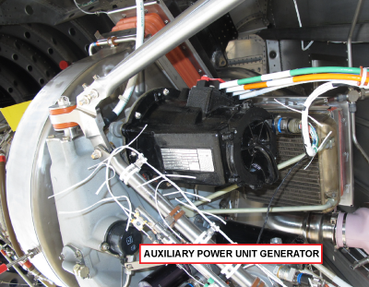
APU Electrical
QUESTION:
What is the maximum electrical load the APU generator is rated to?
Answer:
45kVA on the ground, 40 kVA in the air and 28kVA above FL370.
Notes:
Slide Title: APU Electrical
Instructor Action:
NA
Content Information:
What is the maximum electrical load the APU generator is rated to?
45kVA on the ground, 40 kVA in the air and 28kVA above FL370.
If the APU is powering a bus above 37,000 feet, the associated hydraulic pump must be selected OFF to prevent overloading of the APU generator.
Ref. FCOM Vol. 2, pg. 05-10-15
Ready to Load (Electrical):
At 99% RPM plus 2 seconds, the APU is ready to load electrically.
If the APU drops below 95%, electrical loading is no longer available (on ground and in flight)
See the AFM for the electrical pumps and their power sources.
References:
FCOM Vol. 2, pg. 05-10-15

Slide 8
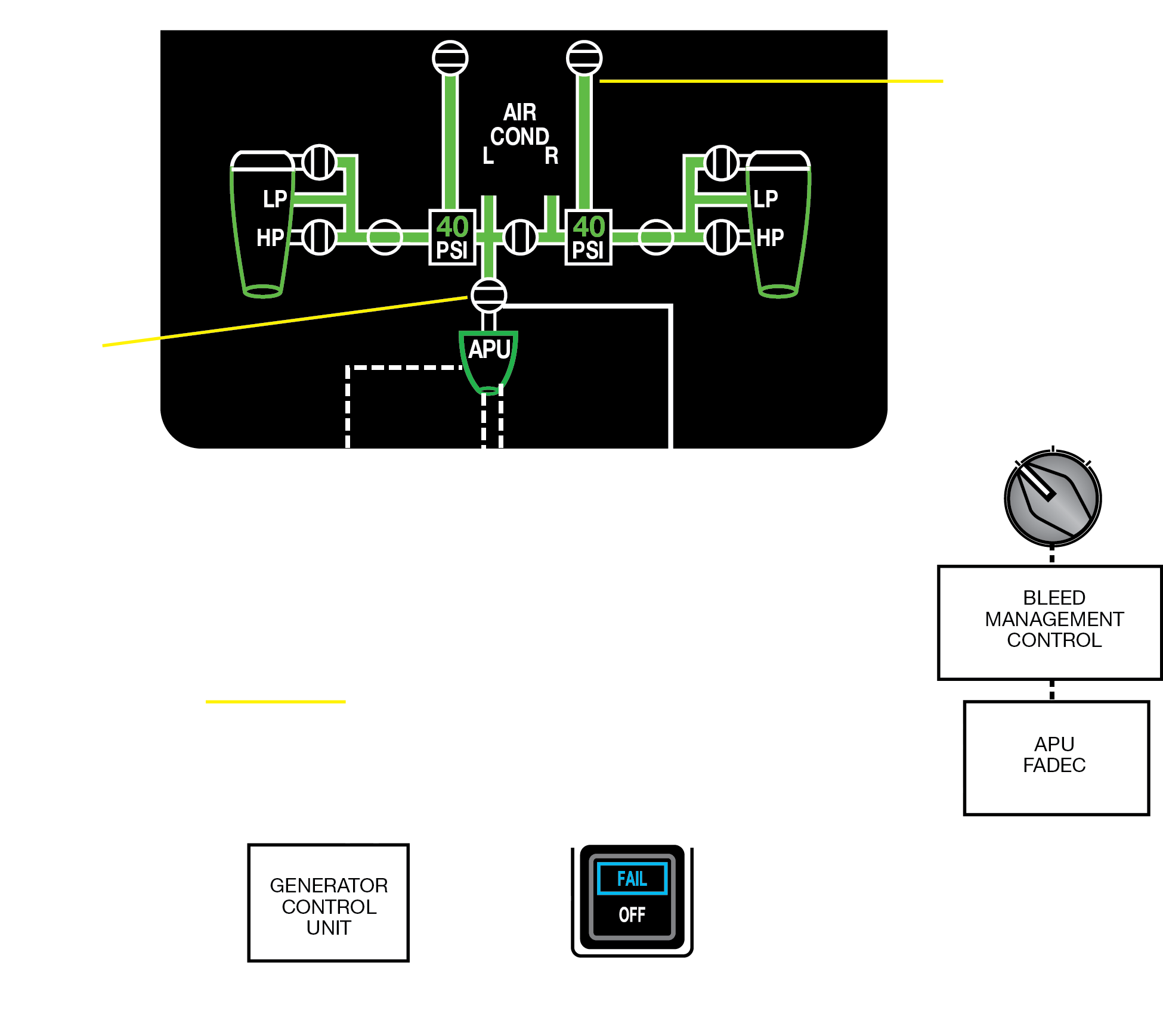
APU Bleed Air
QUESTION:
Which system does the APU give priority to, electrical or pneumatics?
Answer:
The FADEC insures that system priority is given to electrical loads over the bleed air demand, by cycling the LCV closed (reducing bleed load) when the exhaust gas temperature approaches operating limits.
Notes:
Slide Title: APU Bleed Air
Instructor Action:
NA
Content Information:
Which system does the APU give priority to, electrical or pneumatics?
The FADEC insures that system priority is given to electrical loads over the bleed air demand, by cycling the LCV closed (reducing bleed load) when the exhaust gas temperature approaches operating limits.
LCV interlock protection:
The bleed and load management systems are responsible to ensure that the APU bleed air request is activated only when another source of bleed air is not commanded.
Example: L engine bleed valve open or the R engine bleed valve open and the cross-bleed valve open; if either condition exists, the LCV remains closed to prevent damage to the APU.
System priority:
The FADEC insures that system priority is given to electrical loads over the bleed air demand, by cycling the LCV closed (reducing bleed load) when the exhaust gas temperature approaches operating limits.
References:
FCOM Vol. 2, pg. 05-10-20

Slide 9
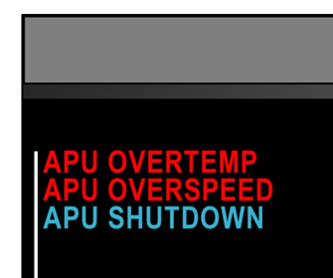
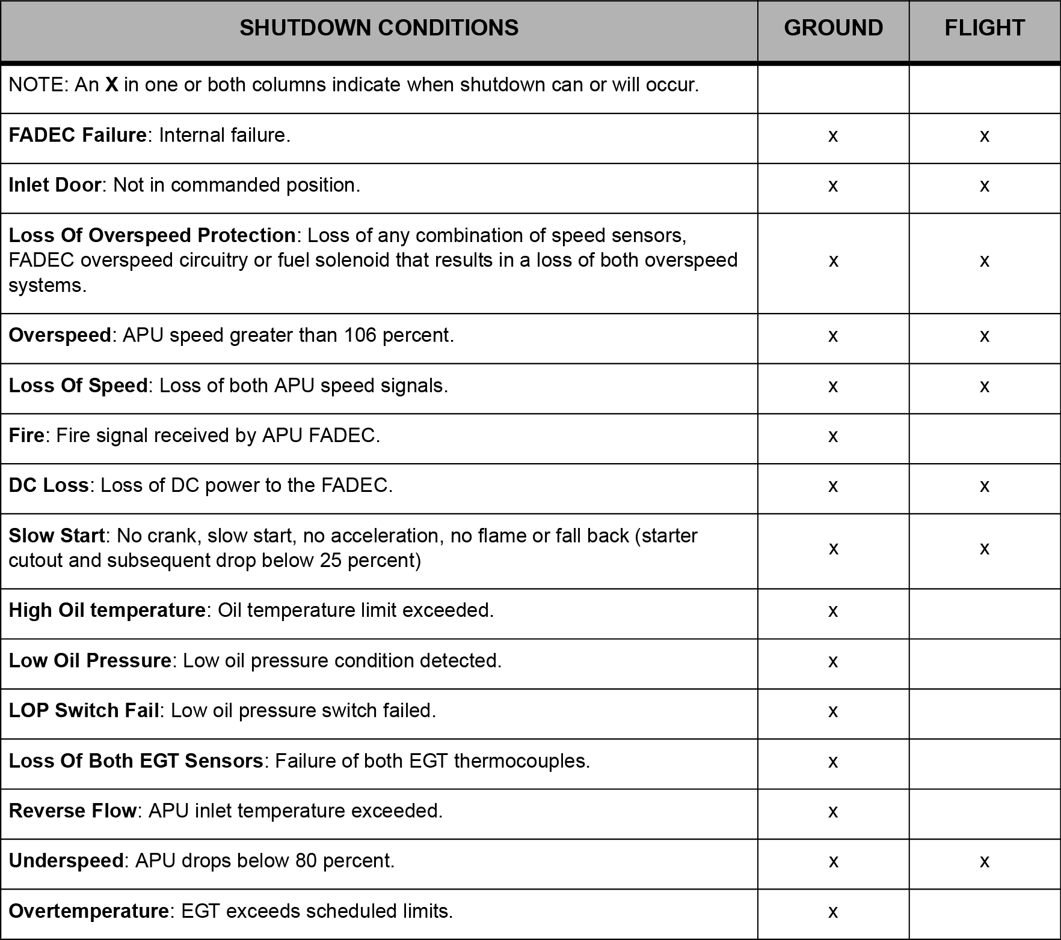
APU Protective Shutdowns
APU remains in essential mode until touchdown + 30 seconds
Notes:
Slide Title: APU Protective Shutdowns
Instructor Action:
Describe differences between ground and essential modes
Content Information:
The ECU has the authority to inhibit starting of the APU, or automatically shut down the APU, when continued operation may cause damage.
To determine this the RE220 functions using two modes of operation:
When the APU switch is selected to RUN on the APU CONTROL panel the ECU performs a BITE check.
The ECU determines the Weight-On-Wheels (WOW) status and selects the operational mode.
NON ESSENTIAL Mode
The APU is in the NON-ESSENTIAL mode of operation anytime the APU is started and operated on the ground.
ESSENTIAL Mode
The ECU will switch to the ESSENTIAL mode when the aircraft transitions from ground operations to flight operations, as a function of WOW.
The APU will always be in the ESSENTIAL mode of operation anytime the APU is started in flight.
If the APU is in operation during landing it will remain in the essential mode for 30 seconds and then revert back to NON-ESSENTIAL mode. If any protective features were tripped during operations in ESSENTIAL mode the APU will shut down upon reversion to NON-ESSENTIAL mode.
A cyan APU FAULT message will display if a protective fault trips in the essential mode.
References:
MTM Vol. 2, Table 49-1, Faults Causing Protective Shutdown

Slide 10
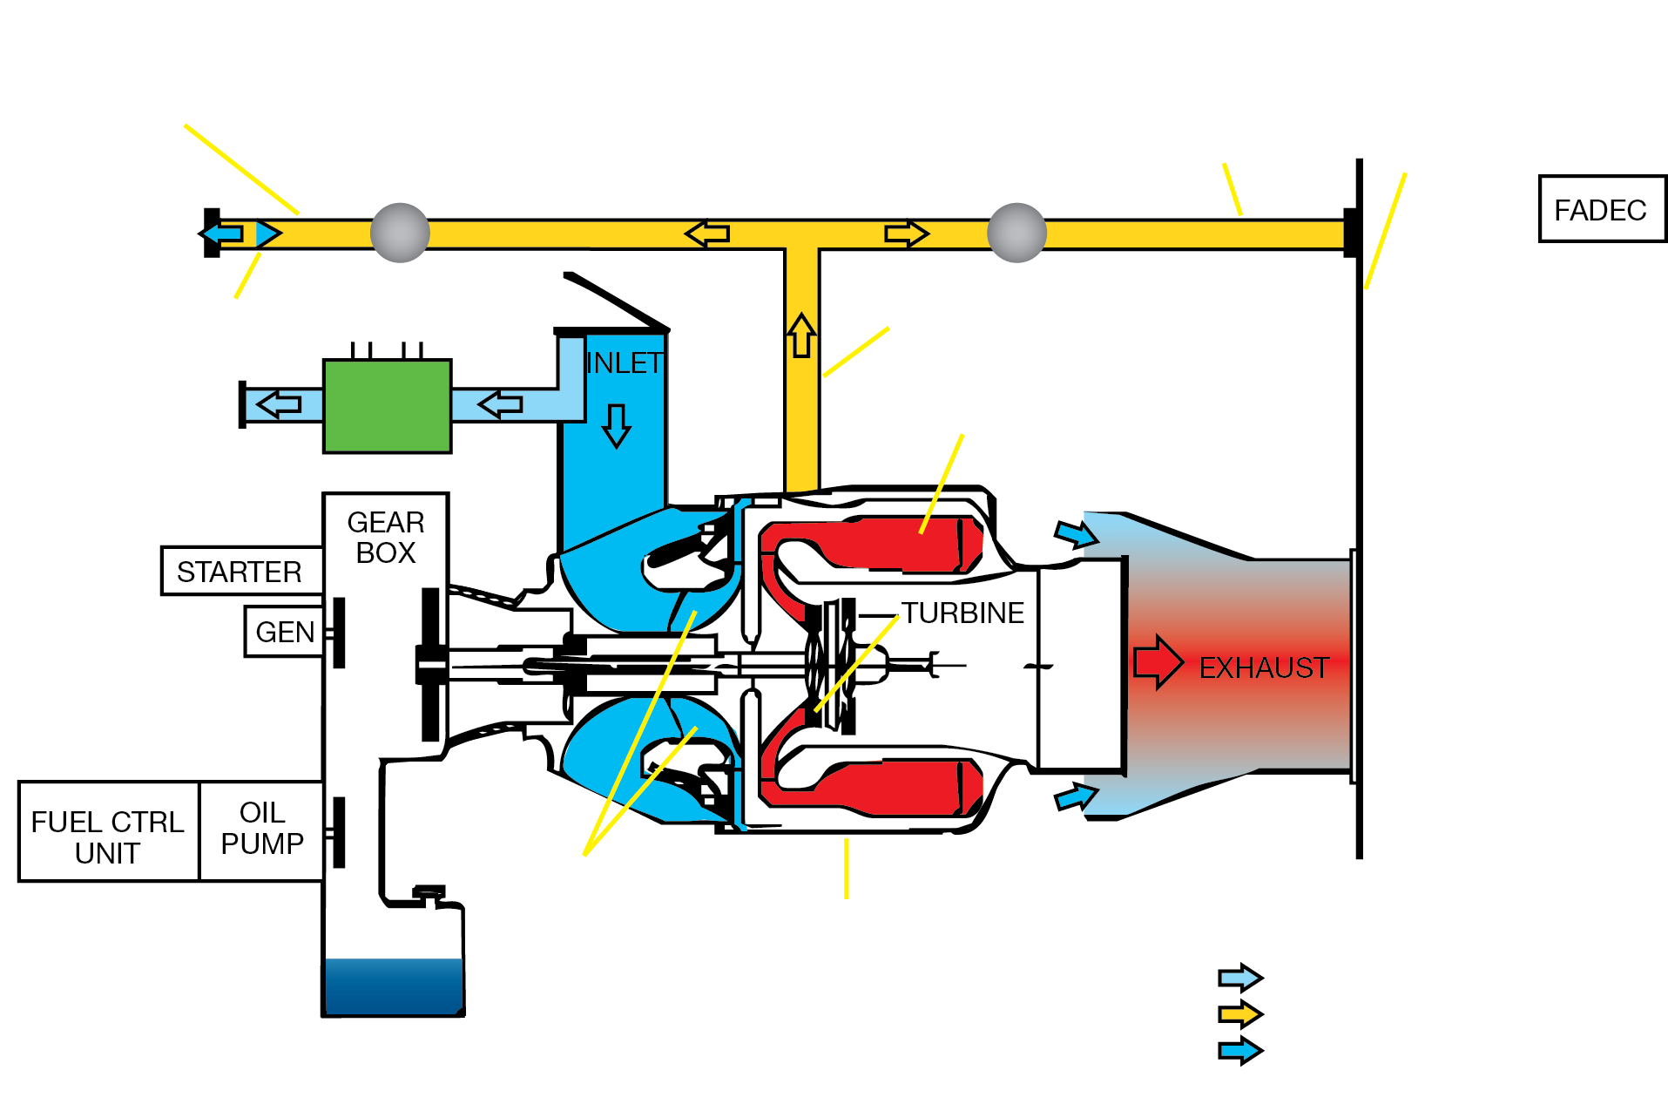
Component Control Schematic
QUESTION:
What conditions does the APU shutdown without a cool down period?
Answer:
APU Fire Handle Pulled
APU Shutoff on the Exterior Services Panel
Notes:
Slide Title: Component Control Schematic
Instructor Action:
Discuss APU Control Panel & Starting & Ignition Systems
Content Information:
What conditions does the APU shutdown without a cool down period?
APU Fire Handle Pulled
APU Shutoff on the Exterior Services Panel
* Red Button inside APU compartment (Ref. AMM Tasks 49-62-00-710-801)
APU Control Panel
START Position (Switch spring loaded from START position to RUN position) Fuel and ignition on at 5%
Starter disengage at approximately 50% RPM
Ground – ignition off at 50% RPM
In flight – ignition off at 98% RPM
Accelerates to 100% RPM
RUN Position:
Initiates the APU prestart BITE
On ground, commands the inlet door to full open
In flight, commands the inlet door to open to either 10% (0.85 MACH) or 20% (0.40 MACH)
Activates the EICAS displays (oil quantity, speed, and RPM)
Starts the fuel pump
OFF (APU enters a 60 second cool down period)
RPM decreases to 70% RPM for 60 seconds (below 20,000 FT) or remains at 100% above (20,000 FT)
After 60 seconds, the RPM will continue to decrease and fuel will stop at this time
Below 25% RPM the inlet door closes
Below 5% RPM the EICAS displays and indications are removed
Starting and Ignition System:
The ignition system consists of a dual output ignition unit, two (2) ignition leads and two (2) igniter plugs
Two cycles of operation:
“BURST” for starting (at 5%)
“MAINTENANCE” for acceleration (duration of the start)
Ignition system is fully automatic and controlled by the FADEC
Ignition occurs at 5% APU RPM
During APU operation ground (non-essential mode), ignition is terminated at 50% RPM
During operation in flight (essential mode), ignition is terminated at 98% RPM
Should flameout occur during operation, the ignition unit will automatically start through the “Auto Relight” function of the FADEC
Starter operation automatically controlled by the FADEC, through the APU control switch
Starter operation begins by selecting the START position on the APU control panel
At sea level, starter cutout occurs at 46%
At altitude, starter cutout may be as high as 60% APU RPM to ensure a positive start
The starter is capable of an immediate restart on roll down when APU RPM is at or below 7% RPM
References:
AMM Tasks 49-62-00-710-801
PTM Vol 1 & 2

Slide 11
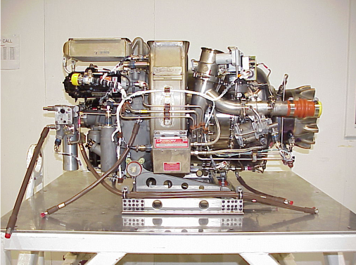
APU Operating Parameters
FADEC Controlled
APU Overspeed 106%
Main Engine Start = 54.5 psia
ECS Operation = 51.2 psia
Electrical Power = 115V, 400HZ, 3 Phase
Notes:
Slide Title: APU Operating Parameters
Instructor Action:
Discuss content
Content Information:
First we will discuss an overview of the APU operating parameters.
FADEC Controlled
Full-load governing speed—45,586 rpm
APU overspeed—106%
Main engine start—54.5psia, 107.9 lb/min
ECS operation—51.2 psia, 91.3 lb/min
Electrical power—115V 400 Hz, 3 Phase
References:
MTM pages 49-5

Slide 12
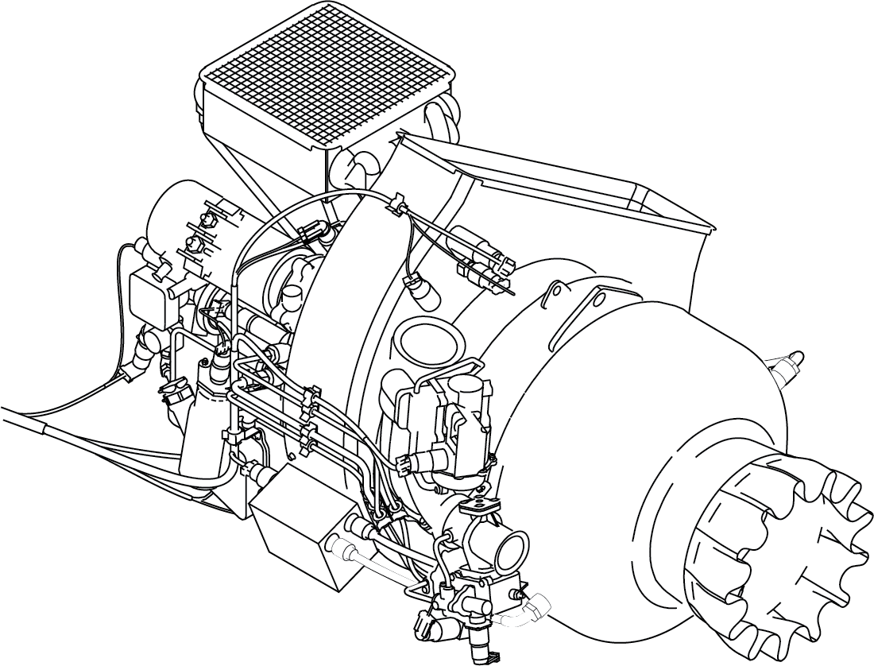
APU IgnitION
Operational Modes
Burst Mode
5 to 6 sparks per second
for the first 5 to 6 seconds
Maintenance Mode
1 to 2 sparks per second
for the duration of the ignition
cycle.
Ignition Termination
50% On Ground
98 % In Flight
Notes:
Slide Title: APU Ignition
Instructor Action:
Discuss content
Content Information:
Each plug delivers a spark to the fuel mixture in the combustion chamber for starting the APU
The igniter plug is the drop-in type, and has a location dowel for proper positioning into a plug adapter installed in the combustion plenum case.
The ignition system is fully automatic and controlled by the ECU.
At 5% rpm, the ECU commands the ignition system to enter the BURST cycle of operation.
BURST ignition provides 5.5 to 6.5 sparks per second, to each channel of the ignition system for 5 to 6 seconds.
At the end of the BURST cycle, the ignition system switches to the "MAINTENANCE" cycle of operation.
The MAINTENANCE ignition cycle has a spark rate of 1.3 to 1.7 sparks per second to each channel of the ignition system for the duration of the ignition cycle.
Ignition is terminated on the ground at 50% APU rpm (98% in flight).
The ignition system has an automatic relight mode to energize the igniters
References:
AIPC, pg. 49-41-09
MTM 49-31

Slide 13
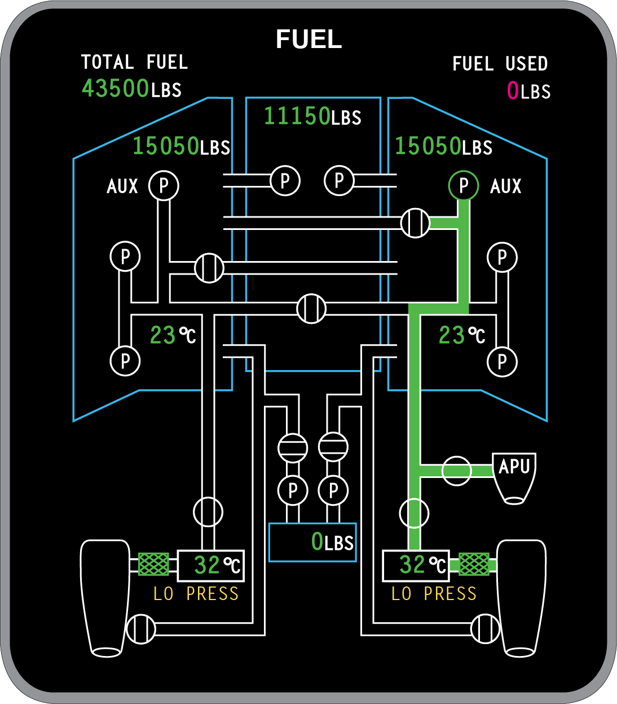
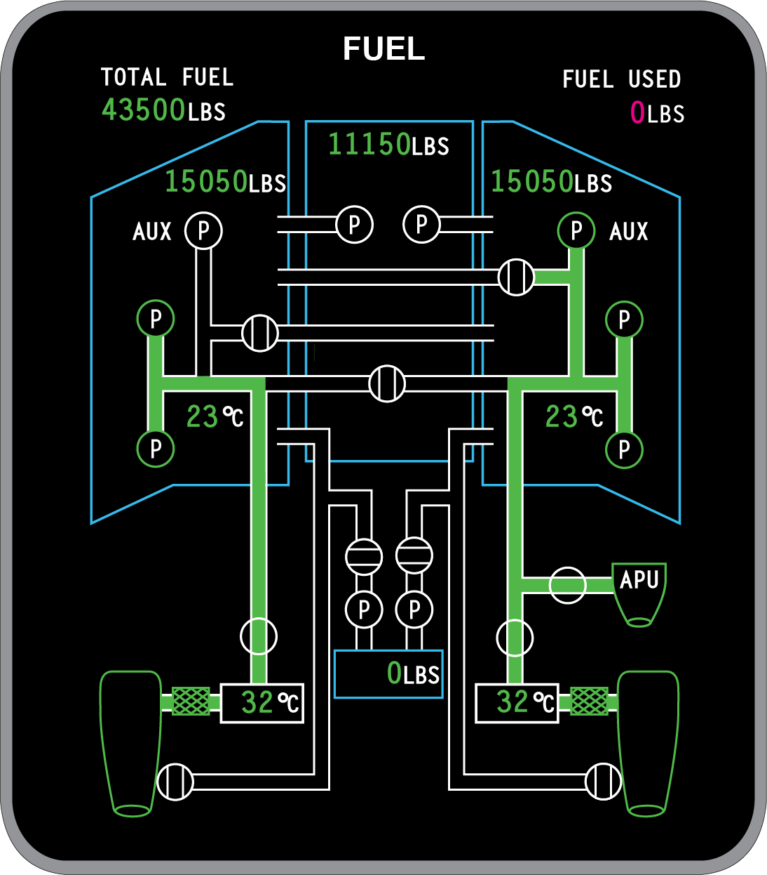
APU Fuel System
CROSSFEED
SHUTOFF
VALVE
AUXILIARY PUMP
PRIMARY
PUMPS
APU Starting and No Main Engines Running
APU and Engines On-speed
Notes:
Slide Title: APU Fuel System
Instructor Action:
Describe fuel requests during and after APU start
Content Information:
The fuel system is a fully automatic electronic control system
The fuel control unit provides metered fuel to 10 fuel dual orifice nozzles regulated by signals
received from the FADEC
APU Start:
Fuel system provides the correct amount of fuel to support combustion and for smooth acceleration
of the engine to full rated speed
APU at Rated Speed:
Fuel flow is modulated as necessary to meet the demands of varying pneumatic and electrical loads, while maintaining a constant speed
Fuel is normally supplied to the APU from the right engine feed line or from the left engine feed line by opening the crossfeed shut-off valve (approximately 200 - 225 PPH)
APU starting and no main engines running:
Right AUX pump supplies the APU through the right engine feed line
APU on-speed and main engines running:
Right PRI pumps feed the APU through the right engine feed line.

Slide 14
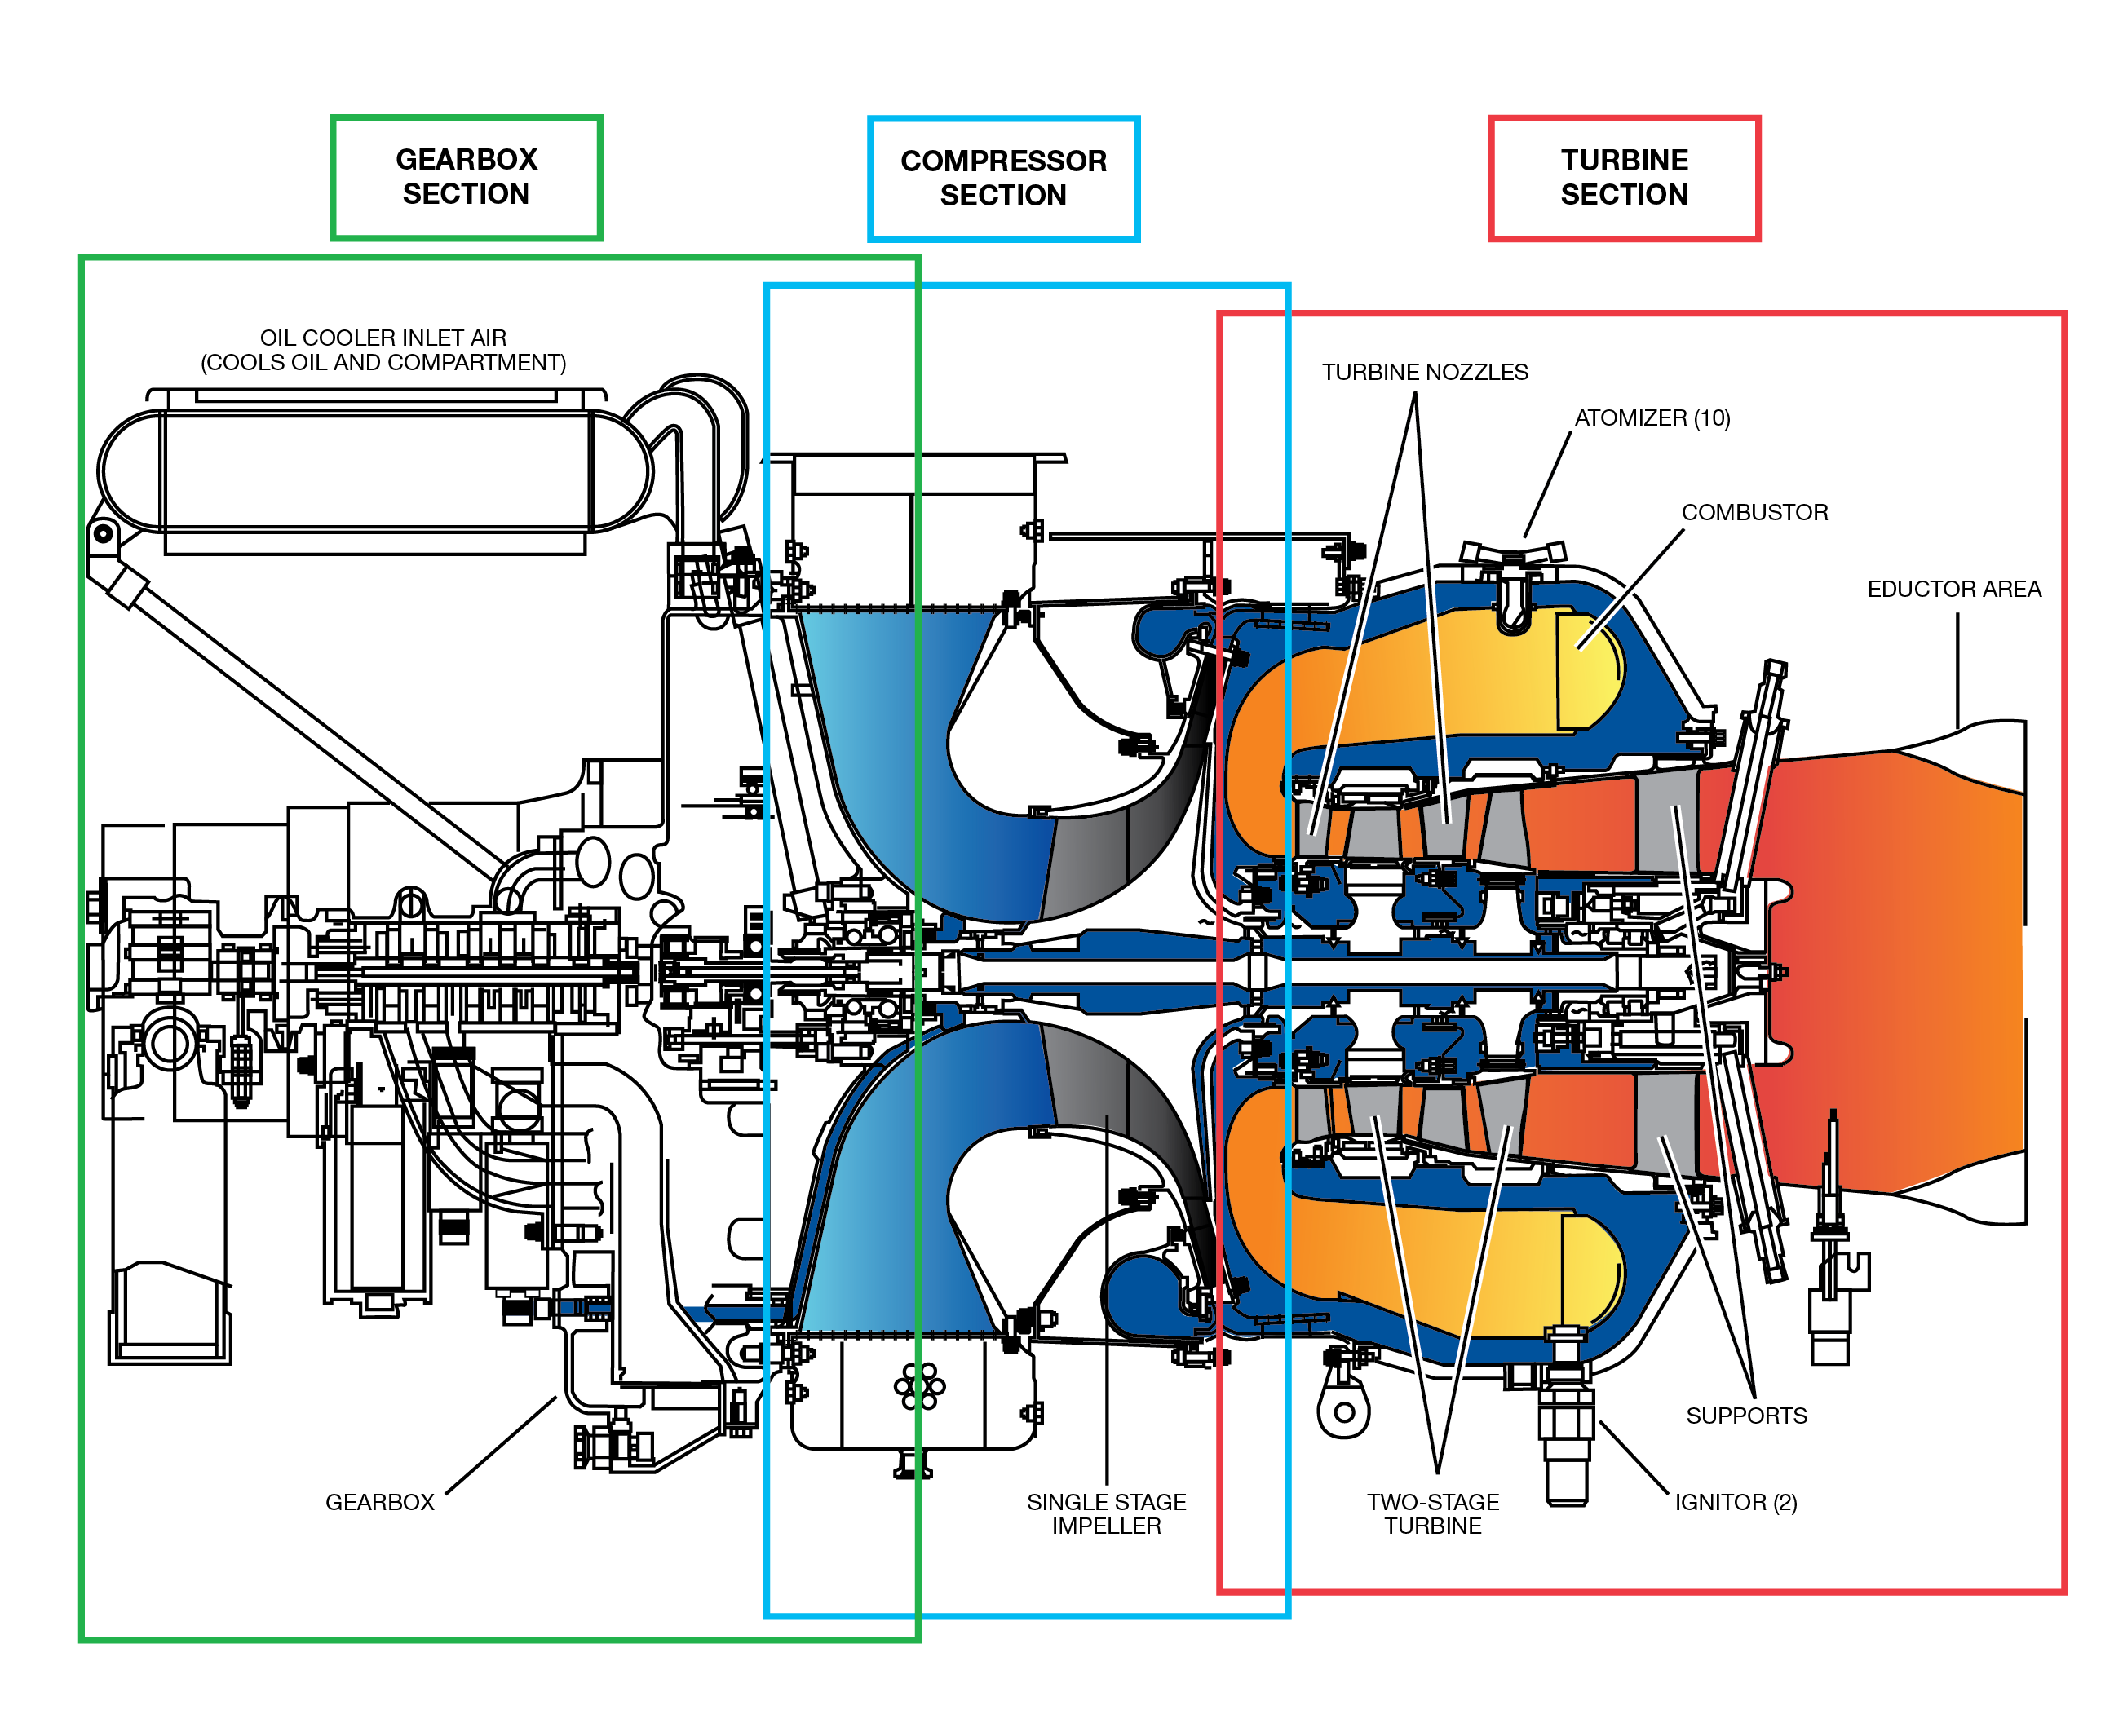
APU Engine Operation
Notes:
Slide Title: APU Engine Operation
Instructor Action:
NA
Content Information:
Air enters the APU inlet and flows to the compressor impeller. The impeller spins the air increasing the pressure. This compressed air is used for combustion, sealing and cooling, and bleed extraction.
The combustion air stream flows through a radial diffuser and axial deswirl nozzle into the combustor case. Fuel is added in the combustor case and ignited.
Hot gases from the combustor case encounter vanes of the first-stage turbine nozzles. The vanes form convergent ducts that increase gas velocity. This powers the turbines and turns the first-stage turbine rotor. The gases then pass through the second-stage stator to spin the second-stage turbine rotor. The gases continue through the turbine system to exhaust overboard.
The tie rod transfers mechanical power from the rotary group to the gearbox. The primary gears in the gearbox change the mechanical power to power the auxiliary generator, oil pump, and FCU.
With APU engine at 100% and no loads, the APU idles. The idle exhaust gas temperature (EGT) on EICAS represents fuel required to operate the gas generator alone. It indicates the condition of compression, combustion, and turbine. Recording these as a baseline can be a reference EGT for troubleshooting and monitoring.
References:
MTM Vol. 2, fig. 49-11, APU Engine Operation
MTM Vol. 2, pg. 49-12

Slide 15
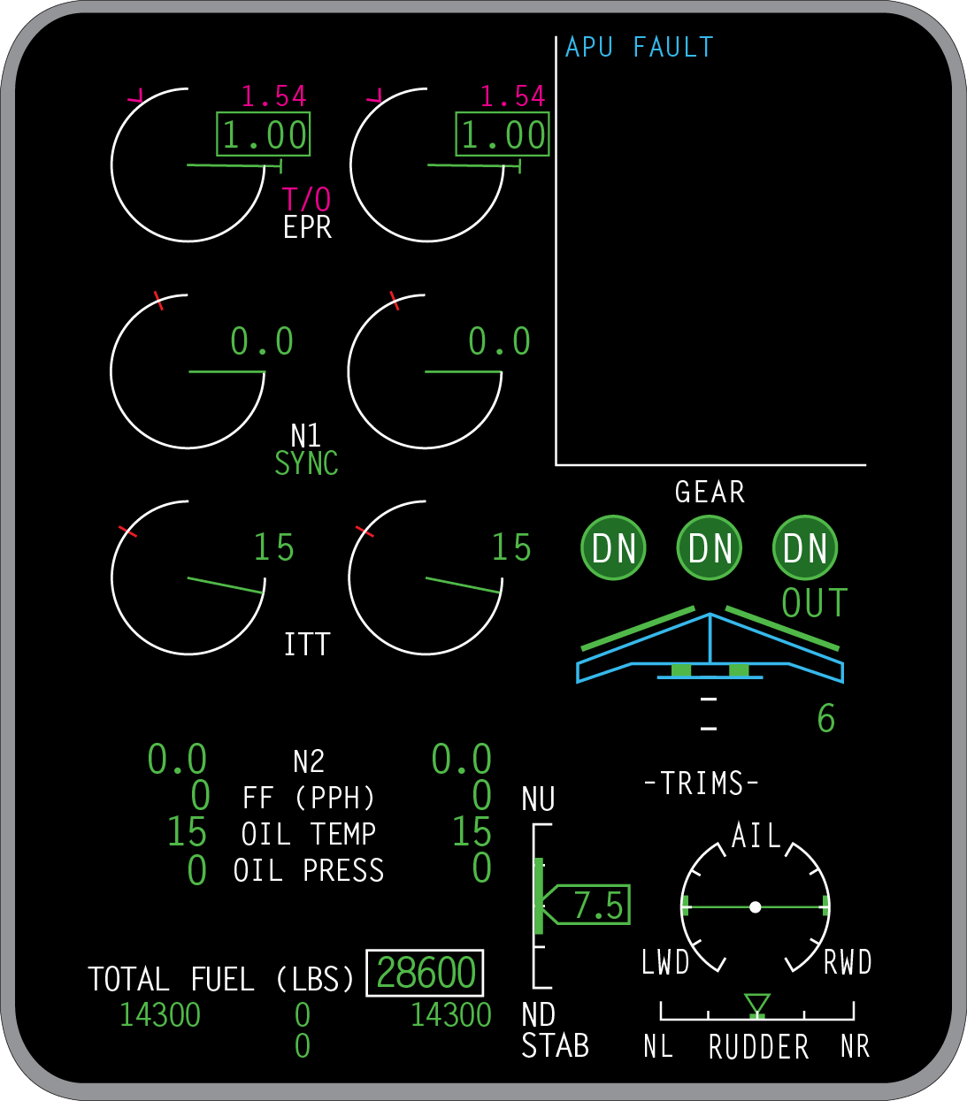



APU Scenario 1
As you try to start the APU you notice the APU FAULT message. You remember that there was heavy rain from the previous night…
ANSWER:
Yes, Except for ER Operations, aircraft may be dispatched provided:
  APU allows normal start and shutdown,
  APU is only used for in-flight emergency,
  A minimum of three engine electrical generators are operative,
  Engines are started by an external power source.
ANSWER:
If you can’t identify if it’s an EGT probe then you run the risk of the second EGT probe failing.
QUESTION:
QUESTION:
Can you dispatch with the APU FAULT?
Should you dispatch?
Notes:
Slide Title: APU Scenario 1 (APU FAULT CAS)
Instructor Action:
Based on Global Customer Advisory Meeting 33
Root cause: Moisture causes a conductive path from the thermocouple circuit to the EGT probe chassis creating a condition where the FADEC detects and annunciates a short to ground (STG) fault.
Launch FlightDeck on iPad and open DDG, pg. CAS-16
Document button opens MMEL pg. 2-5 (APU FAULT)
Content Information:
Can you dispatch with the APU FAULT?
Yes, Except for ER Operations, aircraft may be dispatched provided:
a) APU allows normal start and shutdown,
b) APU is only used for in-flight emergency,
c) A minimum of three engine electrical generators are operative,
d) Engines are started by an external power source.
NOTE: Where APU fault does not allow normal start and shutdown, APU is to be considered inoperative. Aircraft may be dispatched provided APU is considered inoperative and not used. Ref. MMEL, pg. 2-5
Should you dispatch?
If you can’t identify if it’s an EGT probe then you run the risk of the second EGT probe failing.
References:
AWW700-49-0538 (released 18 Dec 2015)
DDG, pg. CAS-16 (Rev 22)
MMEL, pg. 2-5 (APU FAULT)

Slide 16
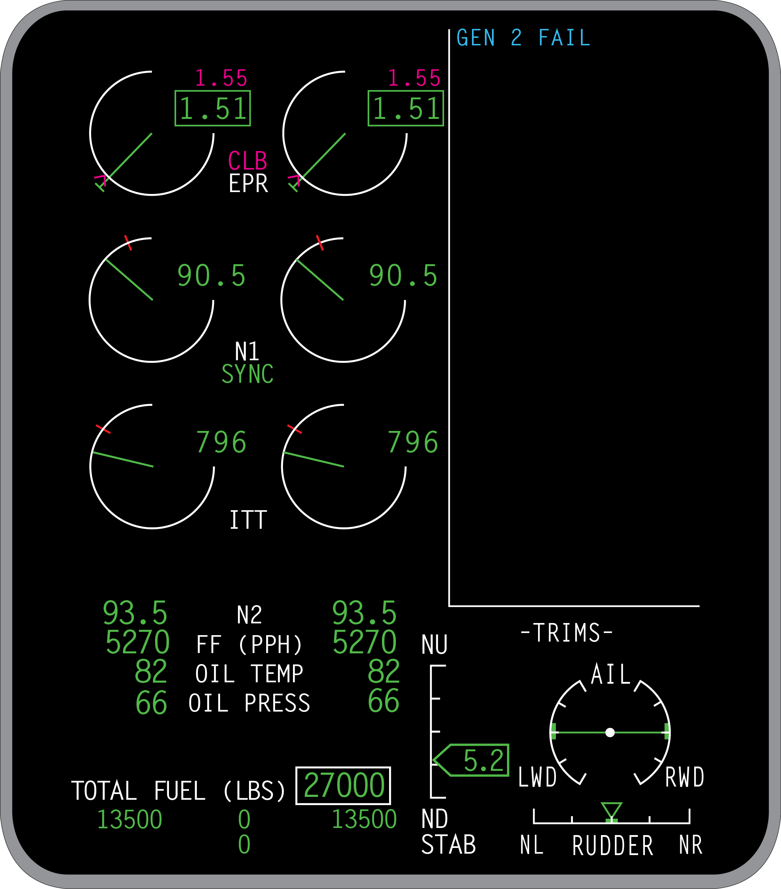
APU Scenario 2
Climbing out at FL280 the GEN 2 FAIL CAS message appears and the PIC elects to start the APU…
ANSWER:
Yes, maximum altitude for operation is 45,000 feet.
If the APU is powering a bus above 37,000 feet the associated hydraulic pump must be secured.
QUESTION:
ANSWER:
QUESTION:
QUESTION:
ANSWER:
Does this limit our altitude with the APU on?
When is it permissible to start the APU in flight (-150)?
You’re only allowed 2 because then it locks it out.
How many resets are you allowed?
37,000 feet
Notes:
Slide Title: APU Scenario 2 (GEN 2 FAIL CAS)
Instructor Action:
Document: QRH Vol. 2, ELEC 04-27
Content Information:
Does this limit our altitude with the APU on?
Yes, maximum altitude for operation is 45,000 feet. Ref. AFM, pg. 02-05-13
If the APU is powering a bus above 37,000 feet the associated hydraulic pump must be secured. Ref. AFM, pg. 02-08-2
How many resets are you allowed?
You’re only allowed 2 because then it locks it out.
Ref. QRH Vol. 2, ELEC 04-27
When is it permissible to start the APU in flight (-150)?
37,000 feet
Ref. AFM, pg. 02-05-13
References:
AFM, pg. 02-05-13
AFM, pg. 02-08-2
QRH Vol. 2, ELEC 04-27

Slide 17
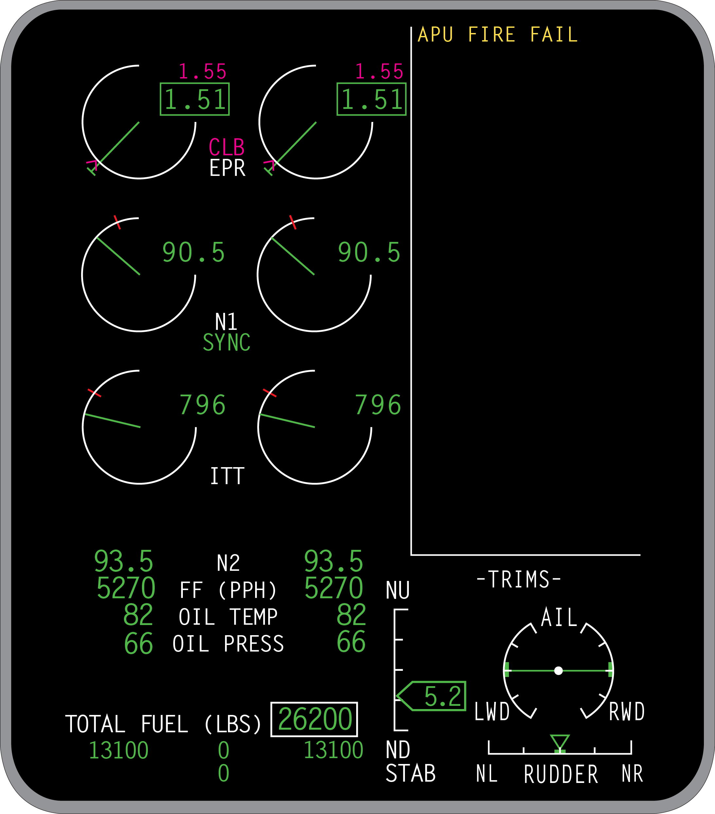
APU Scenario 3
Climbing through FL300 the APU FIRE FAIL CAS message appears…
ANSWER:
QUESTION:
The APU Fire detection system is inoperative
What does the message mean?
Notes:
Slide Title: APU Scenario 3 (APU FIRE FAIL CAS)
Instructor Action:
Document: QRH Vol. 2, SMK 14-9
Content Information:
What does the message mean?
The APU Fire detection system is inoperative
Ref. QRH Vol. 2, SMK 14-9
References:
QRH Vol. 2, GO/NO GO-1
QRH Vol. 2, SMK 14-9

Slide 18

Fuel CAS
← (→) FUEL XFER FAIL
← (→) FUEL XFER ON
AFT XFER FAIL
AFT XFER OFF SCHED
CTR FUEL XFER FAIL
FUEL COMPUTR FAIL
FUEL IMBALANCE
FUEL LO QTY
FUEL TEMP SENSOR
FUEL UNIT MISMATCH
L (R) ENG FUEL LO TEMP
L (R) ENG FUEL SOV
L−R FUEL FILTER
L (R) FUEL LO PRESS
L (R) PRI FUEL PUMPS
L (R) WING FULL
L (R) FUEL RECIRC FAIL
WING FUEL HI TEMP
WING FUEL LO TEMP
WING TO CTR LEAK
CTR TANK FULL
FUEL COMPUTR FAULT
FUEL QTY DEGRADED
CTR XFER FAULT
L (R) AUX FUEL PUMP
L (R) PRI FUEL PUMP
XFEED VALVE FAIL
← (→) FUEL XFER ON
← (→) XFER VALVE OPEN
AFT XFER FAULT
AFT XFER OFF SCHED
AFT R / D VALVE OPEN
Wing fuel transfer has been commanded and failed
An uncommanded fuel transfer is taking place
AFT tank fuel transfer failure (Not applicable G-5000)
AFT tank fuel transfer off schedule (Not applicable G-5000)
Center tank fuel transfer failure
Fuel computer failure
Fuel imbalance
Low fuel quantity
Bulk fault temperature no longer reliable
Fuel unit discrepancy between the fuel quantities displayed on the EICAS and the Refuel/Defuel Panel
Left/right engine inlet fuel temperature is below 5°C with engine running
Left and/or right engine fuel shutoff valve failure
Left and right fuel filter bypass
Left and/or right low engine fuel feed pressure with the HPSOV open
Left and/or right primary (AC) fuel pumps failure
Left or right wing fuel overfill
Recirculation valve not in commanded position
Either the left or right or both wing fuel temperature is high
Either the left or right or both wing fuel temperature is low
Wing tank to center tank leak
Center tank high level shutoff greater than 1000 gallons (Global 5000 only)
Fuel computer fault (only one channel has failed.)
Fuel gauging accuracy degraded.
Affected center transfer pump (either L or R) has failed to operate when requested or a center tank off schedule condition exists.
Affected auxiliary (DC) pump failed.
Affected primary (AC) pump failed.
Crossfeed valve is not in commanded position.
← right to left fuel transfer on or → left to right fuel transfer on.
Fuel transfer valve open.
Aft transfer has failed to operate when requested.
Distribution between wing fuel tank and aft fuel tank is incorrect. If in AUTO mode − Aft transfer in advance of schedule. If in MANUAL mode − Set point to commence transfer reached.
The aft refuel / defuel valve has failed to close when commanded
Notes:
Slide Title: Fuel CAS
Instructor Action:
Choose CAS messages that the instructor would like to emphasize if any. Use checklist as necessary.
Click on the EICAS SCROLL button to view remainder of CAS messages.
CAS Messages:
← (→) FUEL XFER FAIL – Wing fuel transfer has been commanded and failed
← (→) FUEL XFER ON – An uncommanded fuel transfer is taking place
AFT XFER FAIL – AFT tank fuel transfer failure (Not applicable G-5000)
AFT XFER OFF SCHED – AFT tank fuel transfer off schedule (Not applicable G-5000)
CTR FUEL XFER FAIL – Center tank fuel transfer failure
FUEL COMPUTR FAIL – Fuel computer failure
FUEL IMBALANCE – Fuel imbalance
FUEL LO QTY – Low fuel quantity
FUEL TEMP SENSOR – Bulk fault temperature no longer reliable
FUEL UNIT MISMATCH – Fuel unit discrepancy between the fuel quantities displayed on the EICAS and the Refuel/Defuel Panel
L (R) ENG FUEL LO TEMP – Left/right engine inlet fuel temperature is below 5°C with engine running
L (R) ENG FUEL SOV – Left and/or right engine fuel shutoff valve failure
L−R FUEL FILTER – Left and right fuel filter bypass
L (R) FUEL LO PRESS – Left and/or right low engine fuel feed pressure with the HPSOV open
L (R) PRI FUEL PUMPS – Left and/or right primary (AC) fuel pumps failure
L (R) WING FULL – Left or right wing fuel overfill
L (R) FUEL RECIRC FAIL – Recirculation valve not in commanded position
WING FUEL HI TEMP – Either the left or right or both wing fuel temperature is high
WING FUEL LO TEMP – Either the left or right or both wing fuel temperature is low
WING TO CTR LEAK – Wing tank to center tank leak
CTR TANK FULL – Center tank high level shutoff greater than 1000 gallons (Global 5000 only)
FUEL COMPUTR FAULT – Fuel computer fault (only one channel has failed.)
FUEL QTY DEGRADED – Fuel gauging accuracy degraded.
CTR XFER FAULT – Affected center transfer pump (either L or R) has failed to operate when requested or a center tank off schedule condition exists.
L (R) AUX FUEL PUMP – Affected auxiliary (DC) pump failed.
L (R) PRI FUEL PUMP – Affected primary (AC) pump failed.
XFEED VALVE FAIL – Crossfeed valve is not in commanded position.
← (→) FUEL XFER ON – ← right to left fuel transfer on or → left to right fuel transfer on.
← (→) XFER VALVE OPEN – Fuel transfer valve open.
AFT XFER FAULT – Aft transfer has failed to operate when requested.
AFT XFER OFF SCHED – Distribution between wing fuel tank and aft fuel tank is incorrect. If in AUTO mode − Aft transfer in advance of schedule. If in MANUAL mode − Set point to commence transfer reached.
AFT R / D VALVE OPEN – The aft refuel / defuel valve has failed to close when commanded
References:
AFM
PTM Vol 1 & 2
QRH Vol 2

Slide 19
Fuel CAS
L (R) R / D VALVE OPEN
FUEL RECIRC ON
↔ FUEL XFER ON
AFT FUEL XFER OFF
AFT FUEL XFER ON
L (R) AUX PUMP OFF
L (−R) FUEL RECIRC ON
L (R) FUEL RECIRC OFF
L (R) PRI PUMP OFF
WING FUEL XFER OFF
XFEED VALVE OPEN
Affected R/D valve has failed to close when commanded
Indicates that the system has been selected on in a non-allowed configuration.
Fuel transfer selected to applicable wing tank
Aft fuel transfer mode selected off
Aft fuel transfer mode selected
Affected auxiliary pump selected off
Left or right (L (R)) FRTT valve is opened, or left and right (L−R) FRTT valves are opened when selected by flight crew. (For manual FRTT system only)
Affected FRTT valve is closed when selected by flight crew. (For automatic FRTT system only)
Affected primary pumps selected off
Wing transfer selected off
Wing crossfeed valve open
Notes:
Slide Title: Fuel CAS
Instructor Action:
Choose CAS messages that the instructor would like to emphasize if any. Use checklist as necessary.
Click on the EICAS SCROLL button to view remainder of CAS messages.
CAS Messages:
L (R) R / D VALVE OPEN – Affected R/D valve has failed to close when commanded
FUEL RECIRC ON – Indicates that the system has been selected on in a non-allowed configuration.
↔ FUEL XFER ON – Fuel transfer selected to applicable wing tank
AFT FUEL XFER OFF – Aft fuel transfer mode selected off
AFT FUEL XFER ON – Aft fuel transfer mode selected
L (R) AUX PUMP OFF – Affected auxiliary pump selected off
L (−R) FUEL RECIRC ON – Left or right (L (R)) FRTT valve is opened, or left and right (L−R) FRTT valves are opened when selected by flight crew. (For manual FRTT system only)
L (R) FUEL RECIRC OFF – Affected FRTT valve is closed when selected by flight crew. (For automatic FRTT system only)
L (R) PRI PUMP OFF – Affected primary pumps selected off
WING FUEL XFER OFF – Wing transfer selected off
XFEED VALVE OPEN – Wing crossfeed valve open
References:
AFM
PTM Vol 1 & 2
QRH Vol 2

Slide 20
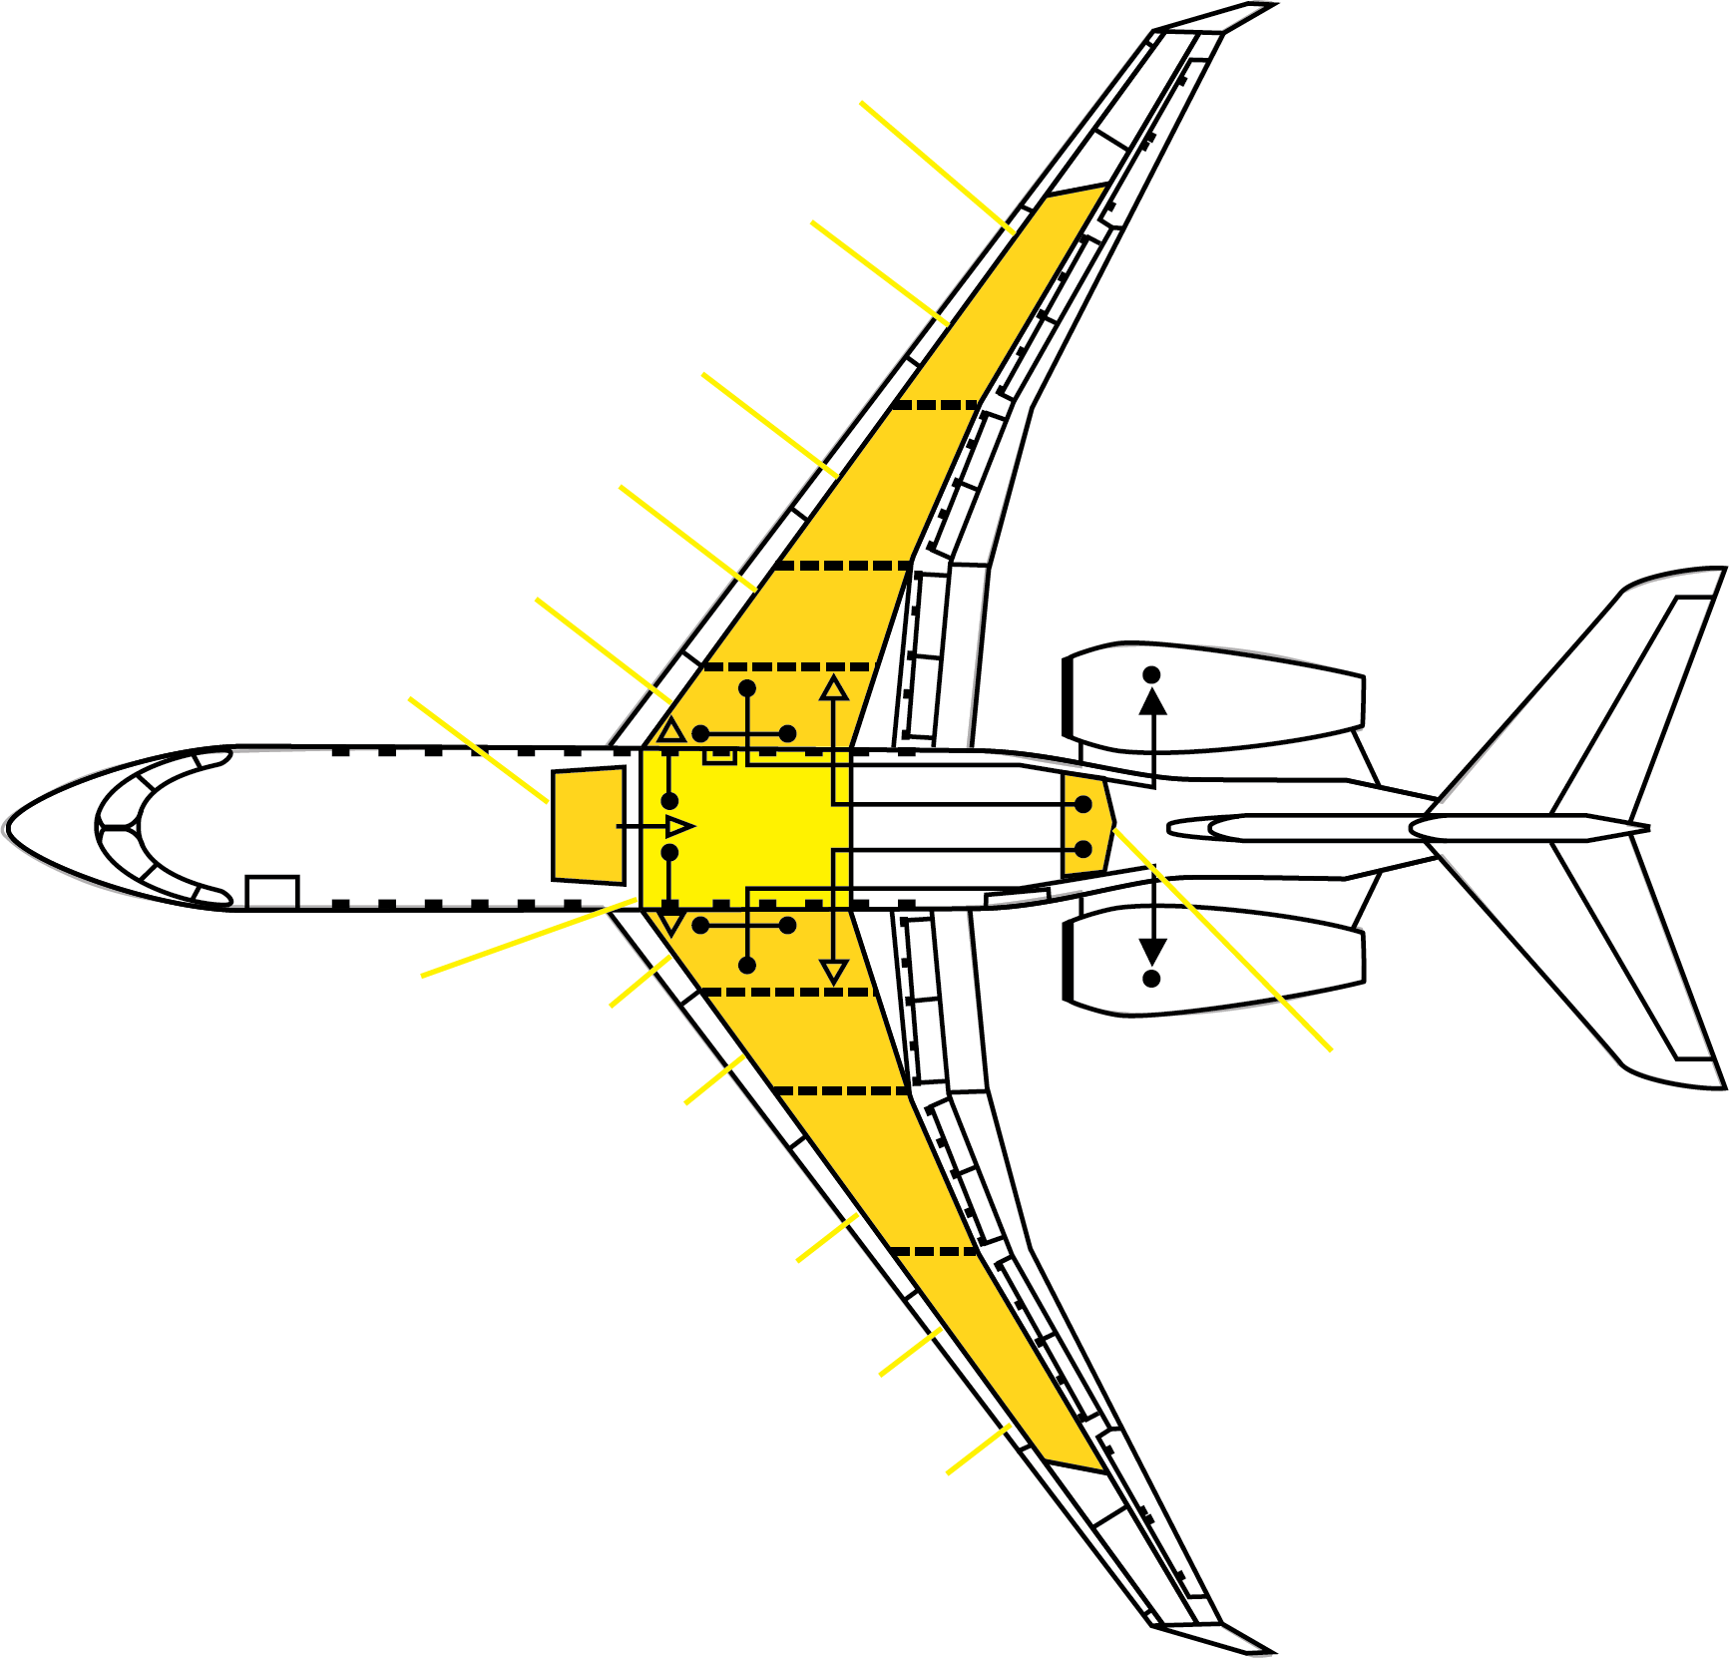
Fuel System
Notes:
Slide Title: Fuel System
Instructor Action:
Discuss content
Content Information:
The integral wing and center tanks are structural components sealed to contain fuel. The aft tank is a bladder within a sealed and drained enclosure aft of the rear fuselage pressure bulkhead.
The forward auxiliary tank is an aluminum tank attached to the aircraft structure forward of the center tank.
All fuel tanks have provisions to minimize trapped air and unusable fuel. For the wing and center tanks, these include drains in the lower wing stringers and ribs that drain fuel down the inner mold line (IML) of the wing.
References:
NA

Slide 21
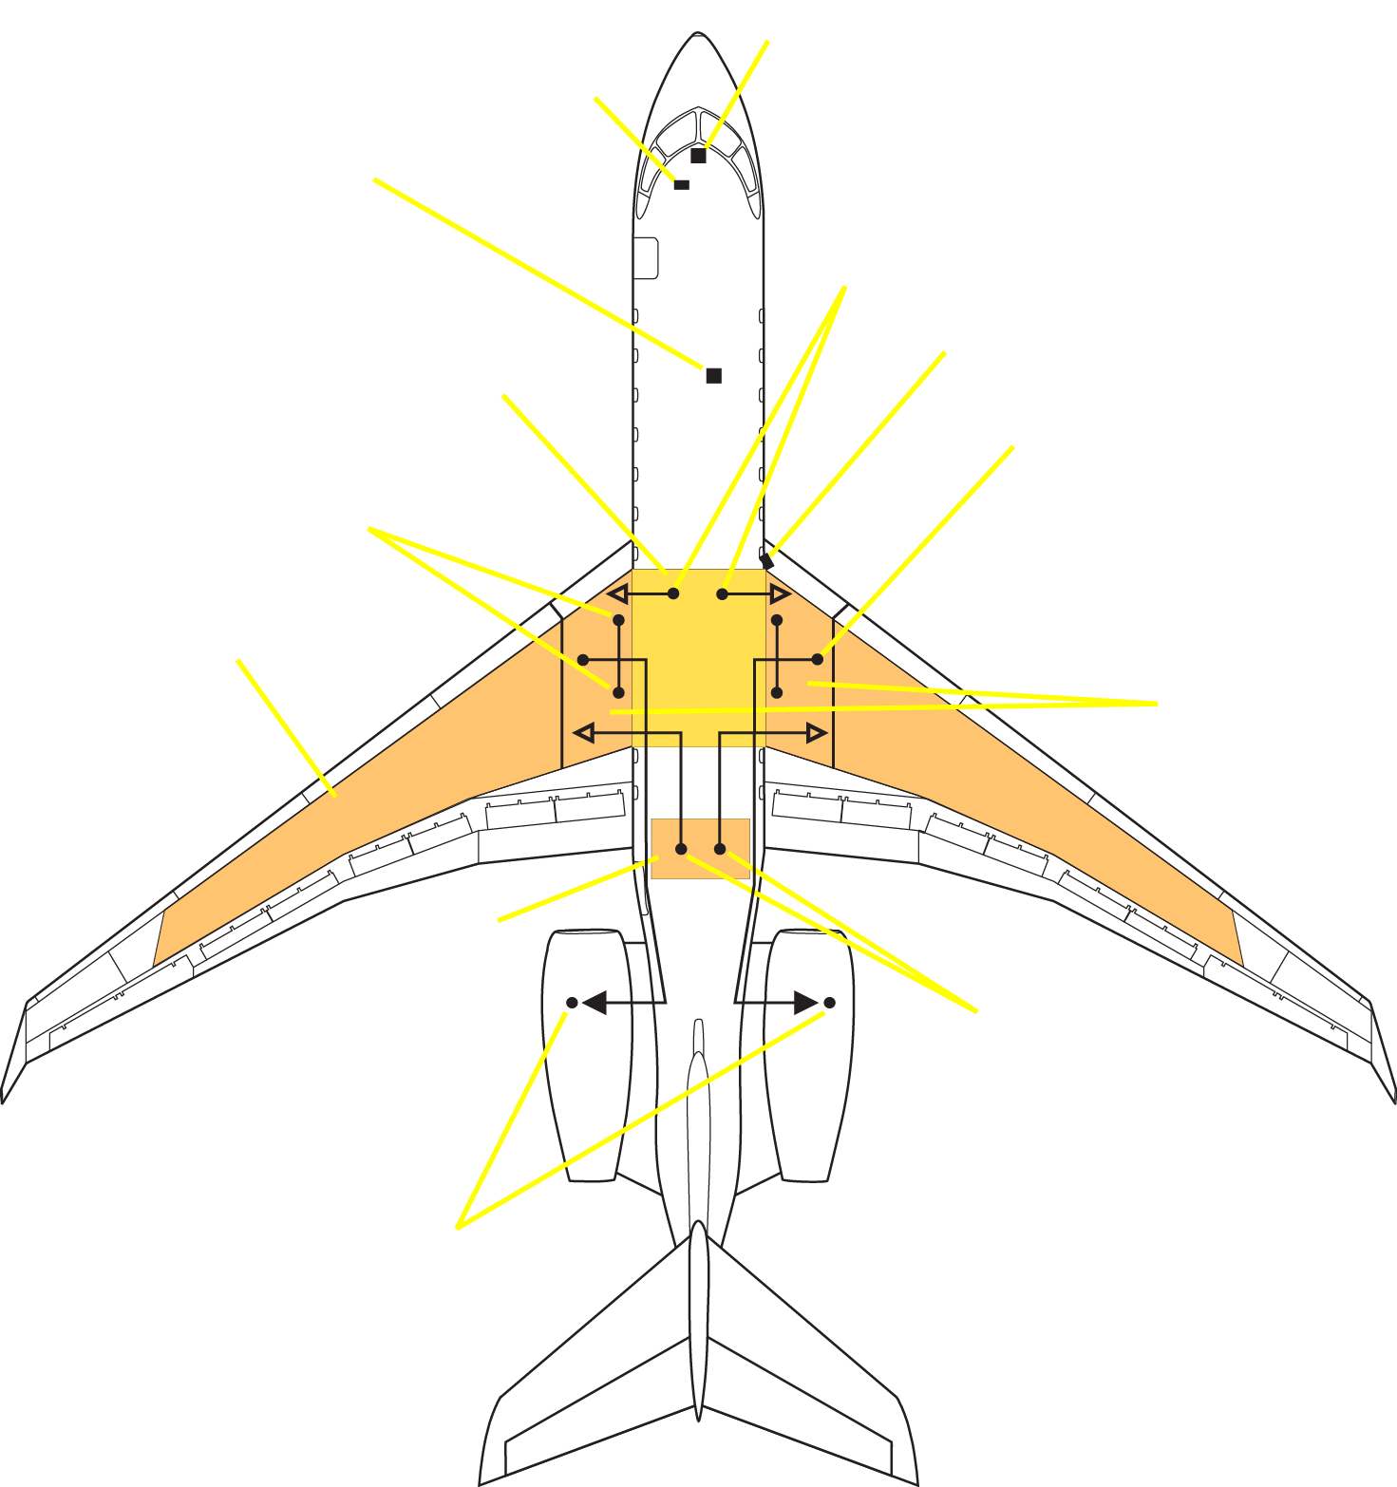
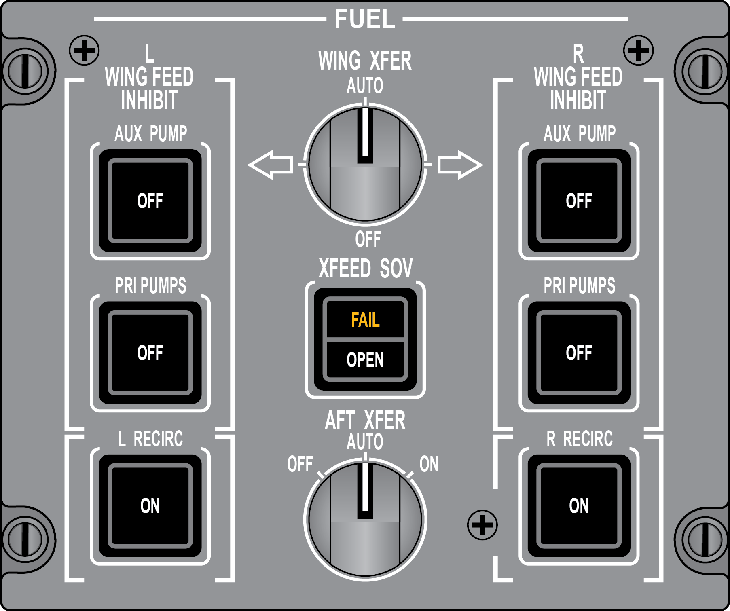
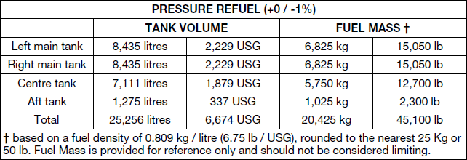
Fuel Limitations
QUESTION:
What conditions must be met in order for the fuel in the center tank to be considered usable?
Answer:
The wing tanks must be full and the planned cruise altitude greater than 30,000 feet.
Notes:
Slide Title: Fuel Limitations
Instructor Action:
NA
Content Information:
What conditions must be met in order for the fuel in the center tank to be considered usable?
The wing tanks must be full and the planned cruise altitude greater than 30,000 feet.
Fuel in the center tank must be considered unusable unless each wing tank is full at departure, and the
planned cruise altitude is greater than 30,000 feet.
Fuel in the aft tank must be considered unusable unless each wing tank contains at least 2495 kg (5500 lbs.)
fuel at departure, and the planned cruise altitude is greater than 30,000 feet.
If use of the center / aft tank is planned, the tank fuel load is to be no less than 230 kg (500 lbs.) to ensure
transfer pumps reprime.
References:
AFM Limitations Section Pg. 02-05-5

Slide 22
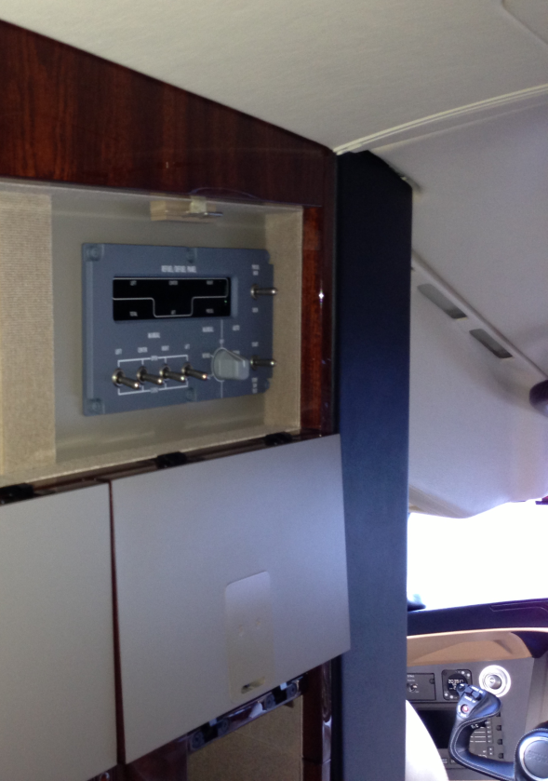
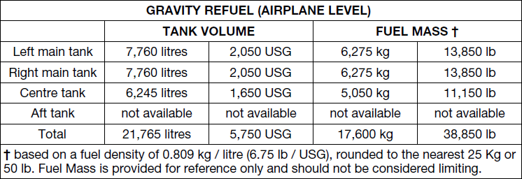
Fuel Limitations
QUESTION:
To be considered usable, how much fuel must be in the AFT tank?
Answer:
At least 500 lbs. must be in the AFT tank.
Notes:
Slide Title: Fuel Limitations
Instructor Action:
NA
Content Information:
To be considered usable, how much fuel must be in the AFT tank?
At least 500 lbs. must be in the AFT tank.
If use of the center / aft tank is planned, the tank fuel load is to be no less than 230 kg (500 lb.) to ensure transfer pumps re-prime.
References:
AFM Limitations Section Pg. 02-05-5

Slide 23
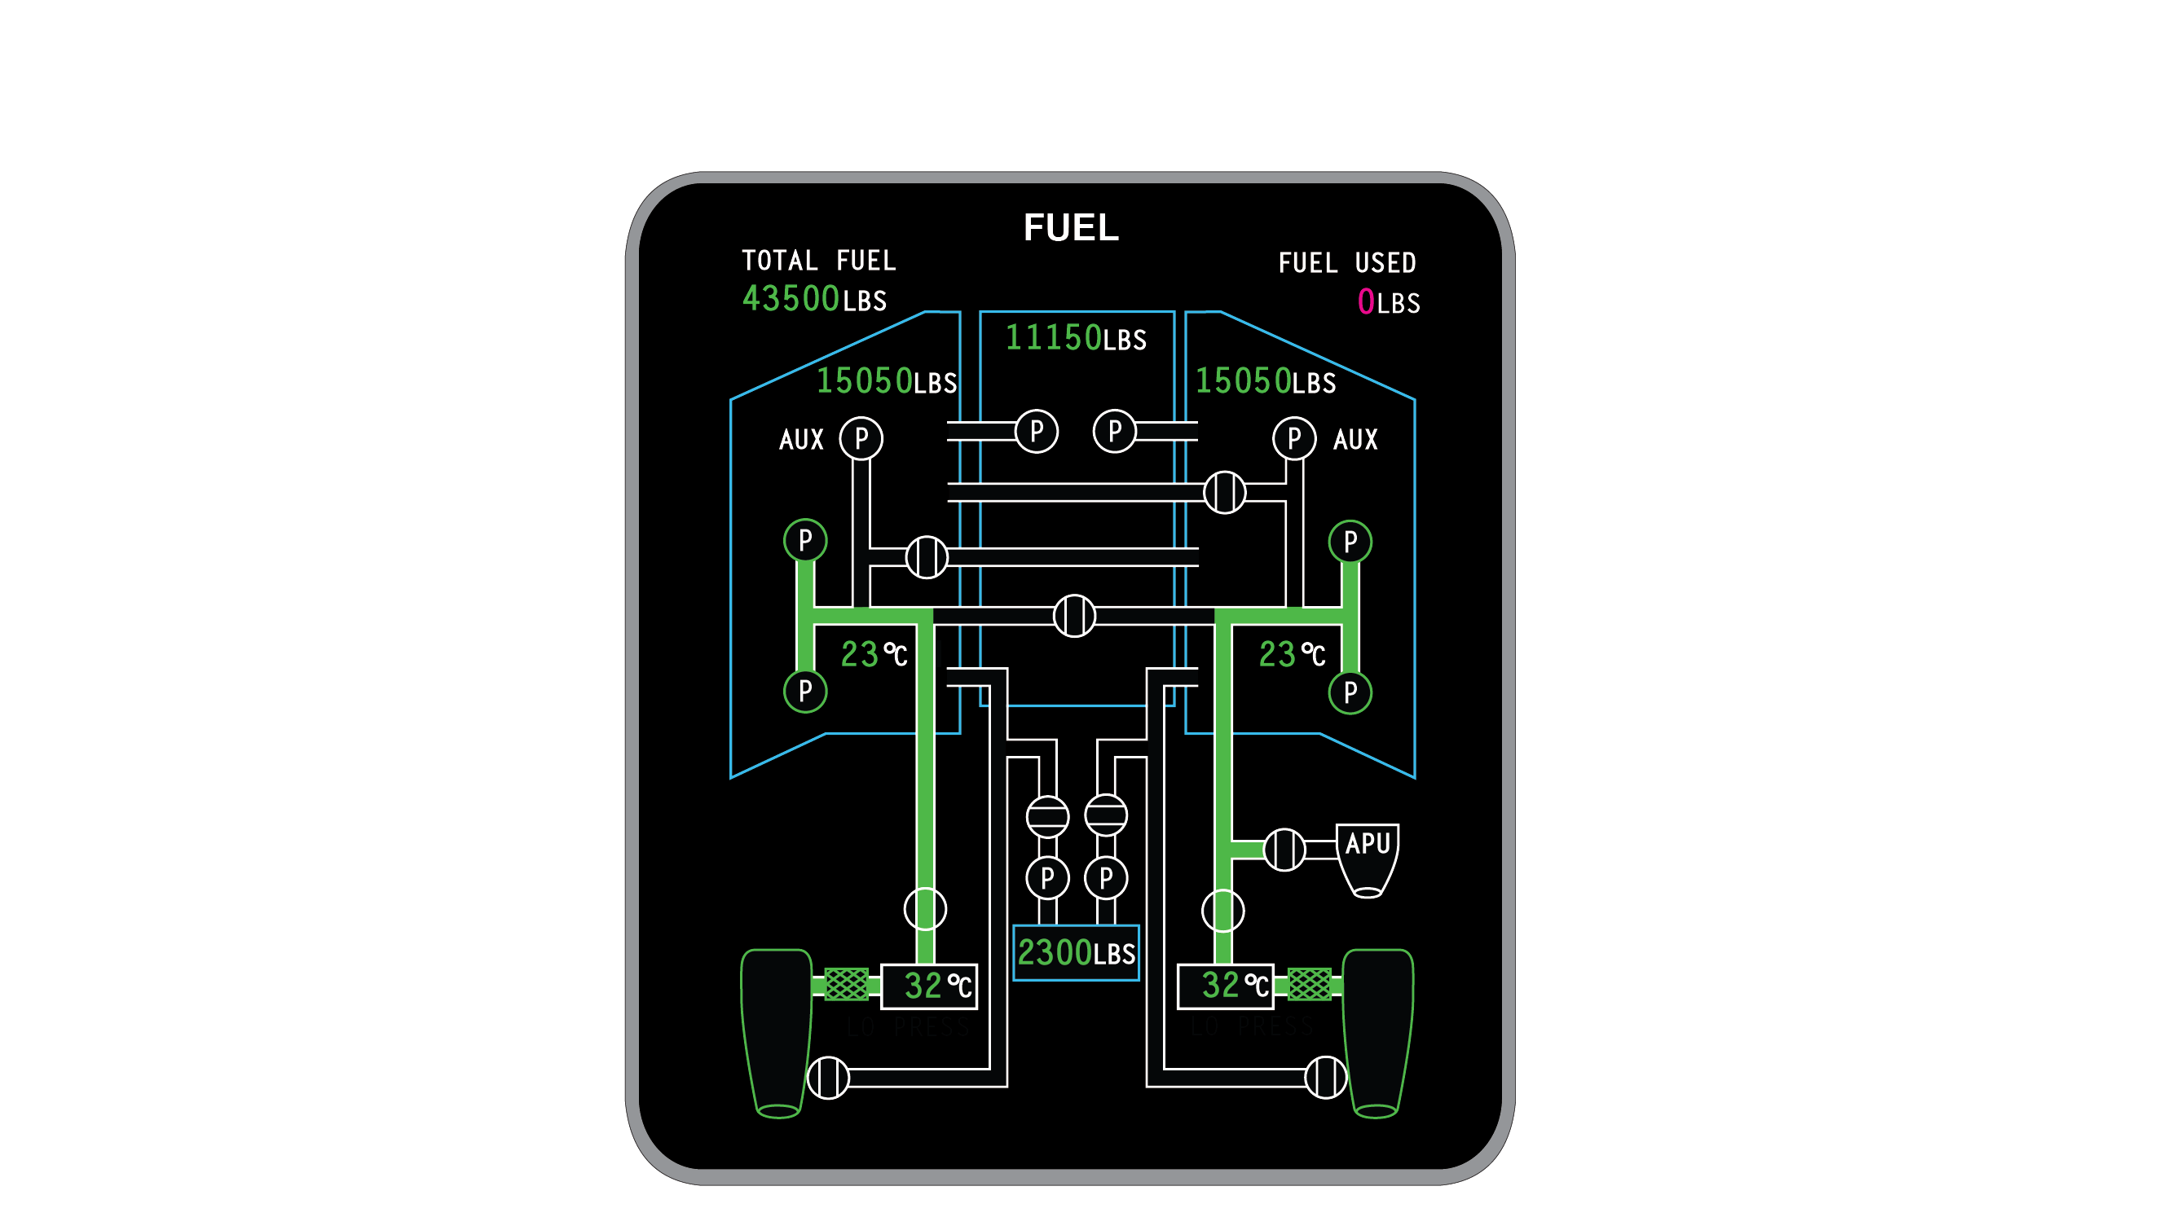
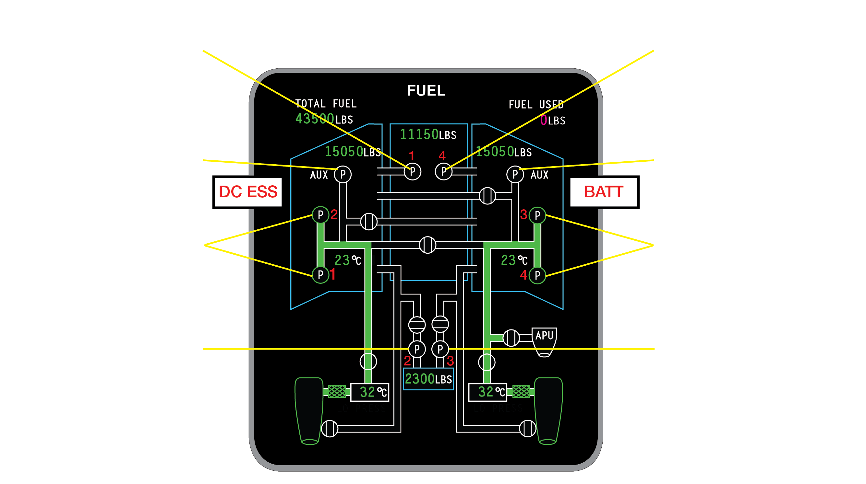

Fuel Pump Display
Notes:
Slide Title: Fuel Pump Display
Instructor Action:
Describe fuel pump specifications
Content Information:
Center Transfer Pumps
Controlled by the FMQGC and transfers center tank fuel to the wing tanks when either wing falls below 93% of full (from FMQGC to EMS CDU then to the ACPC). Fuel is transferred until any one side reaches 97% of full (14,598 lbs.).
L or R DC Auxiliary Pumps
ON – For engine starting (right only, unless Ext AC avail), flaps not at 0, gear down and locked with W, off W, low fuel mode (either wing below 600 lbs.), wing to wing transfer.
NOTE: If the DC pump has been activated automatically due to any of the above conditions, wing to wing transfer mode is inhibited.
OFF – When commanded by the switch on the Fuel Control Panel or when both primary pumps are on
R AUX, Batt Bus, for Batt start: L Aux, DC Essen Bus, requires AC PWR
R AUX is turned on by APU start switch, XFR valve opened (Batt buss)
L or R AC Boost Pumps
ON – At all times with AC power available
L FWD pump, AC Bus 2; L AFT pump, AC Bus 1
R FWD pump, AC Bus 3: R AFT pump, AC Bus 4
OFF – When commanded by the switch on the Fuel Control Panel
AFT Transfer Pumps
ON – When requested by the computer or selected on the Fuel Control Panel
OFF – When commanded by the switch on the Fuel Control Panel or when commanded by the
FMQGC in AUTO mode

Slide 24
Normal Fuel Loading
  NOTE
The left and right wing tank quantities must be within 400 LBS
for normal fuel loading.
The maximum allowed imbalance on ground and during takeoff
and landing is:
  Wing Tank Load < 19,450 LBS: 1,100 LBS
  Wing Tank Load > 19,450 LBS and < 20,250 LBS: 1,100 to 600 LBS
  Wing Tank Load > 20,250 LBS: 600 LBS
Notes:
Slide Title: Normal Fuel Loading
Instructor Action:
NA
Content Information:
NA

Slide 25
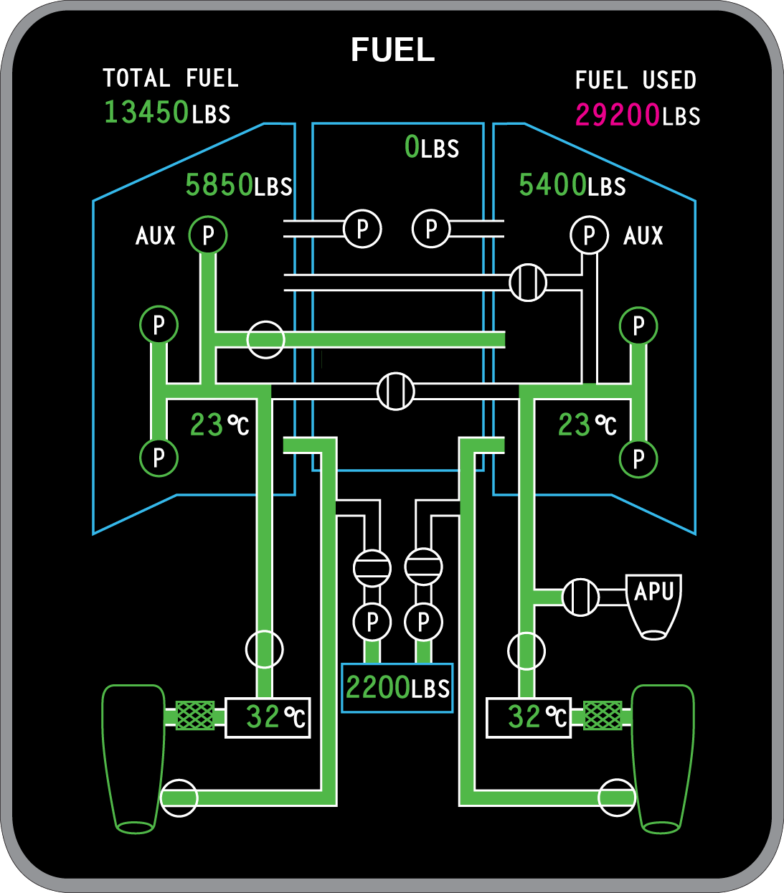
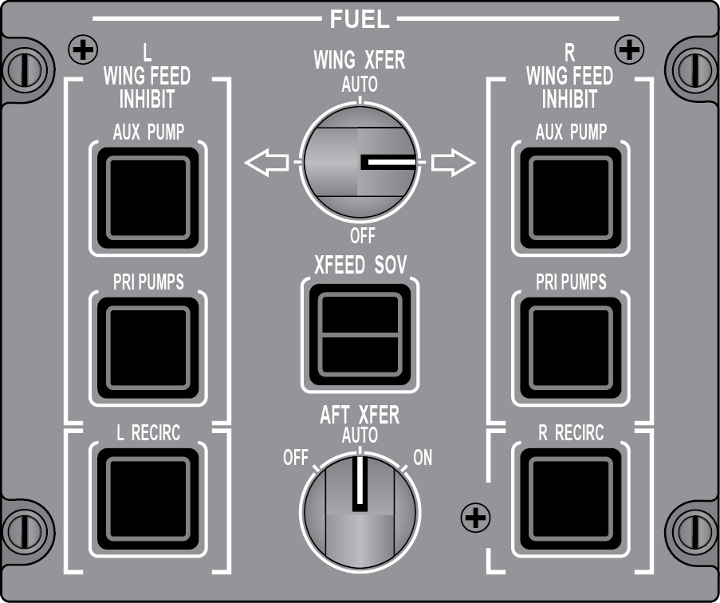
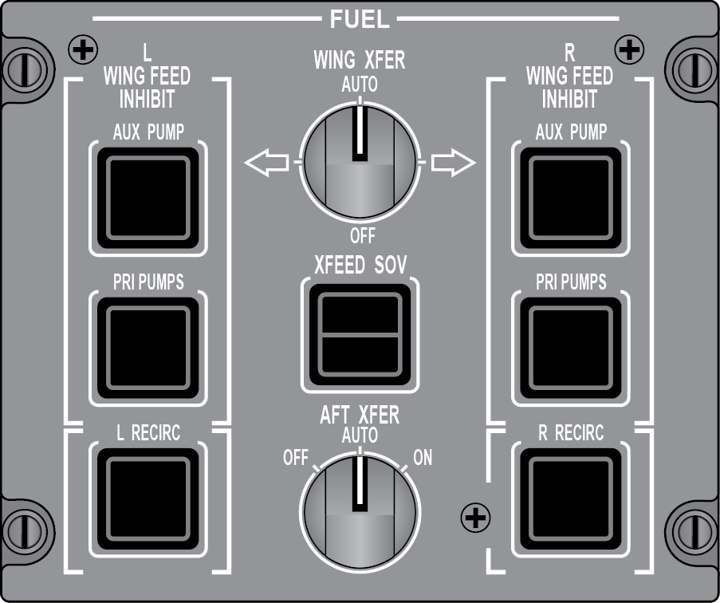
Wing To Wing Transfer
or…
DC AUXILIARY PUMP
In wing transfer demand, commanded on by the FMQGC.
WING TRANSFER SHUTOFF VALVE
Commanded on by the FMQGC or manually by the switch on the fuel panel
QUESTION:
When is the automatic wing to wing fuel transfer inhibited?
Answer:
While flaps are extended
In flight with landing gear down and locked
DC aux pump supplying fuel to an engine
Either wing tank fuel load below 600 lbs.
Notes:
Slide Title: Wing to Wing Transfer
Instructor Action:
NA
Content Information:
When is the automatic wing to wing fuel transfer inhibited?
While flaps are extended
In flight with landing gear down and locked
DC aux pump supplying fuel to an engine
Either wing tank fuel load below 600 lbs.
The wing transfer system is used to maintain a fuel load balance between wing tanks.
The system uses the DC auxiliary pumps and shutoff valves for transfer operation.
The system is automatic with a selectable manual override function available using a WING XFER rotary selector on the fuel control panel.
The selector includes an AUTO and OFF position in addition to two positions indicated by directional arrows and used during manual control of the wing transfer system.
The OFF position inhibits operation of the wing transfer system and is accompanied by a status message of WING FUEL XFER OFF.
The FMQGC enables operation if a lateral fuel imbalance of 400 lb. (181 kg) or more is detected.
As a result, the FMQGC opens a transfer shutoff valve and starts the DC auxiliary pump on the side with the heavier fuel load.
Fuel is subsequently moved by the DC auxiliary pump through the transfer valve to the opposite wing tank until the FMQGC determines that the fuel load between wing tanks is equal.
During AUTO mode operation, in addition to fuel synoptic page flow indications, an EICAS cyan message is provided which includes a directional arrow to show direction of fuel movement (← FUEL XFER ON, → FUEL XFER ON).
NOTE: There is no wing load monitoring that controls operation of the manual wing to wing transfer system. Transfer must be monitored by the crew as there is no automatic shutdown or overfill protection provided to stop operation.
Operation of the automatic wing transfer system is inhibited when:
flap position is greater than 0°
aircraft is in air with landing gear down and locked
a DC auxiliary pump is supplying fuel feed to an engine (AC boost pump failure)
either wing tank fuel load is below 600 lbs.
References:
PTM Vol 1 & 2

Slide 26
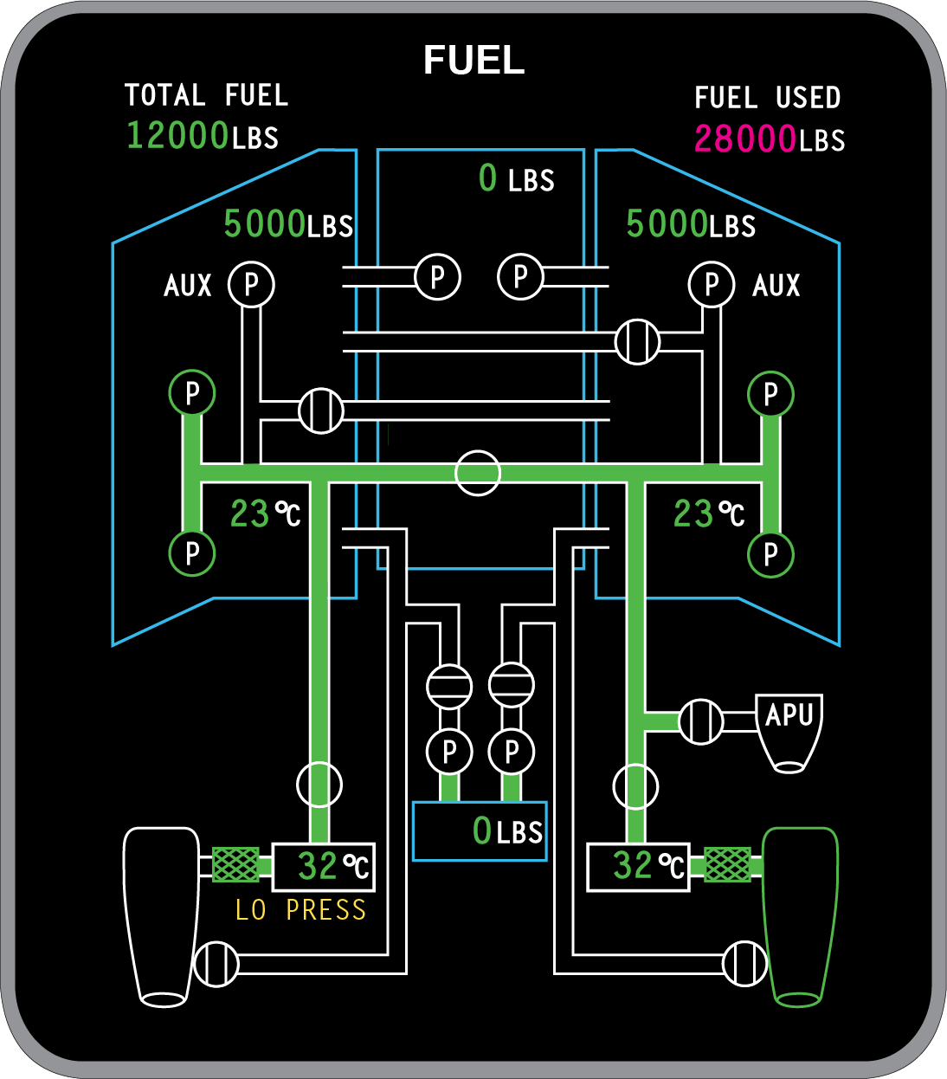
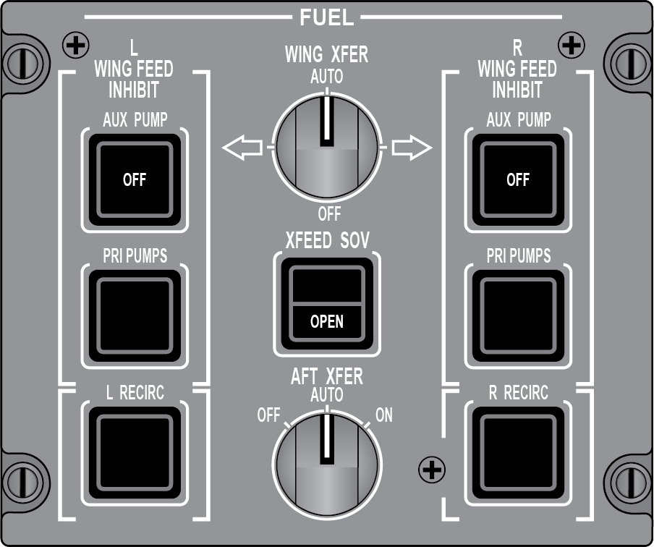
Crossfeed
One Engine Inoperative
Notes:
Slide Title: Crossfeed
Instructor Action:
Describe operation of XFEED SOV system and logic
Content Information:
Crossfeed system permits interconnection between the left and right engine feed lines using a shut-off valve enables both engines to be fed by either feed tank or a single engine to be supplied from both feed tanks in single engine with the crossfeed shut-off valve opened, fuel flows from both feed tanks via the AC primary pumps to the single engine and flow rates are considered essentially the same airplane can be flown indefinitely without developing any significant lateral fuel imbalance
Normal airplane operations, the crossfeed shut-off valve is closed, isolating the feed lines ensuring each engine is supplied fuel only from its own side of the airplane
No automatic means of controlling the crossfeed SOV is provided and selection has to be made using the XFEED SOV switch on the fuel control panel
The FUEL synoptic page shows fuel crossfeed, with the crossfeed shut-off valve selected open, left engine shut down, left engine feed shut-off valve closed and the right engine running

Slide 27
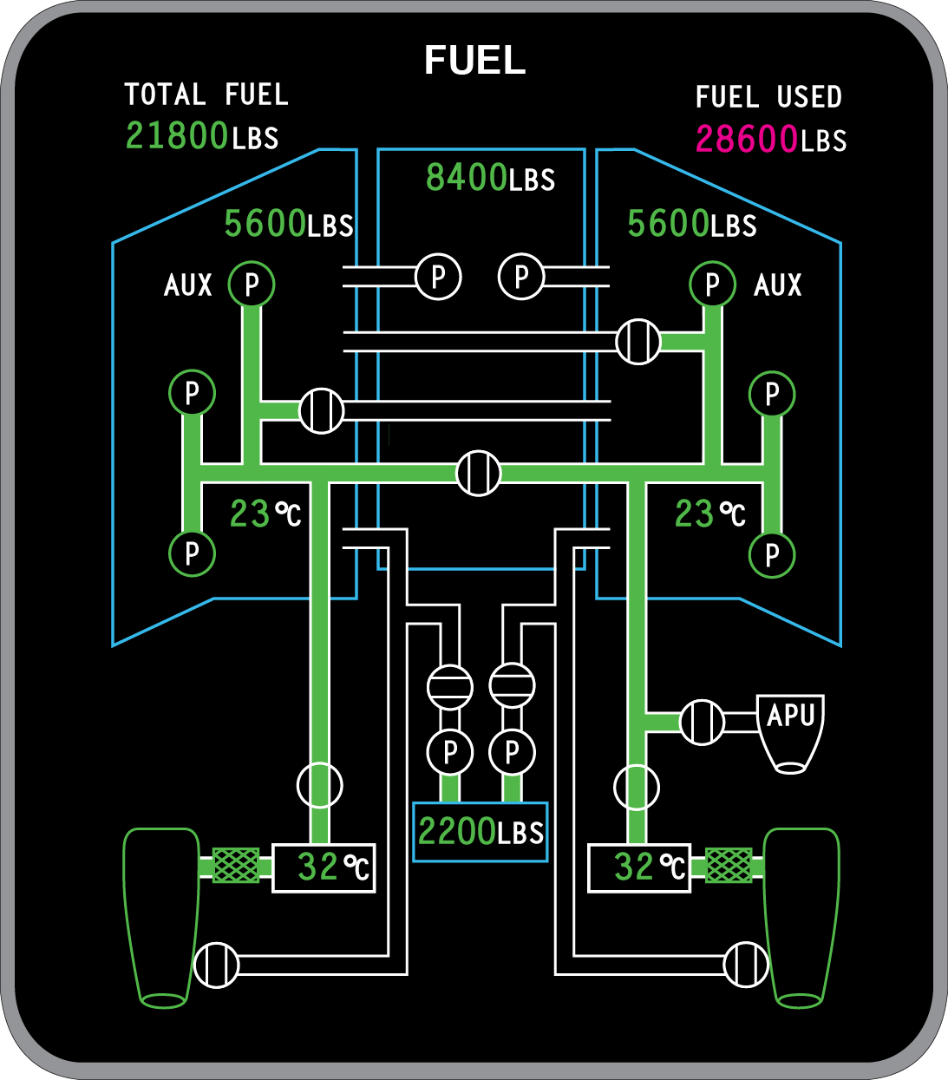
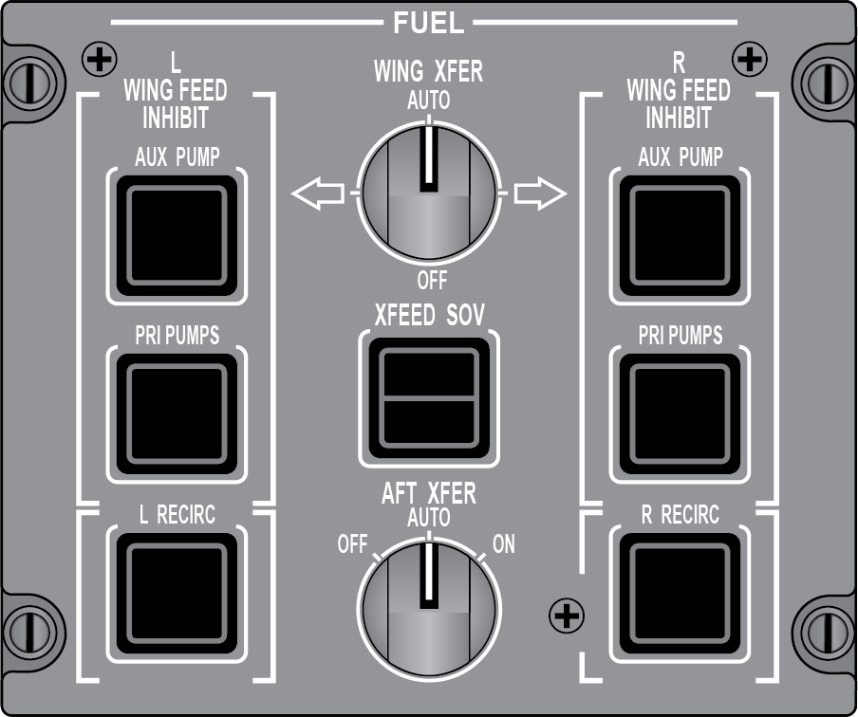
Operations
QUESTION:
What conditions command the DC AUX Pumps to backup an engine?
Answer:
Loss of pressure for an AC Primary Pump on that side
Flaps > 0°
Weight Off Wheels and Gear Down
Wing Fuel < 600lbs
Notes:
Slide Title: Operations
Instructor Action:
NA
Content Information:
What conditions commands the DC AUX Pumps to backup an engine?
Loss of pressure for an AC Primary Pump on that side
Flaps > 0°
Weight Off Wheels and Gear Down
Wing Fuel < 600lbs
What would cause the RDCP to INHIBIT auto refueling?
Fuel SOV switches OPEN, engine run switches ON, Fuel load imbalance > 1100lbs, Power being interrupted during refueling (APU Starting), invalid fuel load selection, if CAIMS is active.
A DC−powered auxiliary boost pump, installed in each wing tank, provides a backup source of fuel pressure in case an AC boost pump become inoperative.
A low pressure condition of one or both AC boost pumps (same side) while the ENGINE RUN switch is selected to ON, causes the onside DC auxiliary boost pump to operate.
Each DC auxiliary pump can provide a flow rate of 2500 PPH.
The fuel control panel includes two columns of switch lights under the title L WING FEED and R WING FEED.
Each column includes a control switchlight for the DC auxiliary pump (AUX PUMP).
Selection of the AUX PUMP switchlight stops and inhibits the operation of DC auxiliary boost pump on the selected side.
This is accompanied by the OFF indication on the switchlight and an EICAS status message of L (R) AUX PUMP OFF.
The DC auxiliary pumps are also used to ensure a continuous fuel supply during certain flight phases.
As a result, both pumps automatically operate, with either or both ENGINE RUN switches ON, and at least one of the following conditions:
Flap > 0°
Landing gear down and locked in flight
In low fuel condition with at least one of the following:
Left wing fuel quantity is under 600 pounds
Right wing fuel quantity is under 600 pounds.
References:
PTM Vol 1 & 2

Slide 28
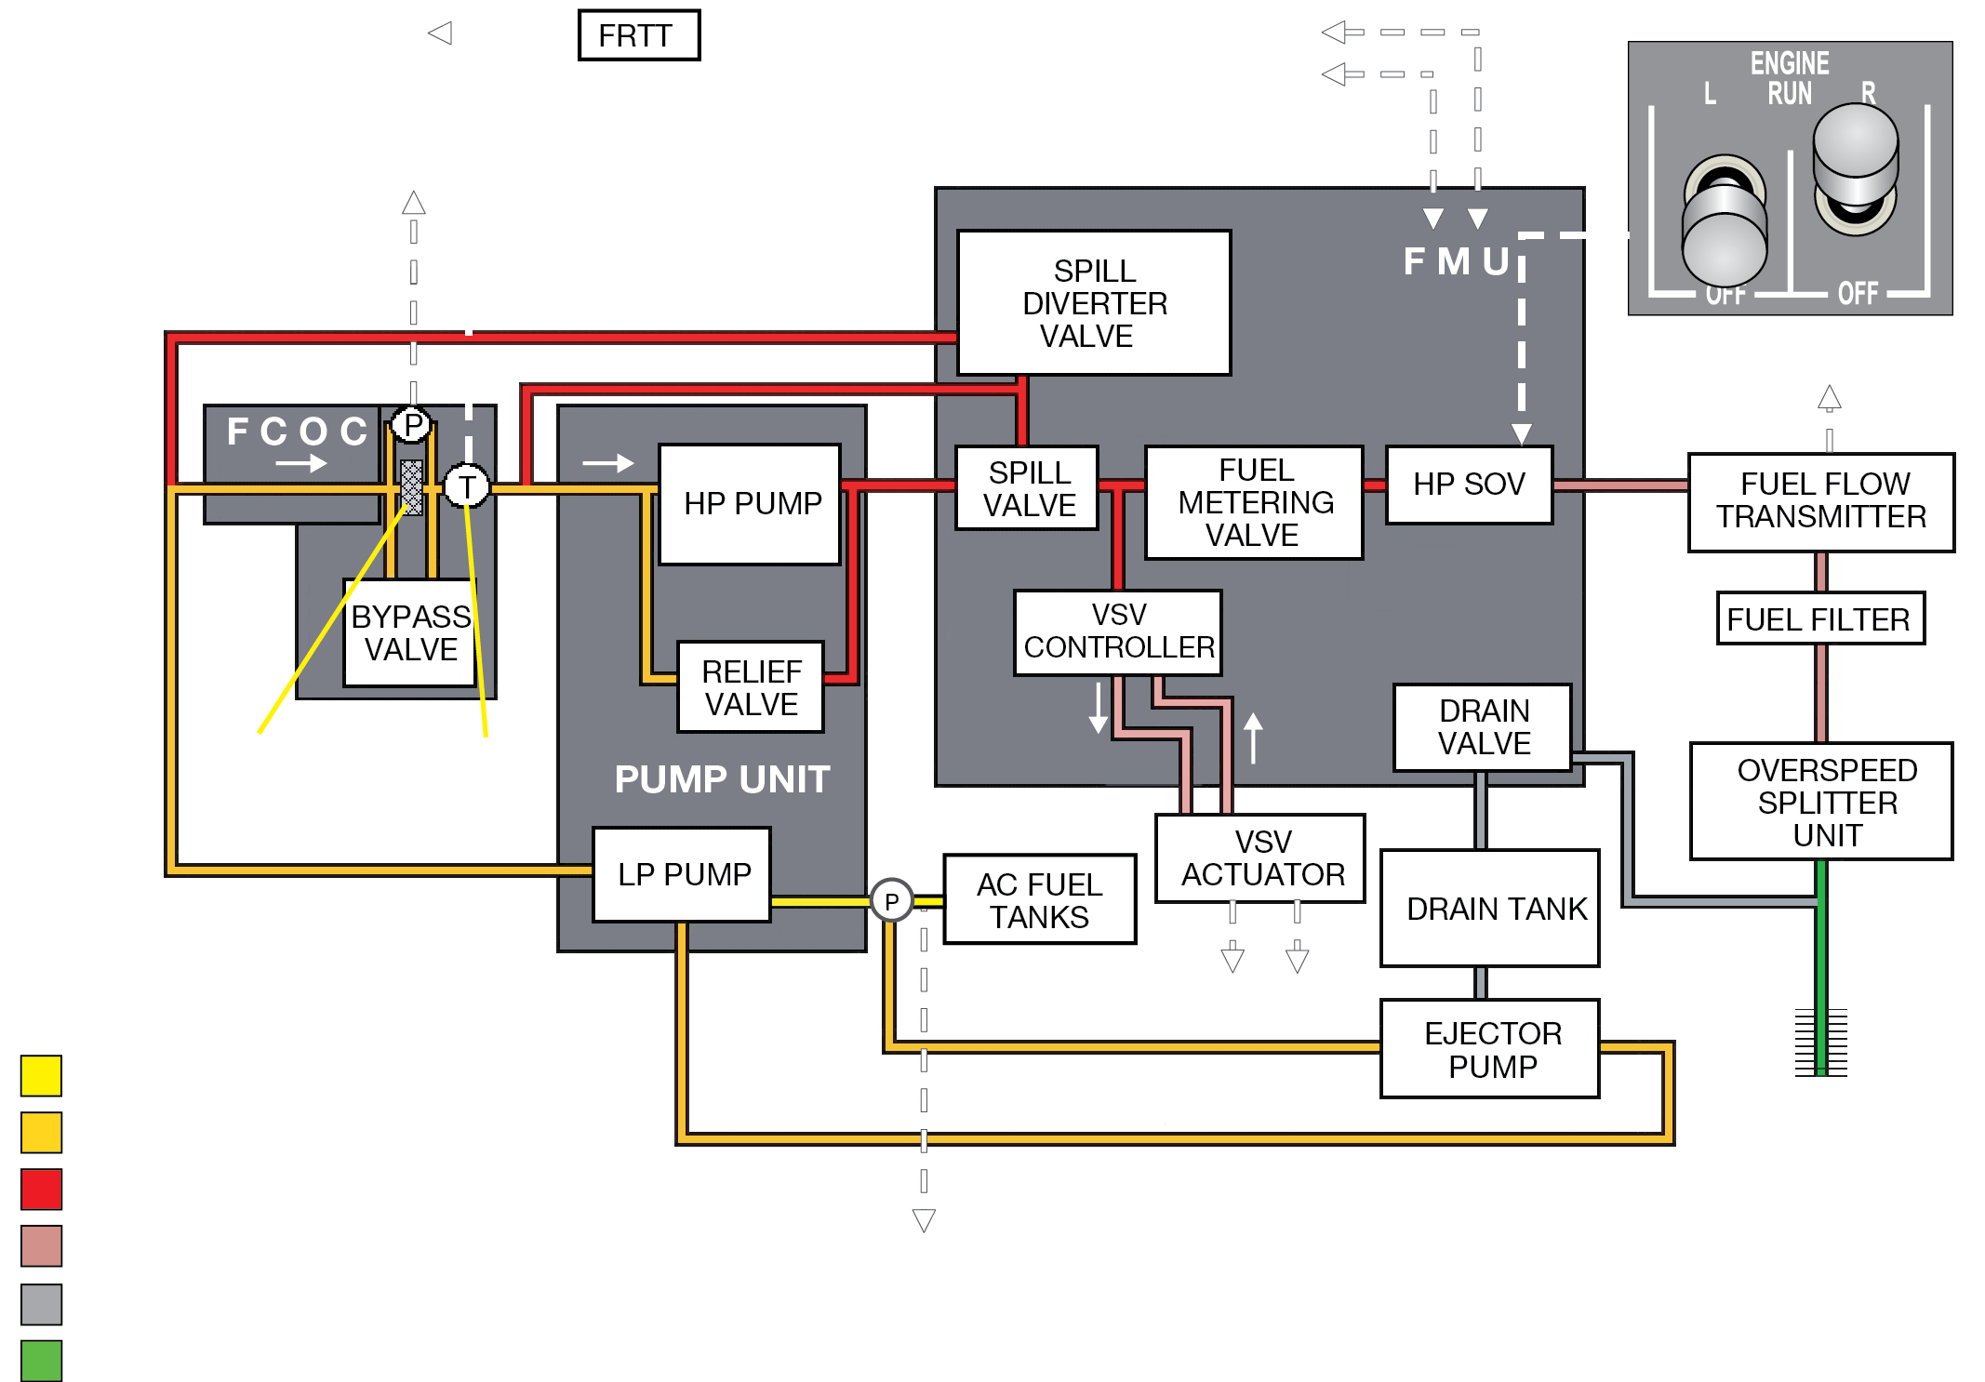
Fuel
QUESTION:
How high can you go with just suction feeding?
Answer:
The QRH guarantees 18,000 ft. with Kerosene fuels.
Notes:
Slide Title: Fuel
Instructor Action:
NA
Content Information:
How high can you go with just suction feeding?
The QRH guarantees 18,000 ft. with Kerosene fuels.
What’s the maximum fuel imbalance in flight?
The maximum fuel balance in flight is 1100 lbs.
What’s the minimum fuel quantity for a go-around?
The minimum fuel quantity for go around is 600 lbs. per wing
Engine fuel system provides fuel for:
Combustion
Variable Stator Vanes actuation
Engine oil cooling
Fuel System components
Fuel Pump Unit
Both LP Pump and HP Pump
LP Filter
Impending blockage will trigger FUEL FILTER EICAS message
Low pressure sensor just past LP Filter will trigger FUEL LO PRESS EICAS message
HP Filter
Fuel Flow Transmitter
Provides fuel flow indications on the EICAS primary display
HP Filter
Fuel Temperature Transducers
Provides fuel temperature on the Fuel Synoptic on the EICAS system display
Overspeed and Splitter Unit (OSU)
Fuel Spray Nozzles
Fuel Drain Tank
Briefly go over fuel schematic. Go over fuel systems starting with fuel tank pumps pumping it out while the engine driven pumps are also sucking the fuel out. Passing through the fuel oil cooler then into the high pressure pump where it’s pumped 120% of what we really need. Some of that extra pressure is used for fuel recirc heat when FRTT is open. Other pressure is used to move the variable stator veins. Then the fuel continues into the fuel metering unit where it’s precisely metered, passes by the high pressure shutoff valve, which is controlled by the pilot with the engine run switch or EEC when the engine run switch is ON, then to the fuel flow transmitter which sends info to the FMS and the EICAS display, then it passes through the high pressure fuel filter and then into the over speed / splitter unit where it splits the fuel between the upper and lower nozzles and then it’s burnt.
Mention that the low pressures which will illuminate if the PSI is < 7. When you turn the engine off fuel trapped in the line after being metered goes into the drain valve and then into the drain tank and will be used during the next engine start. This keeps the fuel from going on the ramp once the engine is off. This is the environmental protection.
References:
AFM
PTM Vol 1 & 2
QRH Vol 2

Slide 29
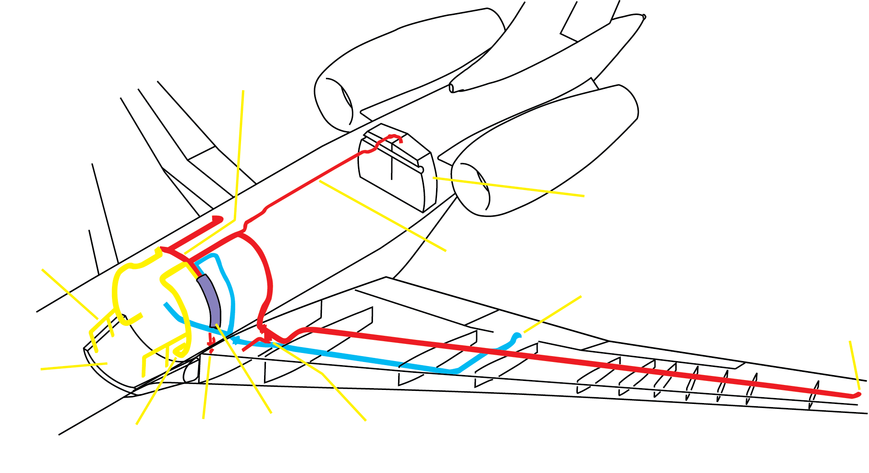
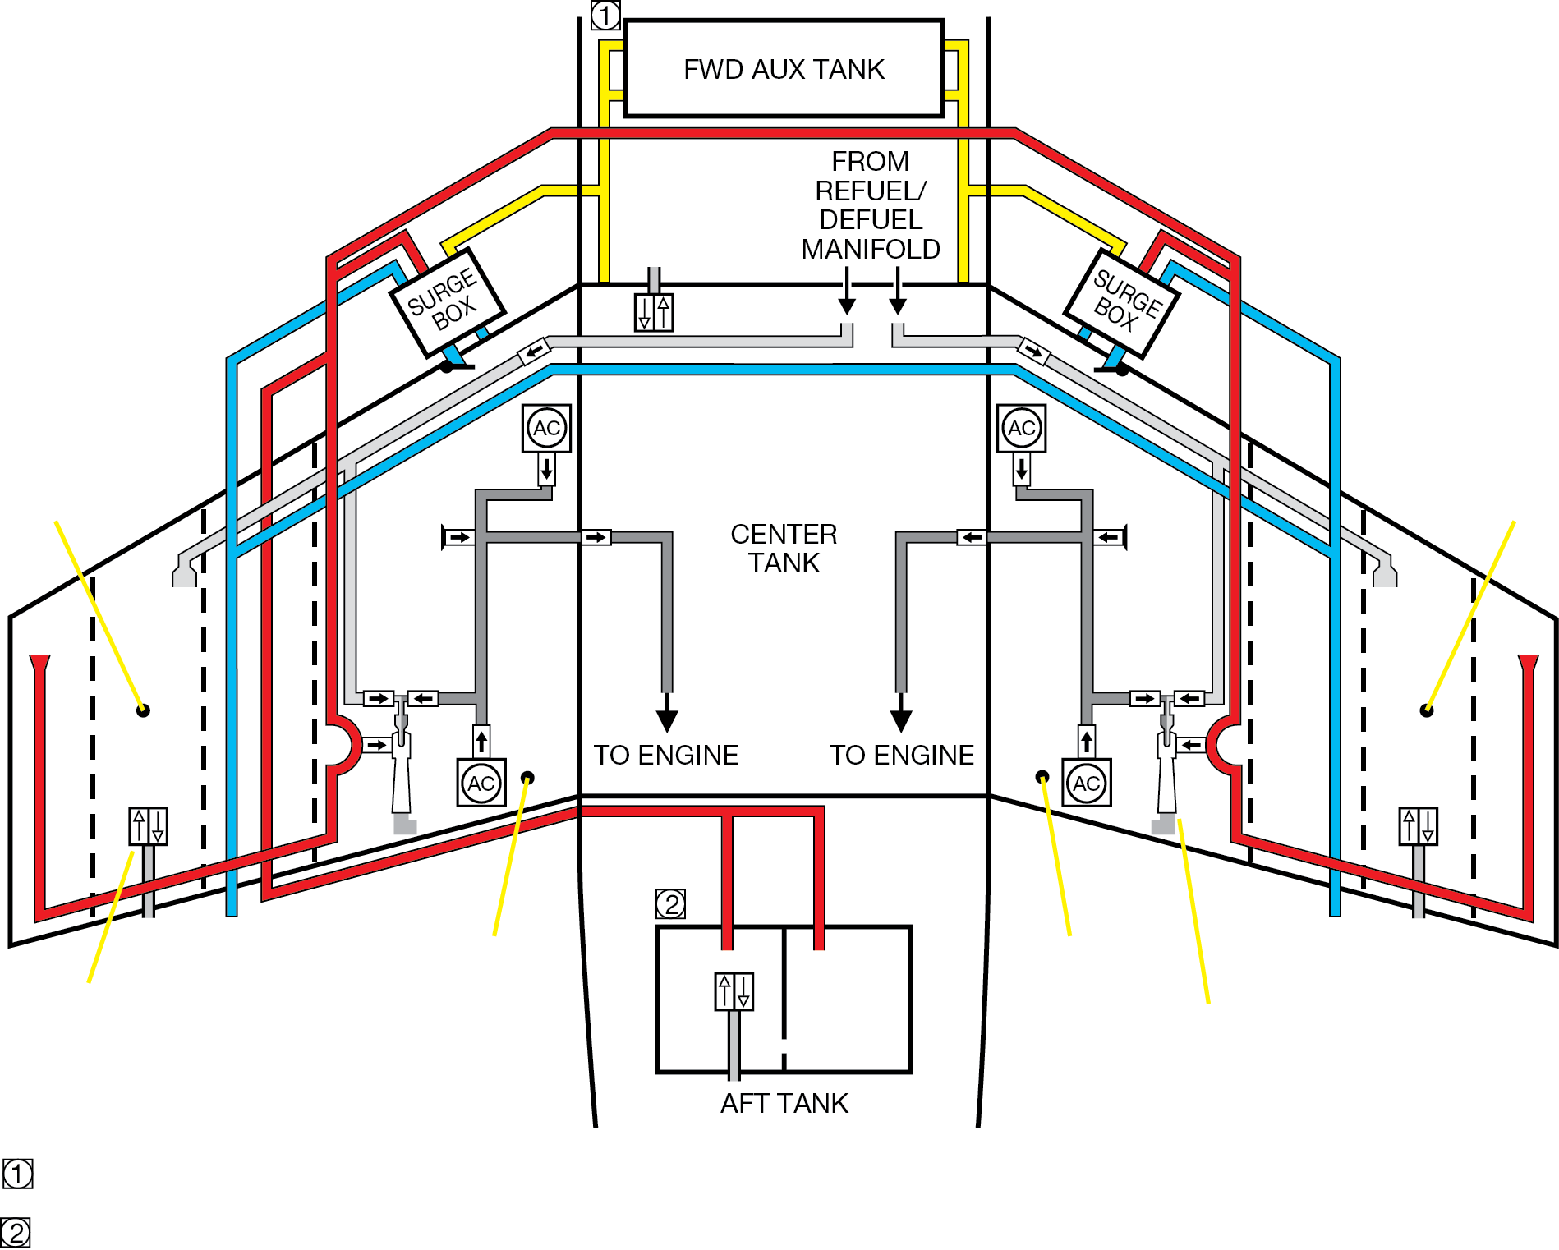
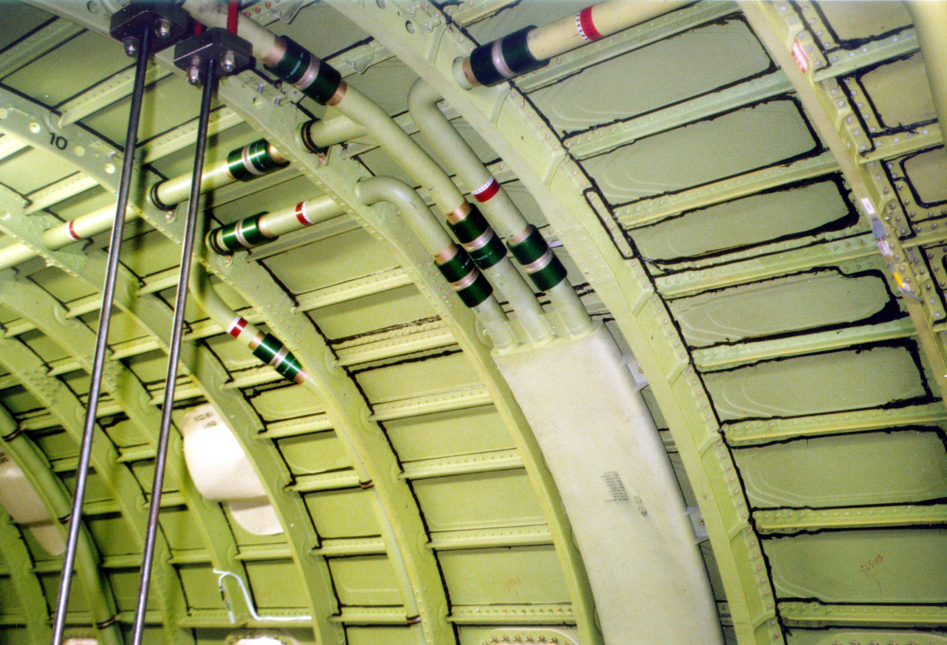
Fuel Venting
Fuel Vent Lines
QUESTION:
What is the procedure to clear the vent system using APU AC Power?
Fuel Vent System
Answer:
Start the APU, while watching the fuel synoptic, open the XFEED SOV, allow AC fuel pumps to run for 2 minutes and then turn them off.
Fuel Vent Surge Box
Notes:
Slide Title: Fuel Venting
Instructor Action:
Document: Ground Handling & Servicing Information (Section 2)
Content Information:
What is the procedure to clear the vent system using APU AC Power?
Start the APU, while watching the fuel synoptic open the XFEED SOV, allow AC fuel pumps to run for 2 minutes and then turn them off.
Ref. GHSI 09-10-00, pg. 12
What is the procedure to clear the vent system using External AC Power?
Turn AC external power on
Pull EMS CDU circuit breakers out for both L & R FADECs Ch. A & B
Pull the left engine fire-handle
Set the L ENGINE RUN toggle switch to ON
Let the AC primary pumps operate for two minutes
Set the L ENGINE RUN toggle switch to OFF
Push the fire handle to OFF (Warning: Do not turn the fire handle. The bottle will be discharged)
Repeat steps for right side
Reset circuit breakers back to the in position
Ref. GHSI 09-10-00, pg. 13
When is it likely to have fuel venting out of the NACA vents?
Fuel venting may occur when the aircraft has been towed with more than 12,000lbs of fuel in each wing.
It’s likely to occur during the next refueling or during L engine starting.
References:
GHSI 09-10-00, pg. 12, 13
SmartFix Plus

Slide 30

Recirculation System
Notes:
Slide Title: Recirculation System
Instructor Action:
Discuss content
Content Information:
Auto recirc logic (5000 and XRS)
References:
MTM 28-81

Slide 31
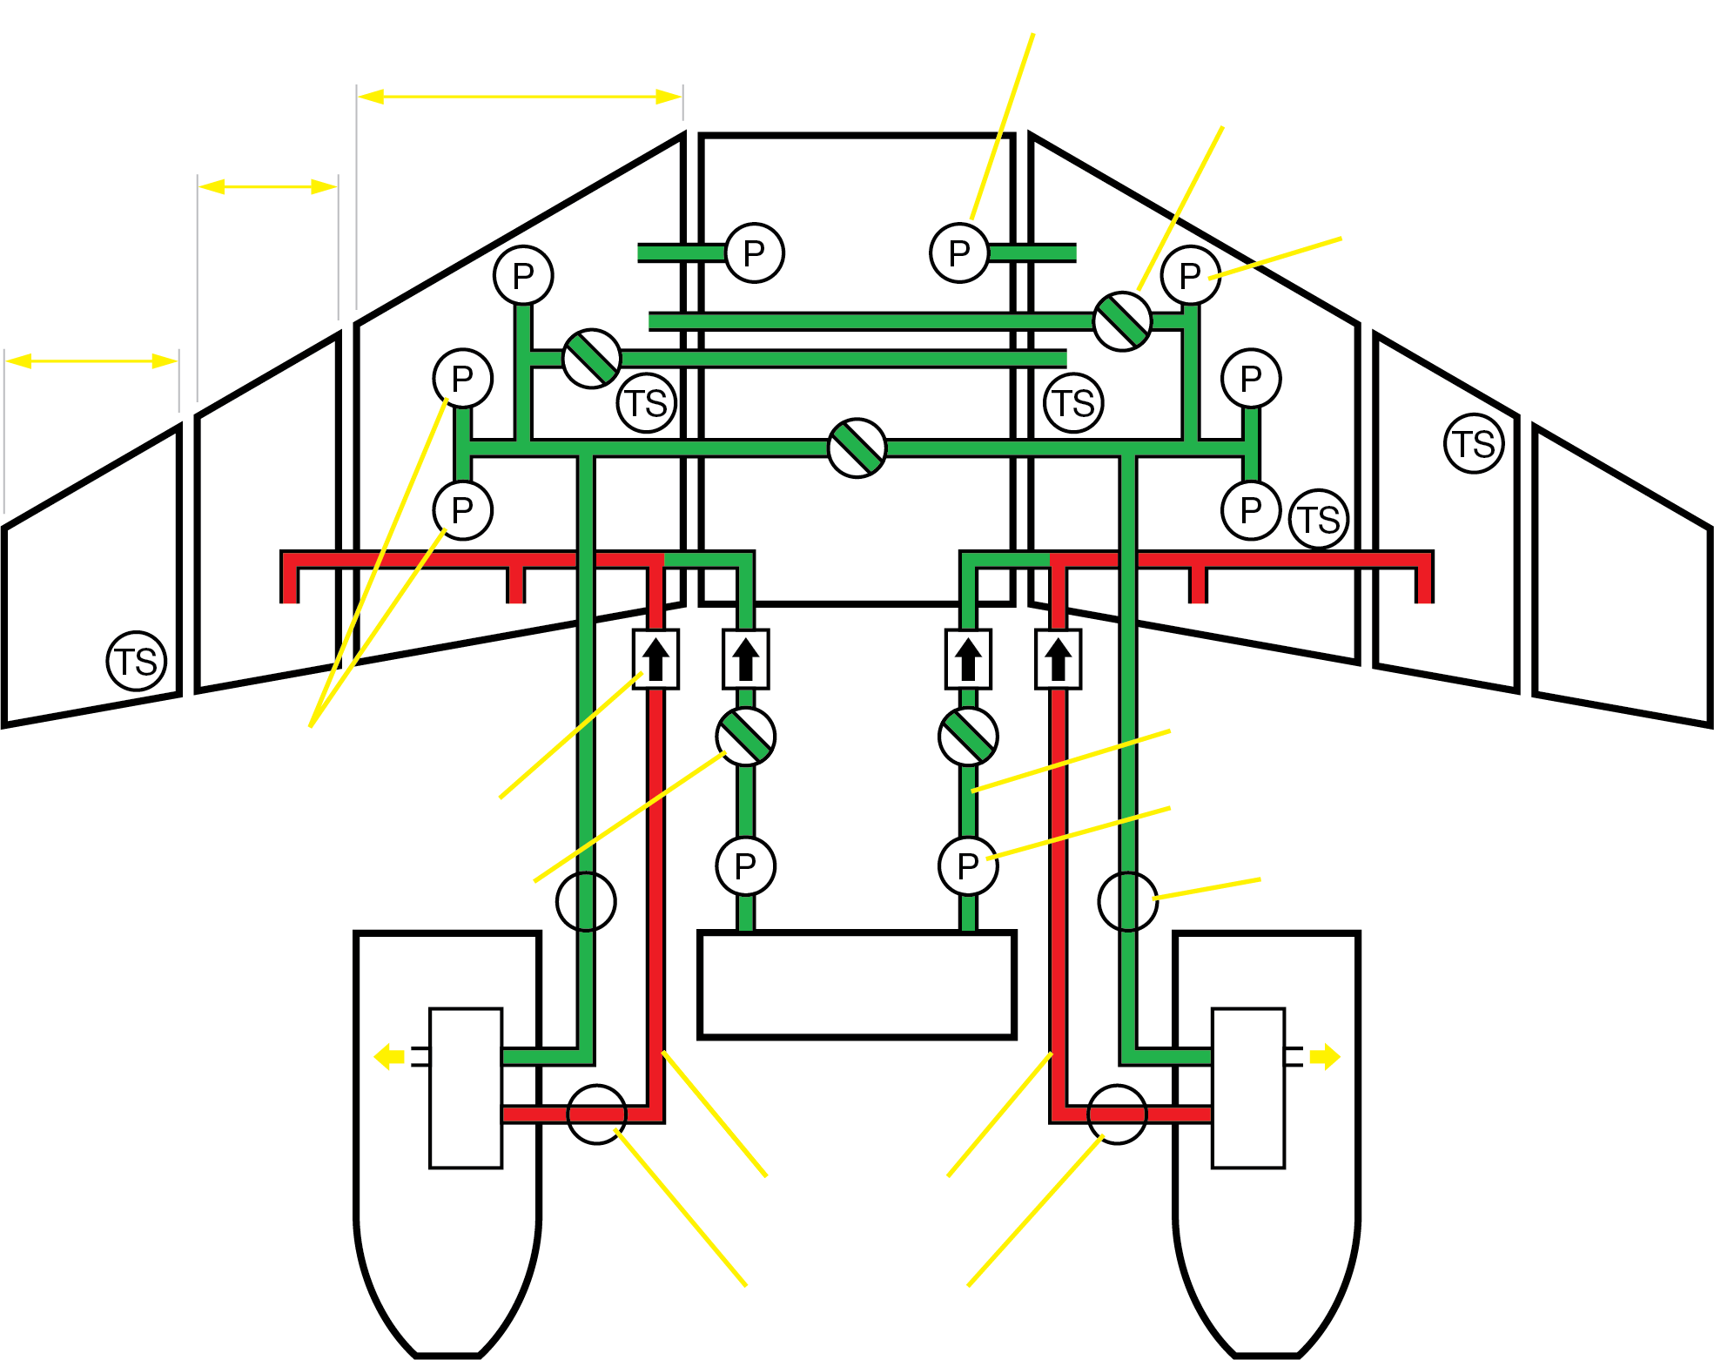

Recirculation System
Notes:
Slide Title: Recirculation System
Instructor Action:
Discuss content
Content Information:
On XRS and 5000 aircraft, the FMQGC controls the recirc system
The FMQGC activates the system when:
Altitude above 34,000 ft. and average fuel temperature drops below –9°C, or
The coldest fuel temperature below –20°C
The FMQGC turns off recirc when:
Average fuel temperature 5°C or more, or
Altitude below 33,800 ft., or
Either engine off
References:
MTM 28-8
FCOM Vol. 2, Fig. 12-10-21 (Fuel Recirculation System Schematic)

Slide 32
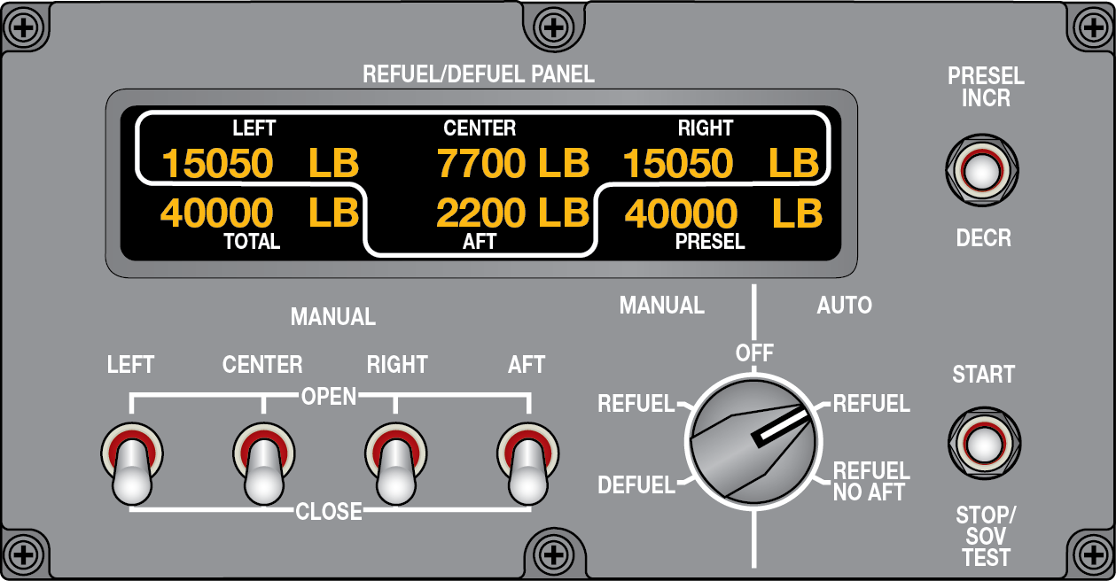
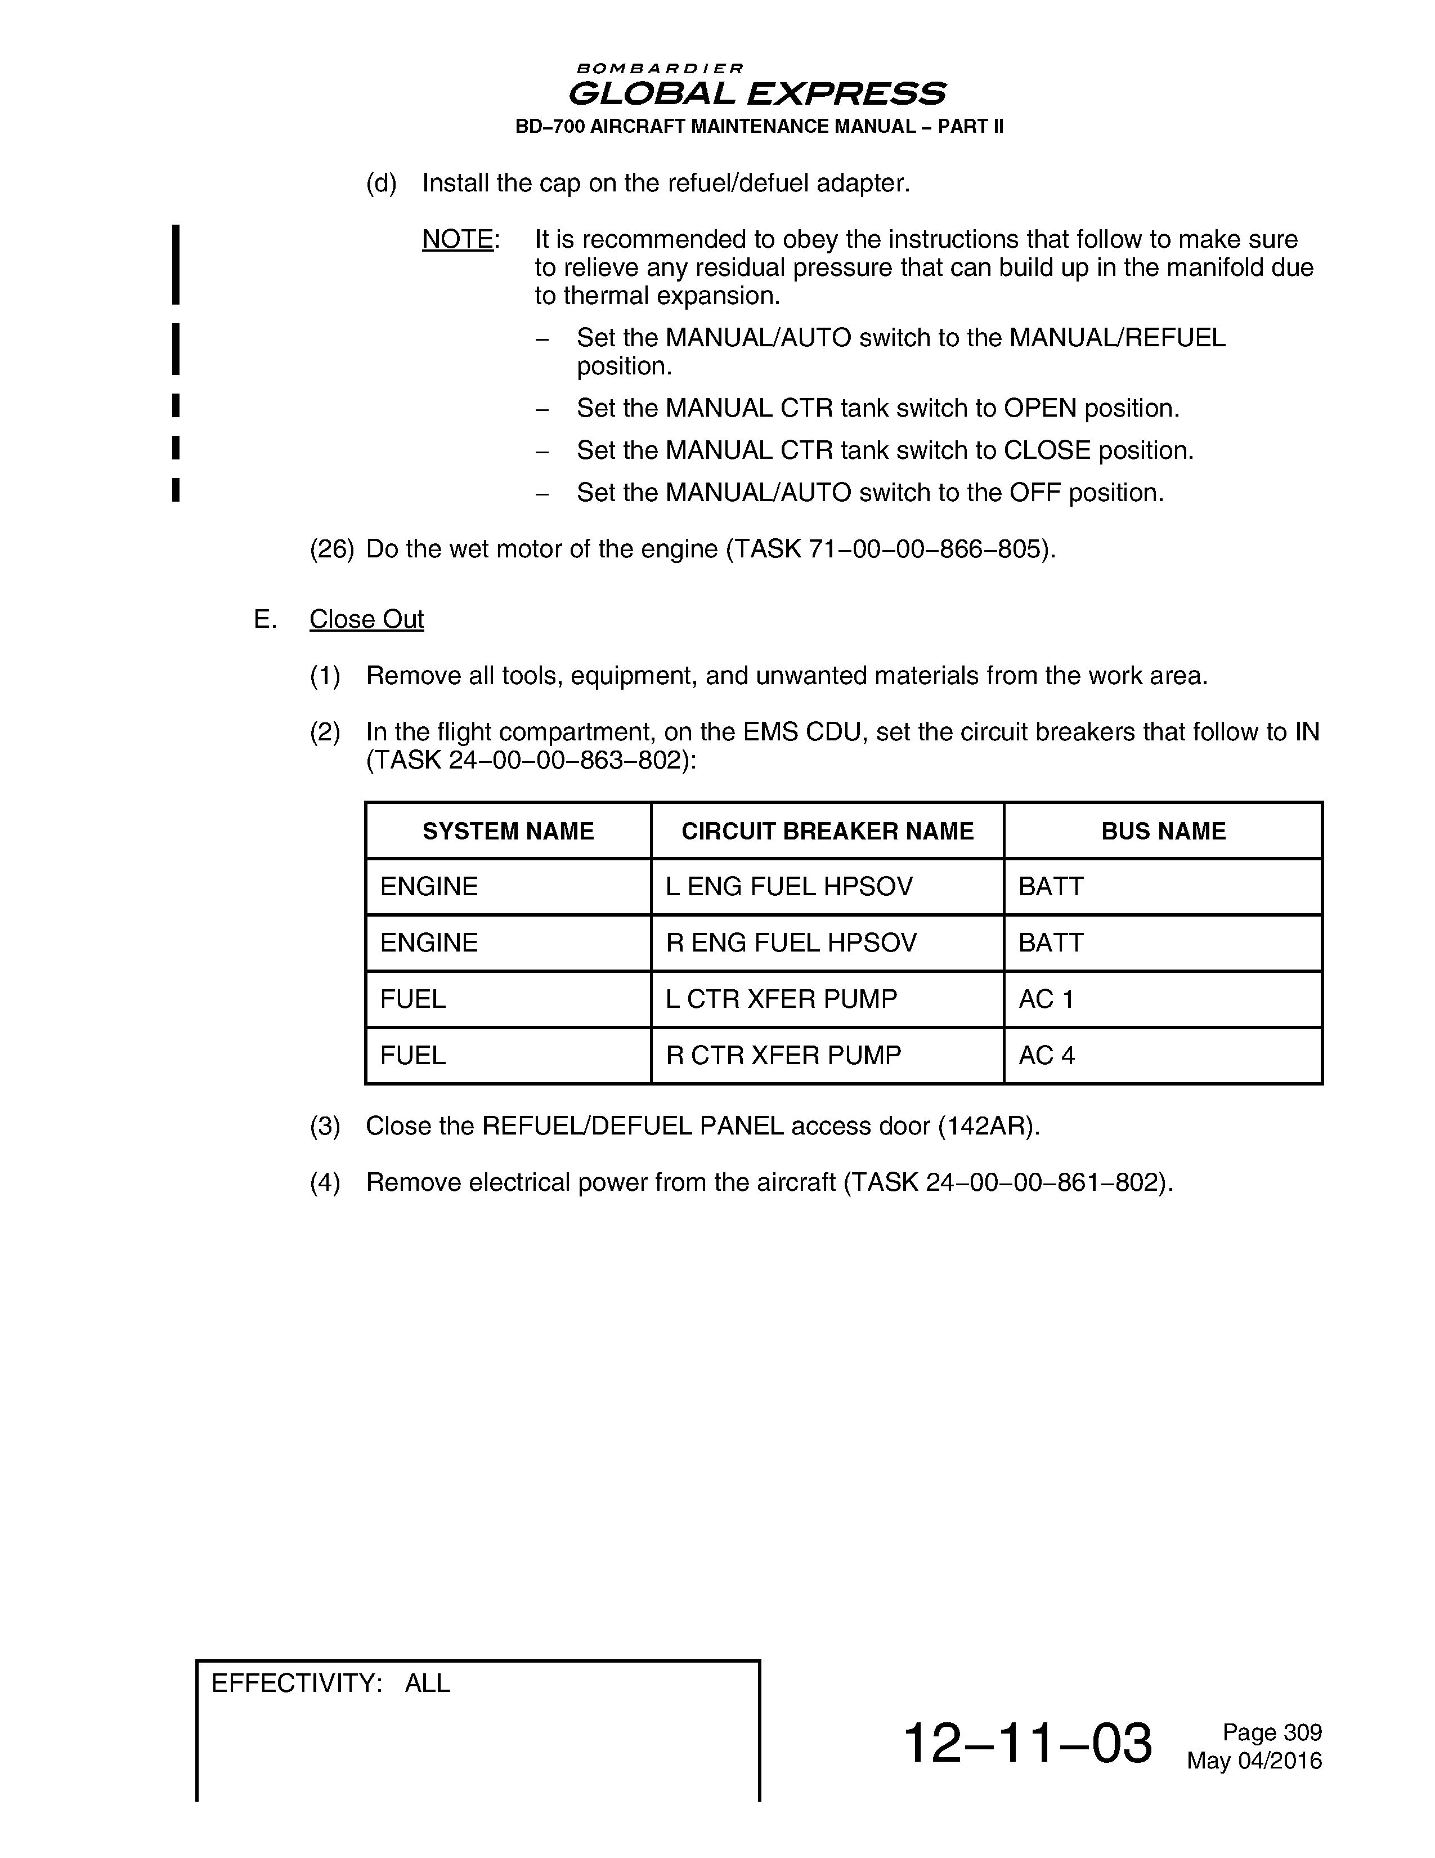
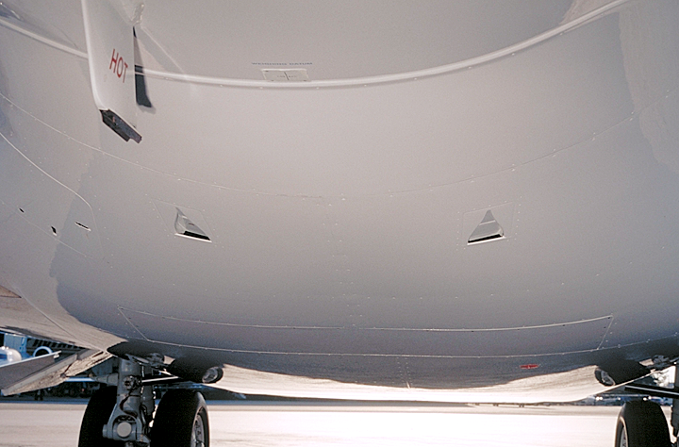
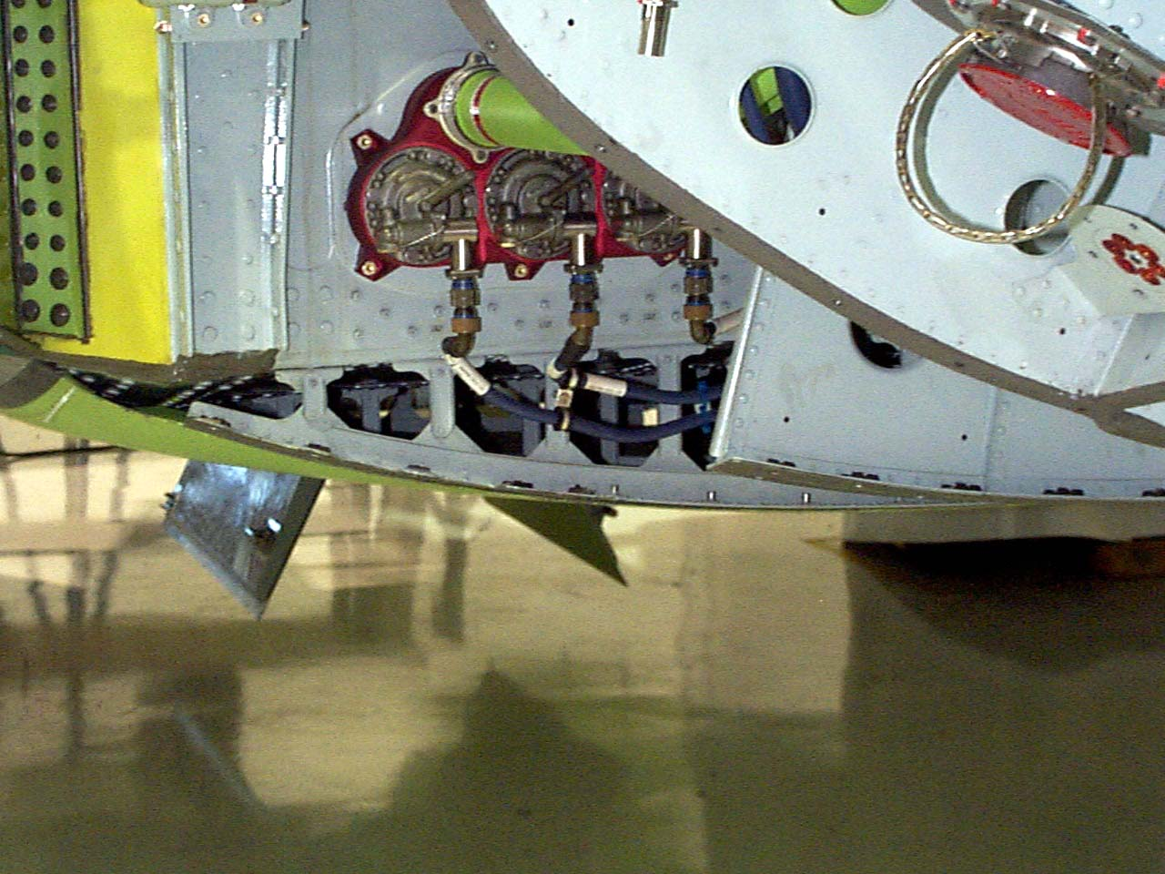

Fuel Scenario 1
During the preflight walkaround, fuel is seen leaking from the wing to fuselage fairing on the right side…
Front
ANSWER:
Make sure to relieve any residual pressure by selecting the refuel/defuel panel to MANUAL and briefly open the center tank valve.
The new procedure calls to select Manual Refuel after refueling and disconnecting the fueling truck then selecting the Center Tank to OPEN, CLOSE then OFF.
Back
ANSWER:
Residual pressure after pressure refueling combined with thermal expansion can create an overpressure condition causing the manifold to crack.
QUESTION:
QUESTION:
What could have caused this?
What preventative measure could be taken?
Notes:
Slide Title: Fuel Scenario 1 (Fuel Leak in Refuel/Defuel Manifold)
Instructor Action:
Based on Global Customer Advisory Meeting (Spring 2016)
Document: Advisory Wire AW700-28-0558, Refuel Defuel Manifold Cracking (Rev. Basic)
Content Information:
What could have caused this?
Residual pressure after pressure refueling combined with thermal expansion can create an overpressure condition causing the manifold to crack.
What preventative measure could be taken?
Make sure to relieve any residual pressure by selecting the refuel/defuel panel to MANUAL and briefly open the center tank valve. Ref. FCOM Vol. 2, pg. 12-10-47
The new procedure calls to select Manual Refuel after refueling and disconnecting the fueling truck then selecting the Center Tank to OPEN, CLOSE then OFF. Ref. AMM Task 12-11-01-650-801
References:
FCOM Vol. 2, pg. 12-10-47
AMM Task 12-11-01-650-801
AW700-28-0558 (Refuel Defuel manifold cracking) Rev. Basic

Slide 33
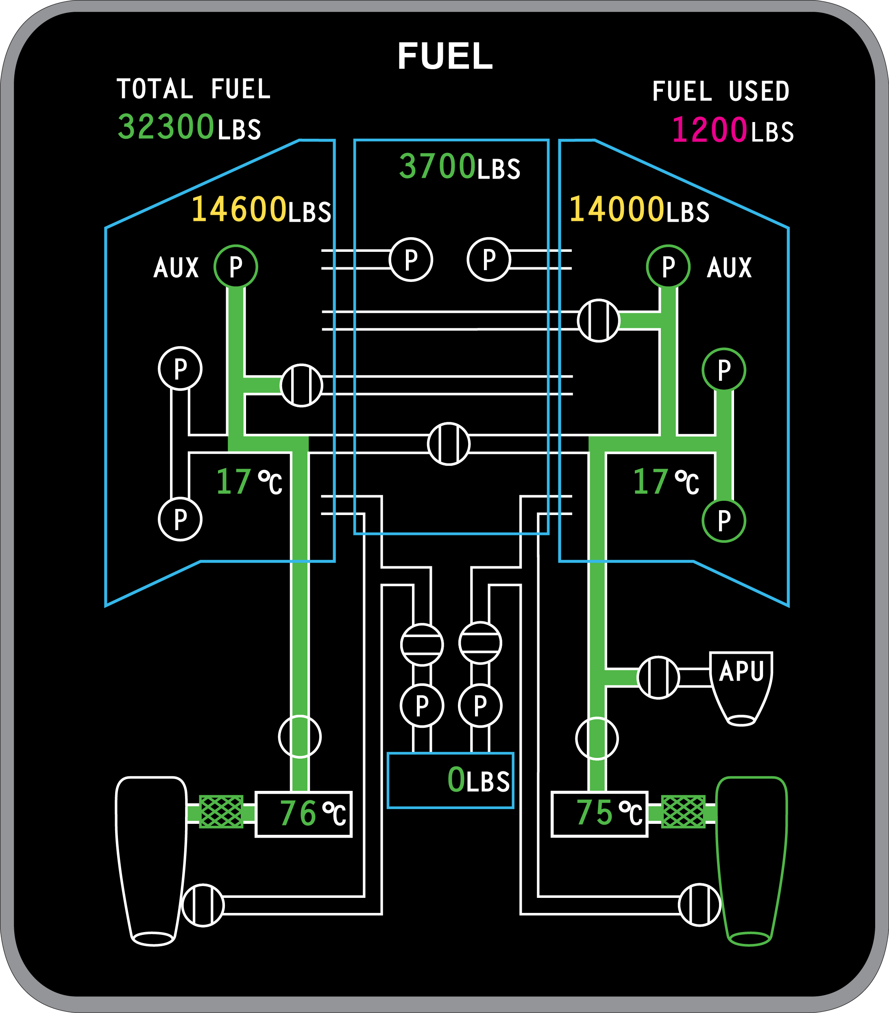
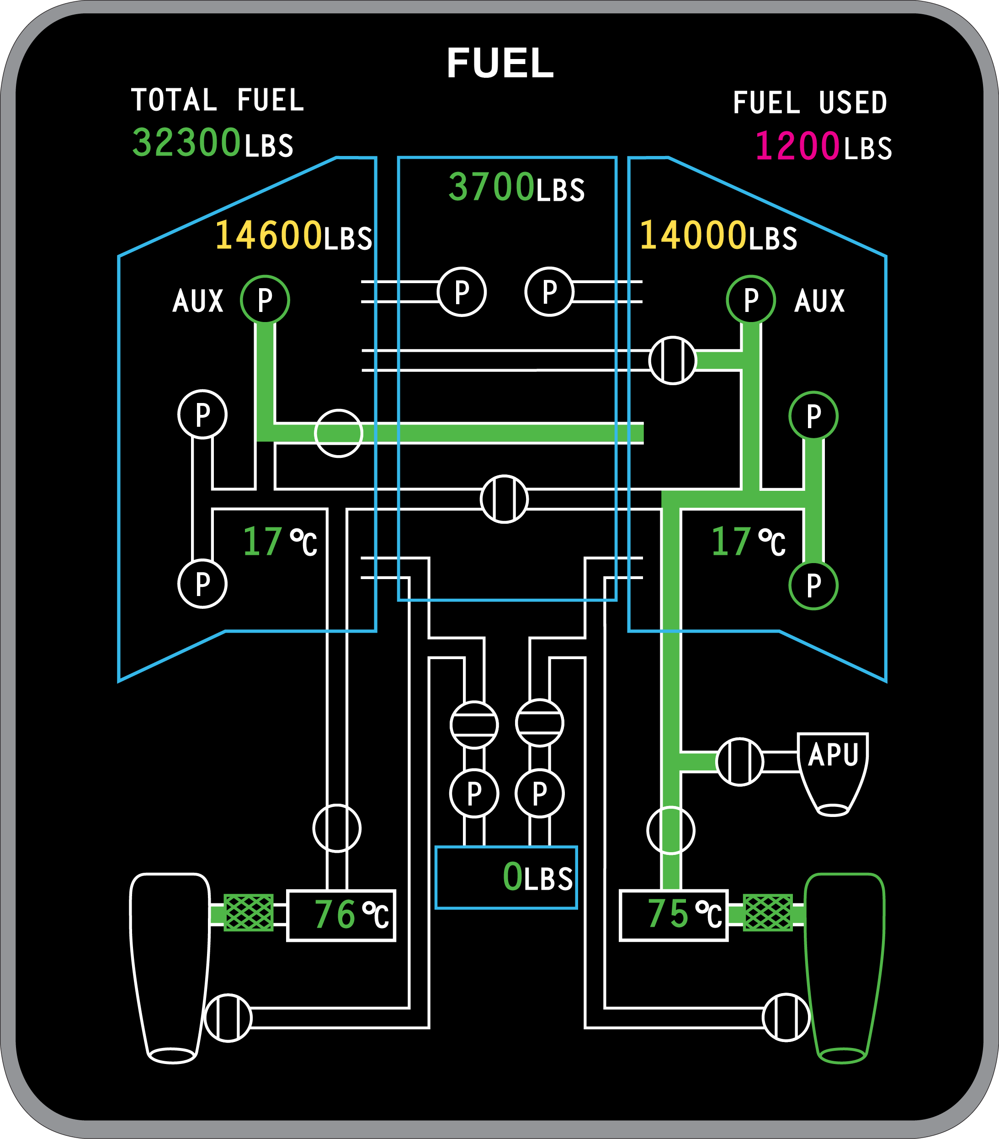

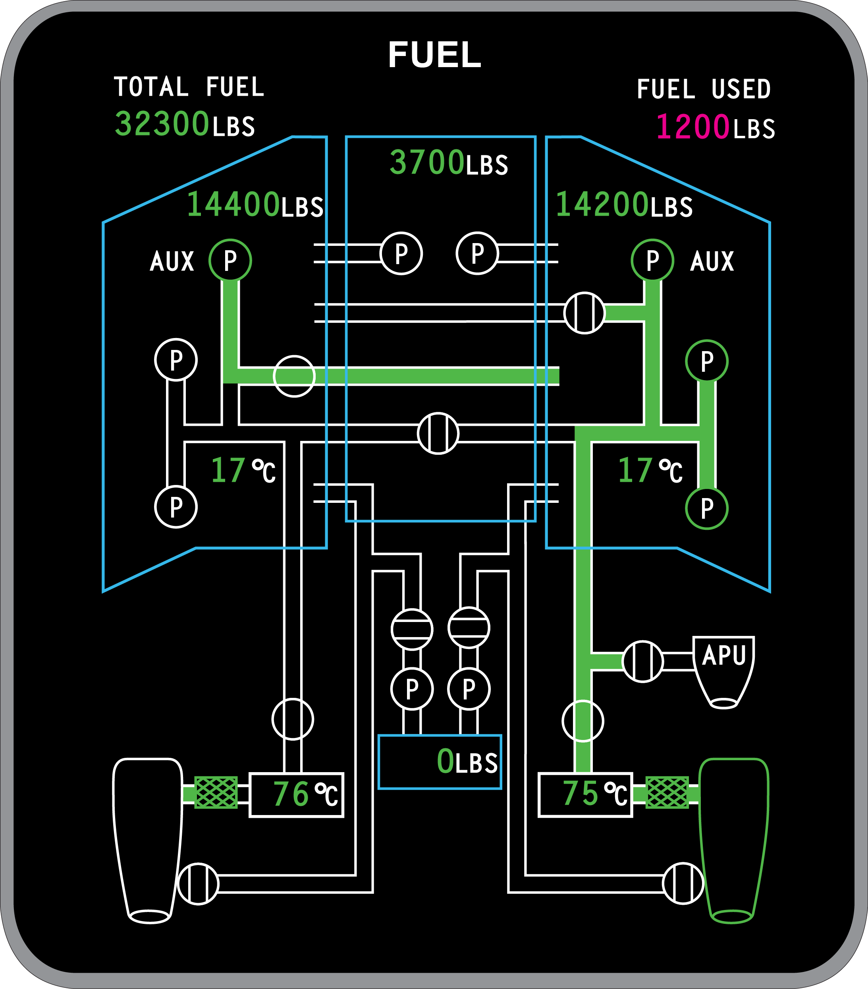

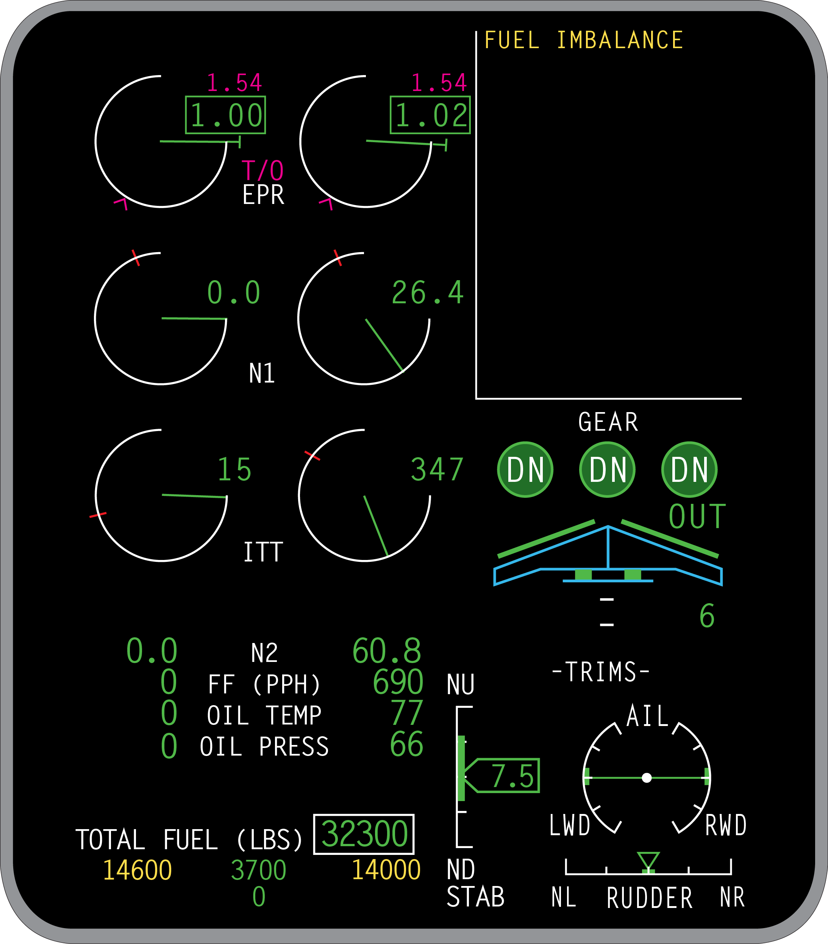
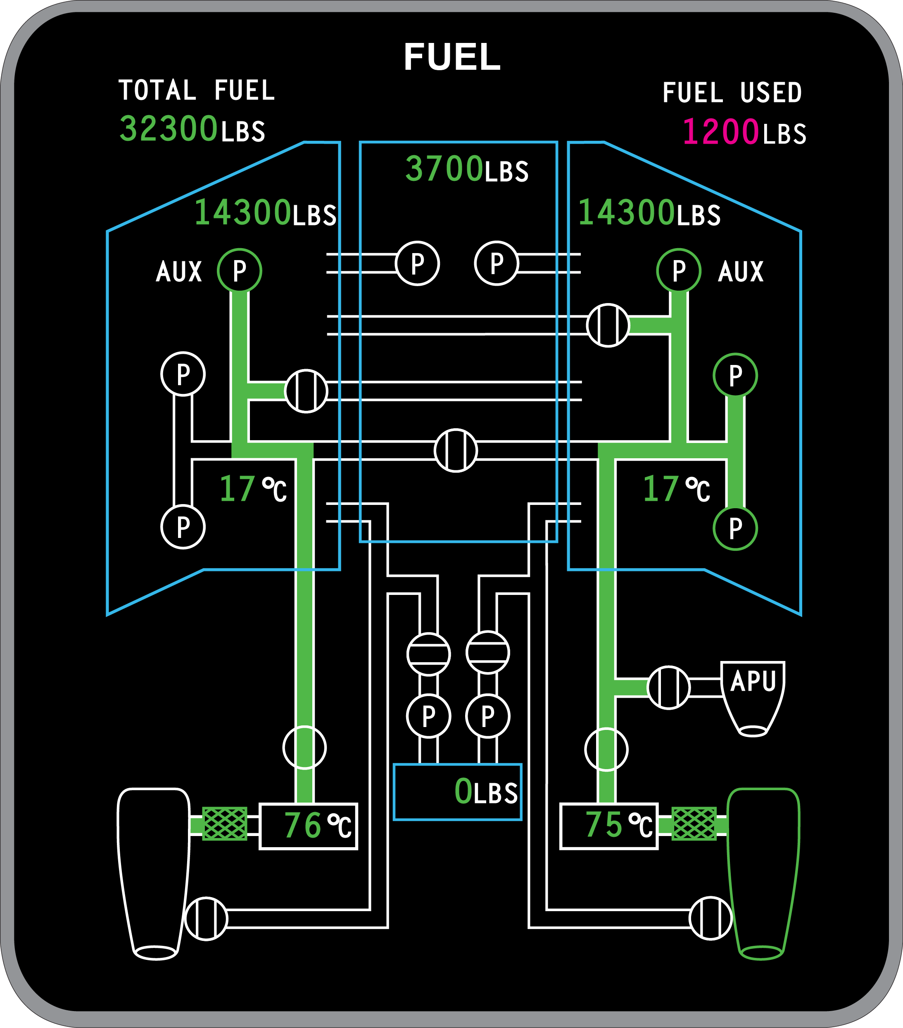
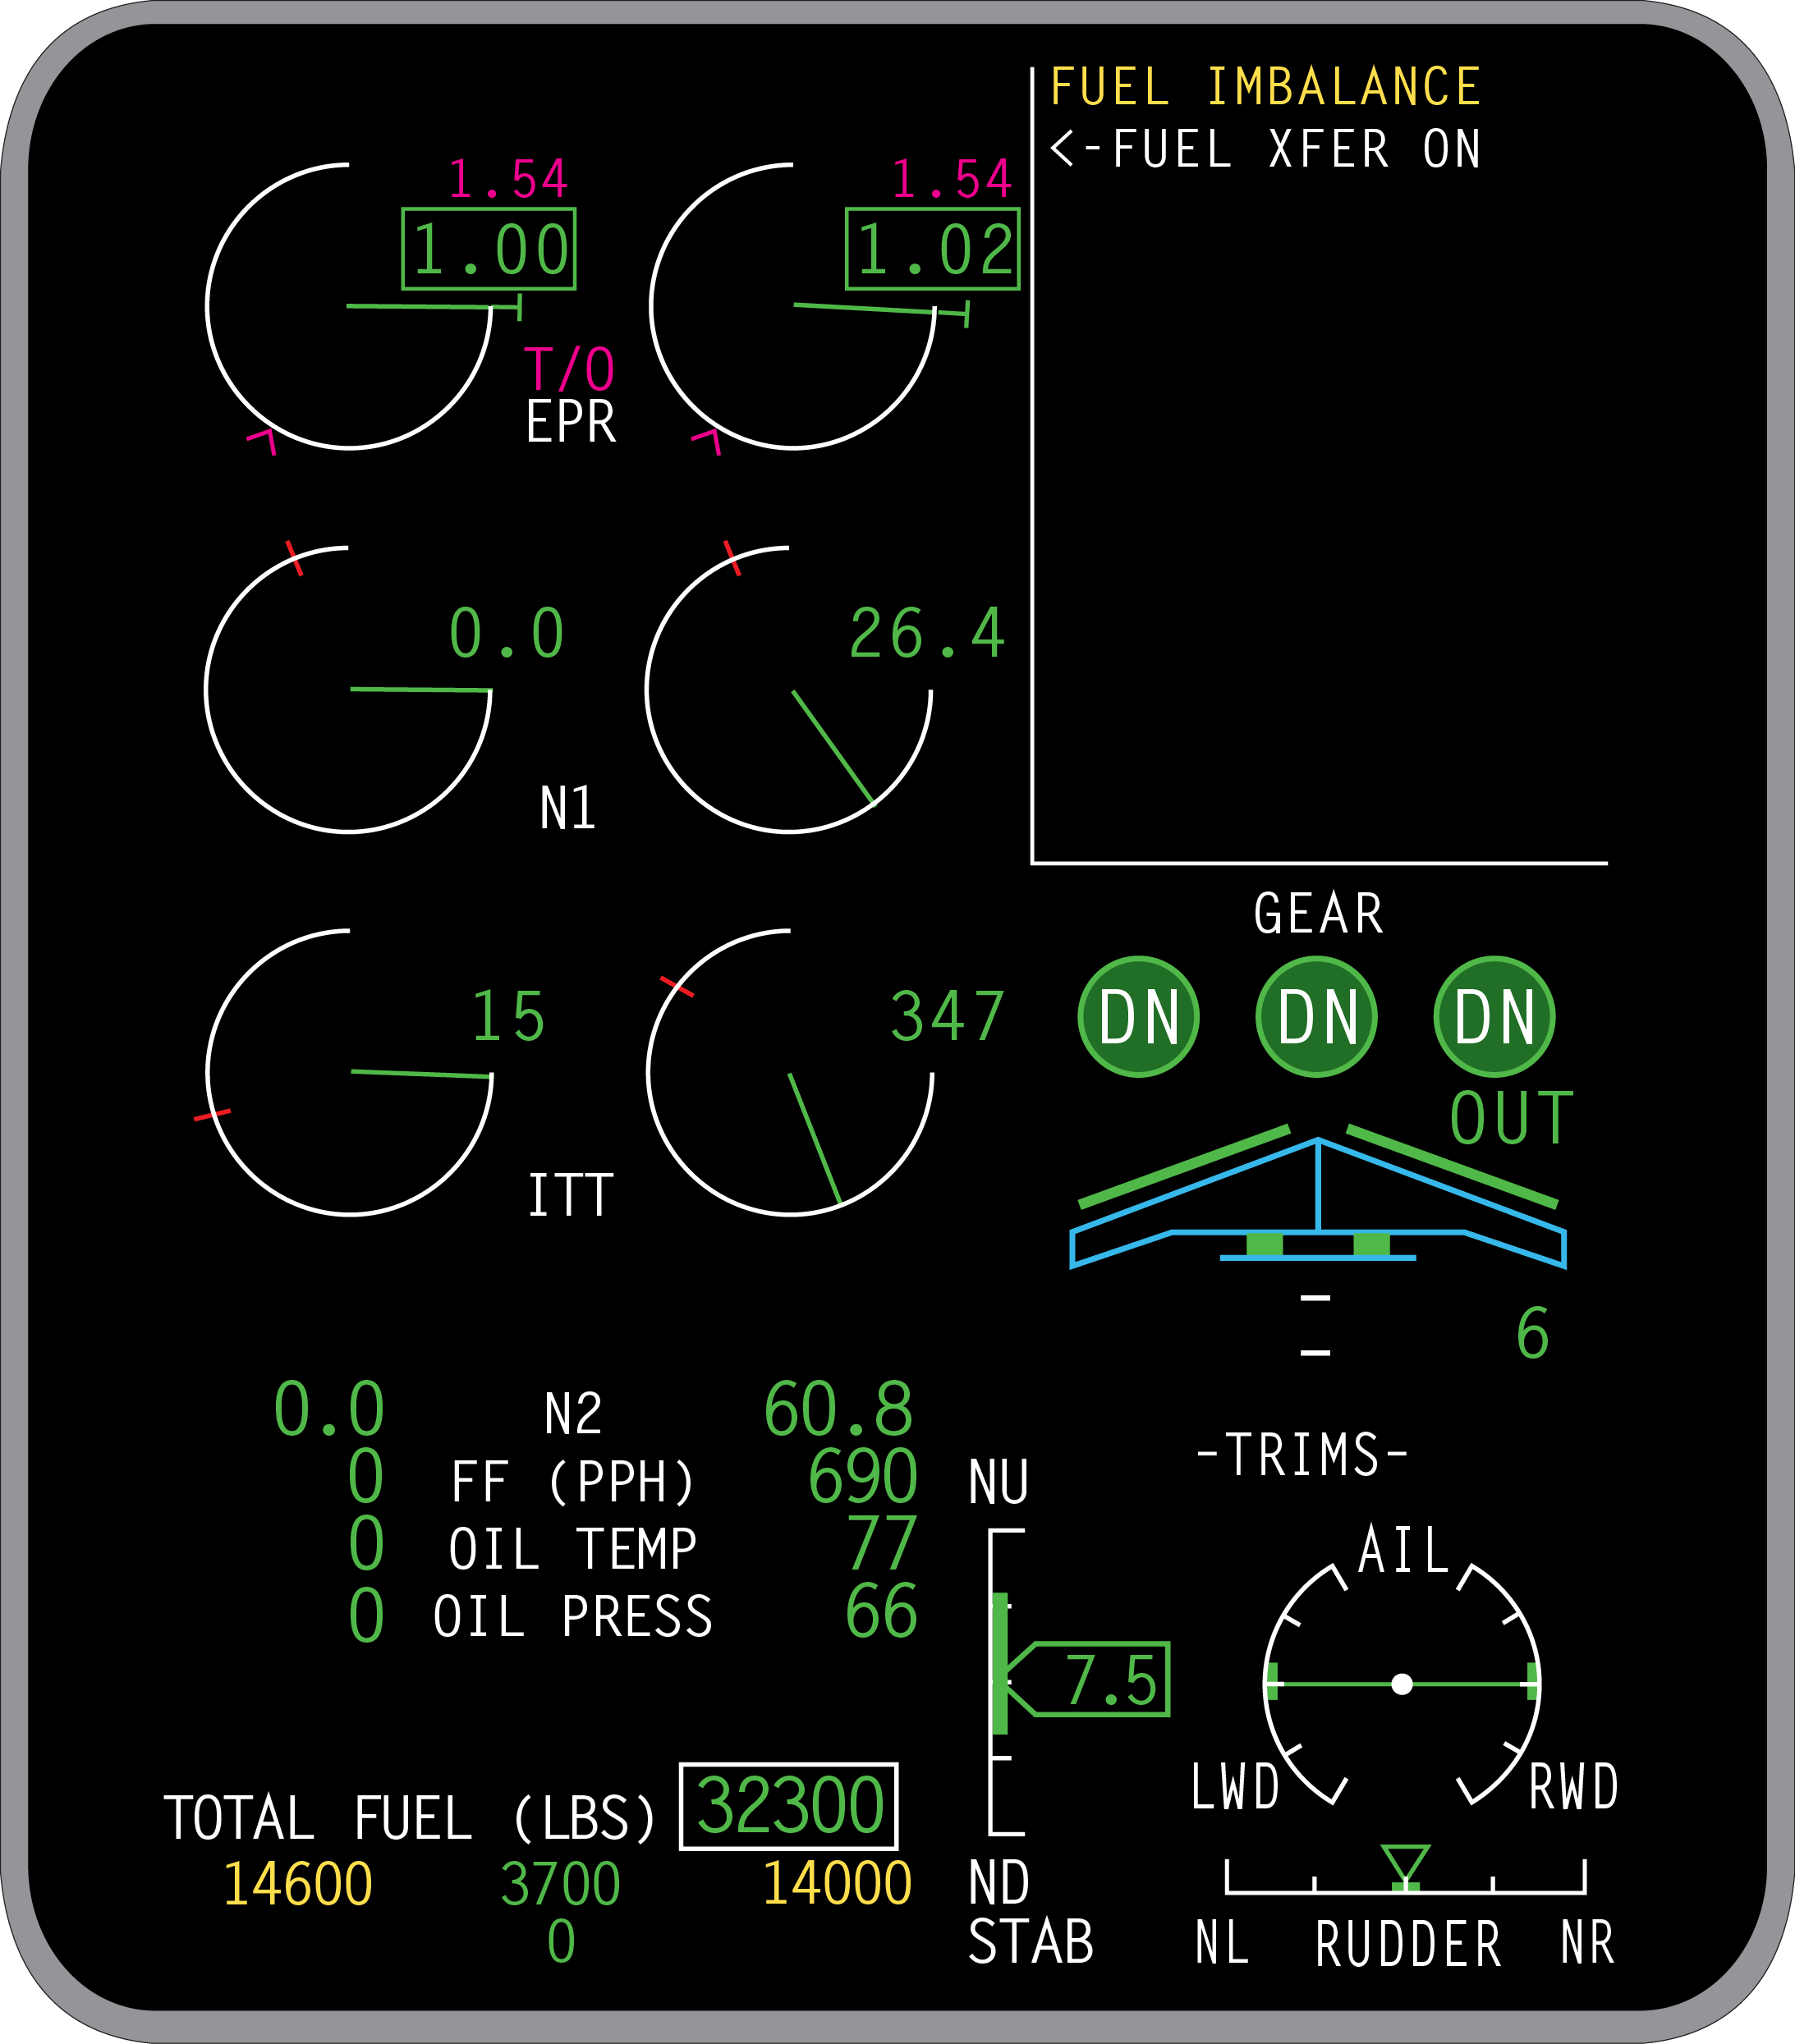

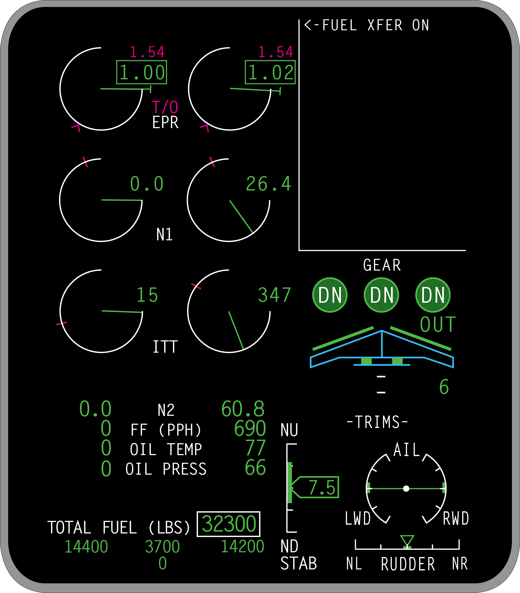
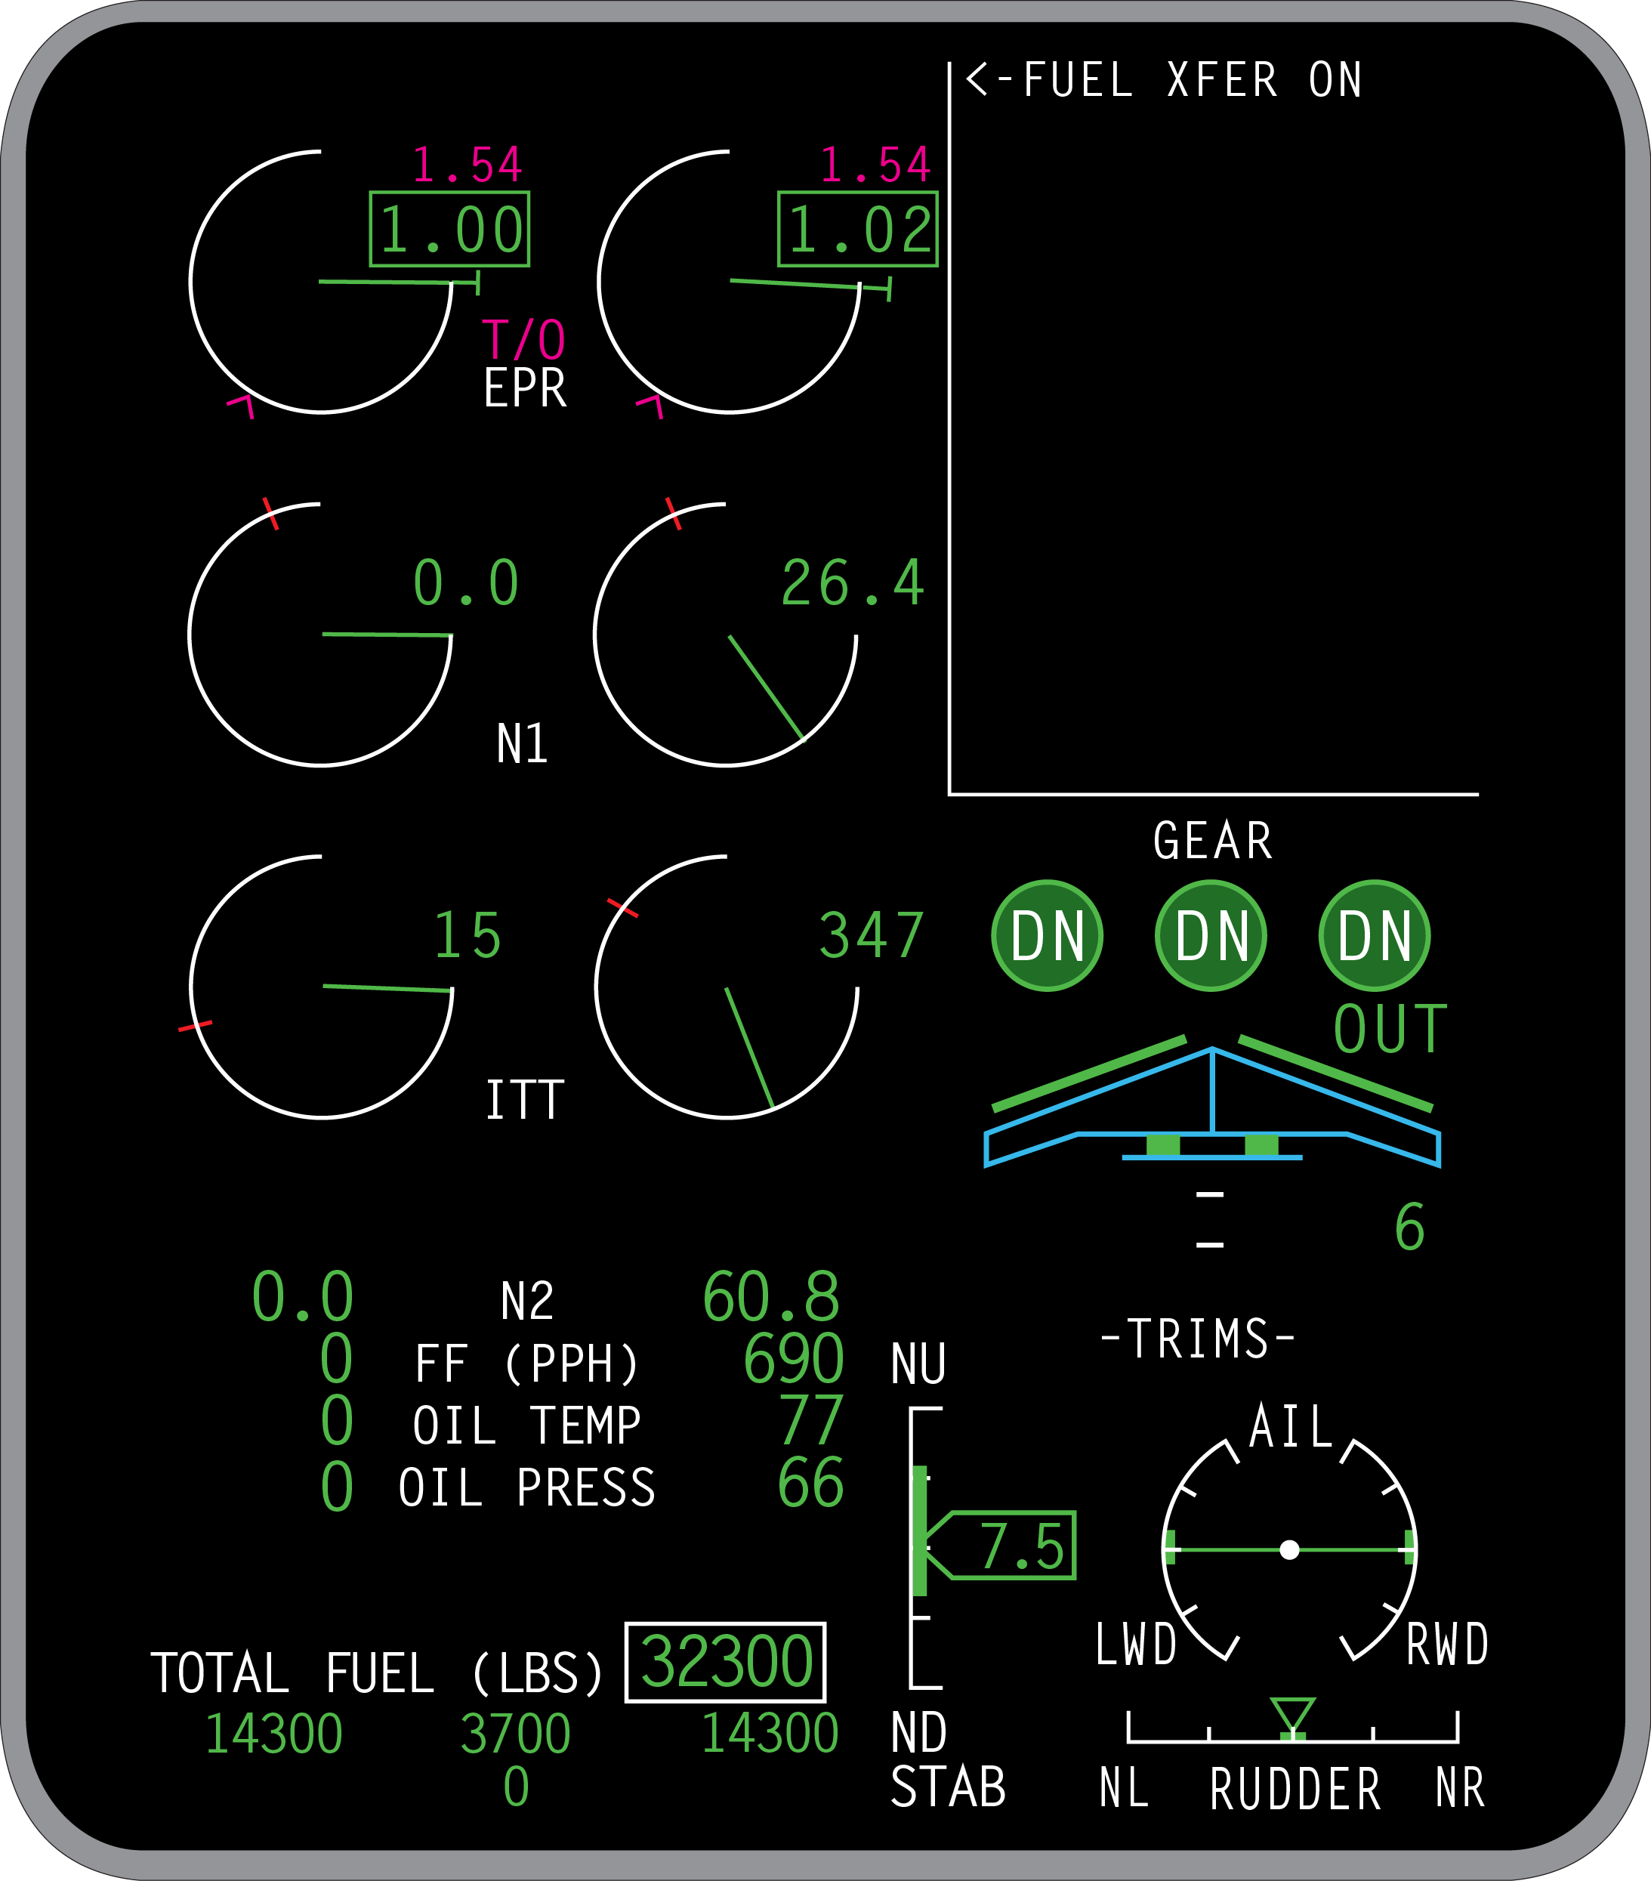
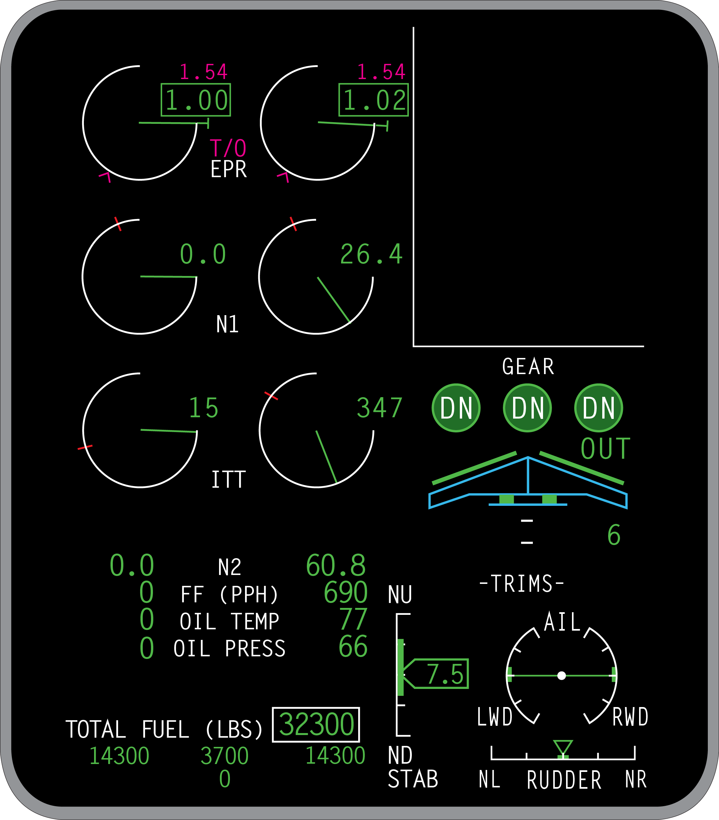


Fuel Scenario 2
Due to a lengthy taxi and short delay before takeoff with the right engine running you get a FUEL IMBALANCE CAS message and notice the wing tanks differ by more than 600 lbs.…
ANSWER:
ANSWER:
Automatic wing transfer mode is only enabled when the Slat/Flap Handle is in the IN and 0 position.
If the slats and flaps were extended on the taxi out the auto transfer becomes inhibited.
Landing gear down in flight
Either wing fuel quantity < 400 lbs.
The DC pump being utilized in the event of an AC boost pump failure
QUESTION:
QUESTION:
Why didn’t the automatic wing to wing transfer fix the problem?
What else inhibits the automatic transfer?
Notes:
Slide Title: Fuel Scenario 2 (Fuel Imbalance)
Instructor Action:
Select the Wing XFER button on the fuel panel to the R/H wing to demonstrate the wing transfer.
Fuel transfer is sped up to transfer 100lbs. every 6 sec. for demonstration purposes (3 sequences total).
When transfer is complete turn the Wing XFER button back to auto.
Content Information:
Why didn’t the automatic wing to wing transfer fix the problem?
Automatic wing transfer mode is only enabled when the Slat/Flap Handle is in the IN and 0 position.
If the slats and flaps were extended on the taxi out the auto transfer becomes inhibited.
Ref. FCOM Vol. 2, pg. 12-10-38
What else inhibits the automatic transfer?
Landing gear down in flight
Either wing fuel quantity < 400 lbs.
The DC pump being utilized in the event of an AC boost pump failure
Ref. FCOM Vol. 2, pg. 12-10-19
References:
FCOM Vol. 2, pg. 12-10-19
FCOM Vol. 2, pg. 12-10-38

Slide 34
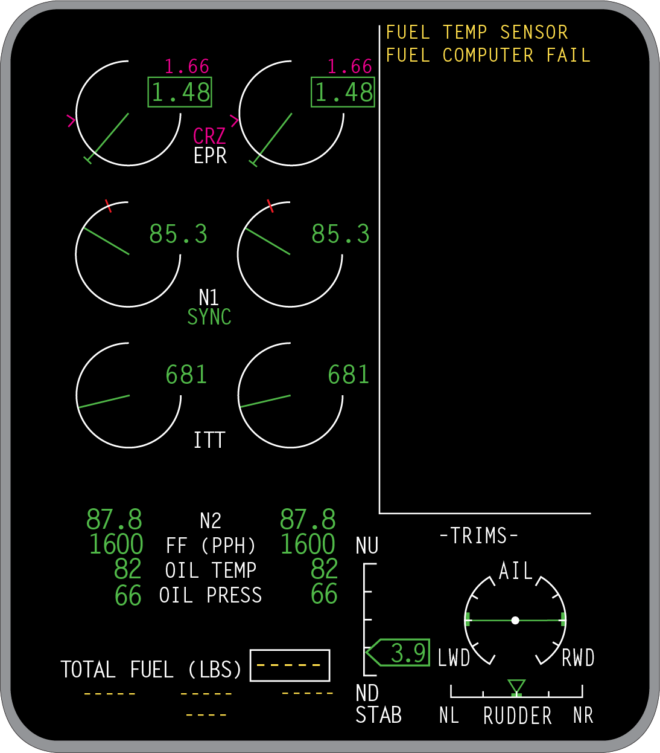

Fuel Scenario 3
While in cruise the FUEL COMPUTER FAIL CAS message appears…
ANSWER:
ANSWER:
QUESTION:
ANSWER:
QUESTION:
QUESTION:
ANSWER:
QUESTION:
In this case, the fuel computer takes care of the fuel temp sensor.
You have to use your fuel flow in PPH, in the fuel log.
Where are you going to go for pertinent fuel information?
FMS > Performance > Maintenance > pg. 2 under Fuel Management
Where do we begin on the EICAS message?
Yes
How do you determine the fuel load?
Is a fuel log required now at this point?
Notes:
Slide Title: Fuel Scenario 3 (FUEL COMPUTER FAIL CAS)
Instructor Action:
Document: QRH Vol. 2, FUEL 09-5
Content Information:
Where do we begin on the EICAS message?
In this case, the fuel computer takes care of the fuel temp sensor.
Is a fuel log required now at this point?
Yes
How do you determine the fuel load?
You have to use your fuel flow in PPH, in the fuel log.
Where are you going to go for pertinent fuel information?
FMS > Performance > Maintenance > pg. 2 under Fuel Management
References:
NA

Slide 35
Fire Protection CAS
L(R) ENG FIRE
APU FIRE
SMOKE AVIONICS BAY
SMOKE BAGGAGE
SMOKE CABIN
SMOKE CLOSET FWD (AFT)
SMOKE FWD (AFT) LAV
APU FIRE FAIL
FIRE BTL 1 (2) LO PRESS
L (R) ENG FIRE FAIL
MLG BAY OVHT FAIL
SMOKE FWD (AFT) LAV FAIL
SMOKE AV BAY FAIL
SMOKE BAGGAGE FAIL
SMOKE CLO FWD (AFT) FAIL
APU FIRE FAULT
L (R) ENG FIRE FAULT
APU SQUIB 1 (2) FAIL
L (R) ENG SQUIB 1 (2) FAIL
FIRE SYS FAULT
MLG BAY OVHT FAULT
Left or right engine fire
APU fire
Smoke warning ON in avionics bay
Smoke warning in the baggage compartment
Smoke warning in the cabin (Global Express only)
Smoking warning in any four of the applicable closet areas
Smoke warning in the forward or aft lavatory
APU detection element system dual loop failure (Complete loss or fire detection capability in APU)
Extinguishing bottle #1 or bottle #2 low pressure
Left or right engine detection element system dual loop failure. (Complete loss of fire detection capability for left or right engine)
Left and/or right main landing gear bay overheat detection element failure. (Complete loss of overheat detection for main landing gear)
Smoke detector installed in the aft lavatory has failed
Smoke detector installed in the avionics bay has failed
Smoke detector installed in the baggage compartment has failed (one or both smoke detectors installed in baggage compartment have failed)
One or more (i.e. up to four) closet smoke detectors have failed
One detector loop out of two is inoperative
One detector loop out of two is inoperative
Affected firex squib inoperative
Affected firex squib inoperative
FIDEEX system fault
One gear bay overheat detection channel inoperative
Notes:
Slide Title: Fire Protection CAS
Instructor Action:
Choose CAS messages that the instructor would like to emphasize if any. Use checklist as necessary.
CAS Messages:
L(R) ENGINE FIRE – Left or right engine fire
APU FIRE – APU FIRE
SMOKE AVIONICS BAY – Smoke warning ON in avionics bay
SMOKE BAGGAGE – Smoke warning in the baggage compartment
SMOKE CABIN – Smoke warning in the cabin (Global Express only)
SMOKE CLOSET FWD (AFT) – Smoking warning in any four of the applicable closet areas
SMOKE FWD (AFT) LAV – Smoke warning in the forward or aft lavatory
APU FIRE FAIL – APU detection element system dual loop failure (Complete loss or fire detection capability in APU)
FIRE BTL 1 (2) LO PRESS – Extinguishing bottle #1 or bottle #2 low pressure
L (R) ENG FIRE FAIL – Left or right engine detection element system dual loop failure. (Complete loss of fire detection capability for left or right engine)
MLG BAY OVHT FAIL – Left and/or right main landing gear bay overheat detection element failure. (Complete loss of overheat detection for main landing gear)
SMOKE FWD (AFT) LAV FAIL – Smoke detector installed in the aft lavatory has failed
SMOKE AV BAY FAIL – Smoke detector installed in the avionics bay has failed
SMOKE BAGGAGE FAIL – Smoke detector installed in the baggage compartment has failed (one or both smoke detectors installed in baggage compartment have failed)
SMOKE CLO FWD (AFT) FAIL – One or more (i.e. up to four) closet smoke detectors have failed
APU FIRE FAULT – One detector loop out of two is inoperative
L (R) ENG FIRE FAULT – One detector loop out of two is inoperative
APU SQUIB 1 (2) FAIL – Affected firex squib inoperative
L (R) ENG SQUIB 1 (2) FAIL – Affected firex squib inoperative
FIRE SYS FAULT – FIDEEX system fault
MLG BAY OVHT FAULT – One gear bay overheat detection channel inoperative
References:
PTM Vol 1 & 2

Slide 36


Fire Handles
QUESTION:
What steps must be accomplished to pull a fire handle with no fire indication?
Answer:
The manual override button must first be pressed.
Notes:
Slide Title: Fire Handles
Instructor Action:
NA
Content Information:
What steps must be accomplished to pull a fire handle with no fire indication?
In order to pull the fire handle with no fire indication, the manual override button must first be pressed.
To prevent accidental engine shutdown and fire extinguisher discharges, each fire DISCH handle is maintained in the stowed position by internal springs and a solenoid operated locking mechanism.
When a fire warning is received, the FIDEEX control unit energizes the solenoid to release the locking mechanism and allow the handle to be pulled out.
The locking mechanism can also be manually released by pressing the manual override button, located behind the handle, while simultaneously pulling the handle out.
References:
FCOM Vol. 2, pg. 09-10-12

Slide 37


Fire Handles
QUESTION:
What happens when you pull the Left Engine fire handle?
Answer:
The Squibs are armed, the generators trip and the following valves are closed: Fuel SOV, PRV, Hydraulic Shutoff Valve.
Notes:
Slide Title: Fire Handles
Instructor Action:
NA
Content Information:
What happens when you pull the Left Engine fire handle?
The Squibs are armed, the generators trip and the following valves are closed: Fuel SOV, PRV, Hydraulic Shutoff Valve.
If the battery master switch is off and you pull the fire handle and turn it; will it fire a bottle?
Yes; if the Avionics battery is connected, the DC emergency bus is powered.
The FIDEEX control unit receives power from the DC EMER BUS.
It is powered anytime the aircraft batteries are connected regardless of the position of the battery switch.
Pulling the Fire Handle will close the Fuel & Hydraulic SOV, Arm the bottle and will discharge the bottle if the handle is turned.
Three fire DISCH handles are provided for the engine and APU fire protection system.
They are installed on the center overhead panel in the flight compartment.
Each fire handle illuminates upon fire detection.
When a fire DISCH handle is pulled out, the following events occur:
Associated (engine/APU) fuel feed shutoff valve (SOV) closes
Associated hydraulic SOV closes
Associated bleed SOV(s) close
A signal is sent to the associated GCU(s) to trip the generator(s)
A signal is sent to the APU FADEC to shutdown the APU (APU only)
Redundant commands are sent to arm the fire extinguisher discharge circuits.
To discharge a bottle into the engine fire zone, the DISCH handle must be turned fully counterclockwise (bottle 1) or clockwise (bottle 2).
References:
FCOM Vol. 2, pg. 09-10-12

Slide 38



Fire Protection - APU
QUESTION:
What must the crew do in order to discharge second fire bottle into the APU?
Answer:
The lock release pin must be slid aside to allow the fire handle to rotate in the other direction.
Notes:
Slide Title: Fire Protection - APU
Instructor Action:
NA
Content Information:
What must the crew do in order to discharge second fire bottle into the APU?
In order to discharge the second fire bottle into the APU the lock release pin must be slid aside to allow the fire handle to rotate in the other direction.
To prevent unintentional discharge of the second extinguisher bottle a lockout release pin, located at the base of the handle, must be moved to the right to allow the handle to be rotated back to the center position.
This is most often a two−handed operation.
When the handle is turned fully in the opposite direction, the remaining bottle will be discharged.
On the ground, the FADEC will automatically shut down the APU if a fire signal is received for at least 5 seconds.
Although the APU will automatically shut down if a fire is detected, there is no automatic discharging of the fire extinguishing agent.
Therefore, the APU must not be left unattended for ground operations.
In flight, the pilots will be presented with aural and visual warnings in the event of a fire but the APU will not automatically shut down.
References:
FCOM Vol. 2, pg. 09-10-14

Slide 39

Fire Bottles
Notes:
Slide Title: Fire Bottles
Instructor Action:
Discuss content
Content Information:
Two stainless steel fire extinguisher bottles are in the rear of the aft equipment bay. The forward container is bottle No. 1; the aft bottle No. 2. Each container holds from 6.50 to 6.60 lb (2.95 to 3.00 kg) of Halon 1301 pressurized with nitrogen at 600 to 625 psig (4190 to 4365 kPa).
Each bottle has three ports. Each port has a discharge head and associated plumbing so that extinguishant flows into either engine or the APU. Each discharge head includes an explosive cartridge (squib) with two bridge wires. A burst disc, part of each discharge head, ruptures when the operator electrically fires the associated squib from the cockpit.
The discs also serve as pressure relief to prevent an explosive bottle rupture. If excessive temperature causes the bottle pressure to rise, the discs structurally rupture before the bottle.
The extinguishant from that bottle then discharges into the corresponding engine(s) and/or APU compartment. The extinguishant (Halon 1301) does not cause any damage or corrosion. It has no effect if it escapes into an operating engine or APU.
A direct reading pressure gauge on each container displays pressure in that container. A pressure switch signals the FIDEEX unit when pressure decreases to less than 250 ±25 psig (1724 ±172 kPa). The EICAS then displays the caution FIRE BTL 1 (2) LO PRESS message.
References:
MTM Vol. 1, pg. 26-19

Slide 40

Fire Bottles
QUESTION:
If a thermal discharge event occurs, where does the Halon go?
Answer:
Halon will go to the compartment of whichever frangible disk reaches discharge pressure first.
Notes:
Slide Title: Fire Bottles
Instructor Action:
NA
Content Information:
If a thermal discharge event occurs, where does the Halon go?
Halon will go to the compartment of whichever frangible disk reaches discharge pressure first.
References:
PTM Vol 1 & 2

Slide 41





Location & Operation
CLOSET (SMOKE DETECTOR)
MAIN LANDING GEAR BAYS
(RIGHT & LEFT NOT SHOWN)
OVERHEAT DETECTION
SUPPRESSION BY LOWERING GEAR
FIDEEX CONTROL UNIT
Notes:
Slide Title: Location & Operation
Instructor Action:
NA
Content Information:
Main engine fire detection is provided by a dual-loop system of sensing elements
Each zone’s elements are mounted on support tubes
The FIDEEX system provides fire detection and extinguishing to both main engine zones
The Powerplant zones that include fire detecting and extinguishing are:
Accessory
Core
The detection loops of both zones are monitored as a single zone and the fire extinguishing system when discharged, supplies both zones simultaneously
Smoke Detection System
The detection units detect obstruction to visibility
Each smoke detector incorporates a heat sensor which will trigger a smoke alarm @ 115c
Depending on completion, there will be 6 to 8 detectors.
References:
PTM Vol 1 & 2

Slide 42

Detection System
Notes:
Slide Title: Detection System
Instructor Action:
NA
Content Information:
Each engine has two fire detection loops (A and B) attached in parallel. Each loop has three detectors.
On each engine loop the core wires of the three elements that form the loop connect in series. Rails provide structural support to two of the elements on each engine.
References:
MTM Vol. 1, fig. 26-5, Engine Fire Detection System Component Location
MTM Vol. 1, pg. 26-7

Slide 43

APU Fire Detection
Notes:
Slide Title: APU Fire Detection
Instructor Action:
NA
Content Information:
Dual-loop sensing elements detect when the APU area has a fire condition.
The APU also has two independent loops (A and B). Each loop has three detectors connected in a series circuit.
References:
MTM Vol. 1, fig. 26-7, APU Fire Detection Block Diagram and Loops
MTM Vol. 1, pg. 26-10

Slide 44




Fire Protection Scenario 1
On descent the L ENG FIRE CAS message appears along with the aural warning “LEFT ENGINE FIRE”.
After completing the immediate action items…
You pull the fire DISCH handle…
ANSWER:
Associated (engine/APU) fuel feed shutoff valve (SOV) closes
Associated hydraulic SOV closes
Associated bleed SOV(s) close
A signal is sent to the associated GCU(s) to trip the generators
A signal is sent to the APU FADEC to shut down the APU (APU only)
Redundant commands are sent to arm the fire extinguisher discharge circuits.
QUESTION:
ANSWER:
QUESTION:
Does the flashing MASTER WARNING/CAUTION light go out by pulling the fire DISCH handle?
No, the only way you cancel the light is by pushing the MASTER WARNING/CAUTION light.
What happens to the airplane when the fire DISCH handle is pulled?
Notes:
Slide Title: Fire Protection Scenario 1 (L ENG FIRE CAS)
Instructor Action:
Document: FCOM Vol. 2, pg. 09-10-12
Content Information:
What happens to the airplane when the fire DISCH handle is pulled?
Associated (engine/APU) fuel feed shutoff valve (SOV) closes
Associated hydraulic SOV closes
Associated bleed SOV(s) close
A signal is sent to the associated GCU(s) to trip the generators
A signal is sent to the APU FADEC to shut down the APU (APU only)
Redundant commands are sent to arm the fire extinguisher discharge circuits.
Ref. FCOM Vol. 2, pg. 09-10-12
Does the flashing MASTER WARNING/CAUTION light go out by pulling the fire DISCH handle?
No, the only way you cancel the light is by pushing the MASTER WARNING/CAUTION light.
References:
FCOM Vol. 2, pg. 09-10-12

Slide 45
Powerplant CAS
L(R) ENG FIRE
DUAL ENGINE OUT
L (R) OIL LO PRESS
L (R) REVERSER UNLKD
A/T NOT IN HOLD
L (R) ENG FLAMEOUT
L (R) ENG OVHT
L (R) ENG OVERSPEED
L (R) ENG SAV FAIL
L (R) START ABORTED
L (R) FADEC FAIL
L (R) FADEC N1 CTL
L (R) FADEC OVHT
L (R) THROTTLE FAIL
L (R) OIL LO QTY
L (R) REVERSER FAIL
L (R) REV LOCK FAIL
A/T 1 (2) FAIL
A/T ADC MISCMP
A/T IRS MISCMP
ENG SYNC FAIL
ENG SYNC LIMIT
L (R) FADEC FAULT
L (R) FUEL FILTER
L (R) OIL FILTER
ATS ENVELOPE
WINDMILL ENVELOPE
L (R) REV LOCK FAULT
L (R) REV FAULT
Left/right engine has a fire.
Double engine flameout.
Left and/or Right engine has low oil pressure while the engine is running. Pressure below Red line. Inhibited by EEC when N2 is below 56%.
Left and/or right reverser unlocked with thrust lever in forward thrust range. Two stow switches indicate unstowed, and the tertiary lock indicates unlocked. An aural warning is also annunciated. Red REV icon is posted on primary display if door opens, and the EEC limits thrust to idle.
AT not in T/O hold following the transition above 60 knots during T/O roll and until the aircraft transitions 400 ft. AGL.
L (R) engine flame out when engine under normal running conditions i.e. NOT in start mode; NOT overspeed shutdown; fire handles NOT pulled.
Turbine overheat detected by the RBC oil fire detector thermocouple, or by the HP turbine cooling air overheat thermocouple. Reduce Power or shut down engine. Inhibited during T/O and landing.
Left and/or Right engine shutdown caused by the Independent Overspeed Protection system. Restart at Pilot’s discretion.
SAV detected or SAV open with ENG above starter cutout speed. START icon changes from green to amber. Inhibited during T/O and landing.
L(R) ENG auto start aborted by FADEC. May be due to igniter plug failure. Attempt another start. If both igniters are faulty, after 2 start attempts, L-R FADEC FAIL displayed. INHB-TO/LD
Major FADEC failure of both the lanes. Immediate maintenance action required prior to subsequent dispatch. Inhibited during T/O and landing.
EEC is in alternate control mode. Soft reversion from EPR to N1 control.
L(R) ENG EEC OVHT detected. Internal temp monitor tripped at temp > 96°C. Retard PWR & monitor ENG. Shutdown ENG if necessary. INHB –TO/LD
L(R) ENG dual channel TRA failed or Lane A & B x-check OK but throttle is outside rigging range (-22.5° ↔ +39.0°). On the affected ENG, the EEC controls the ENG to last valid TRA & locks the EPR to the last known value until approach. The EEC switches to Hi idle in approach and to Lo idle on landing. INHB-TO/LD.
Left and/or Right engine oil quantity is low. Monitor oil pressure and temp. Land ASAP. Inhibited during T/O and landing. Below 3.2 qt for >10 min.
L (R) ENG thrust reverser has failed and the doors will stay in current position. Defective isolation control unit, interface between ICU and EEC, a defective door position switch, defective EEC, a defective channel of LVDT sensor and the EEC interface, a tertiary lock not removing (lockout T/R). Inhibited during T/O.
L(R) engine thrust lever in FWD thrust range. On a door, either 2 switches indicated unstowed, or the tertiary lock indicates unlocked (2 of 3 reverser locks not locked). Thrust reverser will not deploy uncommanded. Any of the 3 locks on the individual T/R door can keep the door stowed at all power settings.
AT 1 and/or 2 has stopped communicating or is invalid (As determined by FWC) or the AT reports a hardware or Servo failure.
Selected A/T system is disconnected or unavailable due to ADC data miscompare required for dual coupled approach A/T operation.
Selected A/T system is disconnected or unavailable due to IRS data miscompare required for dual coupled approach A/T operation.
Selected Sync system failed or is unavailable due to a detected failure or missing/invalid data.
Selected Sync system is unable to perform the pilot selected sync function due to an authority limit.
L (R) ENG minor FADEC fault. ENG ops shouldn't be affected. Minor loss of redundancy within the ENG control system. (L-R FADEC FAIL not enabled). Short Term Dispatch. INHB-TO/LD
Impending bypass or Dip switch failure of the LP fuel filter for only one of the engines. Inhibited during T/O and landing.
Left and/or Right oil filter impending bypass or filter Dp switch failed. Inhibited during T/O and landing.
FADEC decides A/C within starter assisted relight envelope. Active in flight when ENG START switch in AUTO & ENG RUN switch is OFF. INHB-TO/LD
FADEC has determined that the aircraft is within the windmill starting envelope for applicable engine. Inhibited during T/O and landing.
L(R) ENG thrust lever in the forward thrust range, 1 of 2 primary stow switches on a corresponding T/R door indicating unstowed. INHB-TO/LD
L(R) ENG minor fault in reverser SYS. Reverser ops should be normal. Stow command 1 & 2 disagree; ICU CMND CLSD & P-switch shows H-psi; stow CMND & solenoid = ground on DCV; upper or lower door tertiary lock = ground or EEC T/R interlock commanded to release. Reverser will deploy normally. INHB-TO/LD
Notes:
Slide Title: Powerplant CAS
Instructor Action:
Choose CAS messages that the instructor would like to emphasize if any. Use checklist as necessary.
CAS Messages:
L (R)ENGFIRE - Left/right engine has a fire.
DUAL ENGINE OUT - Double engine flameout.
L (R) OIL LO PRESS - Left and/or Right engine has low oil pressure while the engine is running. Pressure below Red line. Inhibited by EEC when N2 is below 56%.
L (R) REVERSER UNLKD - Left and/or right reverser unlocked with thrust lever in forward thrust range. Two stow switches indicate unstowed, and the tertiary lock indicates unlocked. An aural warning is also annunciated. Red REV icon is posted on primary display if door opens, and the EEC limits thrust to idle.
A/T NOT IN HOLD - AT not in T/O hold following the transition above 60 knots during T/O roll and until the aircraft transitions 400 ft. AGL.
L (R) ENG FLAMEOUT – L (R) engine flame out when engine under normal running conditions i.e. NOT in start mode; NOT overspeed shutdown; fire handles NOT pulled.
L (R) ENG OVHT - Turbine overheat detected by the RBC oil fire detector thermocouple, or by the HP turbine cooling air overheat thermocouple. Reduce Power or shut down engine. Inhibited during T/O and landing.
L (R) ENG OVERSPED - Left and/or Right engine shutdown caused by the Independent Overspeed Protection system. Restart at Pilot’s discretion.
L (R) ENG SAV FAIL – SAV detected or SAV open with ENG above starter cutout speed. START icon changes from green to amber. Inhibited during T/O and landing.
L (R) START ABORTED – L(R) ENG auto start aborted by FADEC. May be due to igniter plug failure. Attempt another start. If both igniters are faulty, after 2 start attempts, L-R FADEC FAIL displayed. INHB-TO/LD
L (R) FADEC FAIL - Major FADEC failure of both the lanes. Immediate maintenance action required prior to subsequent dispatch. Inhibited during T/O and landing.
L (R) FADEC N1 CTL - EEC is in alternate control mode. Soft reversion from EPR to N1 control.
L (R) FADEC OVHT – L(R) ENG EEC OVHT detected. Internal temp monitor tripped at temp > 96°C. Retard PWR & monitor ENG. Shutdown ENG if necessary. INHB –TO/LD
L (R) THROTTLE FAIL - L(R) ENG dual channel TRA failed or Lane A & B x-check OK but throttle is outside rigging range (-22.5° ↔ +39.0°). On the affected ENG, the EEC controls the ENG to last valid TRA & locks the EPR to the last known value until approach. The EEC switches to Hi idle in approach and to Lo idle on landing. INHB-TO/LD.
L (R) OIL LO QTY - Left and/or Right engine oil quantity is low. Monitor oil pressure and temp. Land ASAP. Inhibited during T/O and landing. Below 3.2 qt for >10 min.
L (R) REVERSER FAIL – L (R) ENG thrust reverser has failed and the doors will stay in current position. Defective isolation control unit, interface between ICU and EEC, a defective door position switch, defective EEC, a defective channel of LVDT sensor and the EEC interface, a tertiary lock not removing (lockout T/R). Inhibited during T/O.
L (R) REV LOCK FAIL – L(R) engine thrust lever in FWD thrust range. On a door, either 2 switches indicated unstowed, or the tertiary lock indicates unlocked (2 of 3 reverser locks not locked). Thrust reverser will not deploy uncommanded. Any of the 3 locks on the individual T/R door can keep the door stowed at all power settings.
A/T 1 (2) FAIL - AT 1 and/or 2 has stopped communicating or is invalid (As determined by FWC) or the AT reports a hardware or Servo failure.
A/T ADC MISCMP - Selected A/T system is disconnected or unavailable due to ADC data miscompare required for dual coupled approach A/T operation.
A/T IRS MISCMP - Selected A/T system is disconnected or unavailable due to IRS data miscompare required for dual coupled approach A/T operation.
ENG SYNC FAIL - Selected Sync system failed or is unavailable due to a detected failure or missing/invalid data.
ENG SYNC LIMIT - Selected Sync system is unable to perform the pilot selected sync function due to an authority limit.
L (R) FADEC FAULT – L (R) ENG minor FADEC fault. ENG ops shouldn't be affected. Minor loss of redundancy within the ENG control system. (L-R FADEC FAIL not enabled). Short Term Dispatch. INHB-TO/LD
L (R) FUEL FILTER - Impending bypass or Dip switch failure of the LP fuel filter for only one of the engines. Inhibited during T/O and landing.
L (R) OIL FILTER - Left and/or Right oil filter impending bypass or filter Dp switch failed. Inhibited during T/O and landing.
ATS ENVELOPE - FADEC decides A/C within starter assisted relight envelope. Active in flight when ENG START switch in AUTO & ENG RUN switch is OFF. INHB-TO/LD
WINDMILL ENVELOPE - FADEC has determined that the aircraft is within the windmill starting envelope for applicable engine. Inhibited during T/O and landing.
L (R) REV LOCK FAULT – L(R) ENG thrust lever in the forward thrust range, 1 of 2 primary stow switches on a corresponding T/R door indicating unstowed. INHB-TO/LD
L (R) REV FAULT – L(R) ENG minor fault in reverser SYS. Reverser ops should be normal. Stow command 1 & 2 disagree; ICU CMND CLSD & P-switch shows H-psi; stow CMND & solenoid = ground on DCV; upper or lower door tertiary lock = ground or EEC T/R interlock commanded to release. Reverser will deploy normally. INHB-TO/LD
References:
PTM Vol 1 & 2
QRH Vol 2

Slide 46
Powerplant CAS
L (R) ENG SHUTDOWN
L (R) ENG SOVS CLSD
L (R) FADEC N1 CTL
L (R) FUEL SOV CLSD
L (R) HYD SOV CLSD
L (R) IGNITION ON
Pilot initiated engine shutdown by placing the respective ENG RUN switch in the OFF position.
Left or right engine fire handle has been pulled, and the fuel, hydraulic and bleed shutoff valves operated normally.
L (R) ENG is in alternate control mode through ENGINE L/R N1/EPR control switch selection to the N1 position on the cockpit Engine Control Panel (Hard reversion).
Affected engine fuel SOV closed.
Indicates the respective firewall SOV has been closed, by fire extinguishing system, or by SOV valve cockpit switches.
IGNITION PBA has been selected ON and the EEC confirms receipt of ignition command and will activate ignition when appropriate. (ON light in PBA). Green IGN icon appears when at least one exciter energized.
Notes:
Slide Title: Powerplant CAS
Instructor Action:
Choose CAS messages that the instructor would like to emphasize if any. Use checklist as necessary.
CAS Messages:
L (R) ENG SHUTDOWN - Pilot initiated engine shutdown by placing the respective ENG RUN switch in the OFF position.
L (R) ENG SOVS CLSD - Left or right engine fire handle has been pulled, and the fuel, hydraulic and bleed shutoff valves operated normally.
L (R) FADEC N1 CTL - L (R) ENG is in alternate control mode through ENGINE L/R N1/EPR control switch selection to the N1 position on the cockpit Engine Control Panel (Hard reversion).
L (R) FUEL SOV CLSD – Affected engine fuel SOV closed.
L (R) HYD SOV CLSD - Indicates the respective firewall SOV has been closed, by fire extinguishing system, or by SOV valve cockpit switches.
L (R) IGNITION ON - IGNITION PBA has been selected ON and the EEC confirms receipt of ignition command and will activate ignition when appropriate. (ON light in PBA). Green IGN icon appears when at least one exciter energized.
References:
PTM Vol 1 & 2
QRH Vol 2

Slide 47

Powerplant Operations
QUESTION:
How many attempts could it take to start with 1 bad igniter?
Answer:
On the third attempt you should get light-off.
Notes:
Slide Title: Powerplant Operations
Instructor Action:
NA
Content Information:
How many attempts could it take to start with 1 bad igniter?
On the third attempt you should get light-off.
When can you not use the thrust reversers?
Cannot back up, use in flight, or touch-&-go.
Auto and Quick Relight
EEC will detect engine flameout and initiate an Auto-Relight
Enabled if engine is at or above idle and the ENGINE RUN switch is ON
Two methods used to detect flameouts
Monitoring N2 rate of change
Monitoring the difference between commanded Idle N2 and actual N2
Suppressed for 15 seconds following transition from low idle to high idle
On detecting a flameout
EEC energizes both igniters and schedules fuel flow until relight occurs
Igniters are energized for 20 seconds following relight
If no relight, EEC will close the HP SOV at 35% N2 and de-energize the igniters and initiate an EICAS caution message “L or R ENG FLAMEOUT”
Quick Relight
Deselecting the ENGINE RUN switch and then reselecting ON will cause the EEC to attempt a Quick Relight
Enabled only in flight
Activated when ENGINE RUN switch is reselected ON within 30 seconds after selecting OFF and N2 greater or equal to Idle (42%)
When Quick Relight is activated, fuel and both ignition systems are commanded ON
If no relight, Quick Relight will maintain both ignition systems and fuel ON until the engine speed is regained for up to 20 seconds
Crew can cancel Quick Relight by selecting the ENGINE RUN switch to OFF
References:
PTM Vol 1 & 2

Slide 48


Control
QUESTION:
What engine component controls thrust management through all phases of flight?
Answer:
The FADEC controls thrust management through all phases of flight.
Notes:
Slide Title: Control
Instructor Action:
NA
Content Information:
What engine component controls thrust management through all phases of flight?
The FADEC controls thrust management through all phases of flight.
Thrust management is controlled throughout all phases of operation by the full authority digital engine control (FADEC).
An electronic engine controller (EEC) is the major part of the FADEC, interfacing between the airplane systems and the engine.
The EEC provides the following control functions:
Fuel metering through the FMU for:
Automatic start and relight
Idle speed control, acceleration and deceleration
Engine power setting
Limit protection for N1 and N2 speeds
Limit protection for temperature
Independent overspeed protection of N1 and N2
Compressor airflow control via the HP compressor bleed valves to ensure surge free acceleration, deceleration, recovery and stable operation
Control of oil and fuel temperature
Control of the igniters and starter air valve
Partial control of the thrust reverser system functions
Control of the engine power in reverse thrust
Control of system electrical supply, either 28 VDC (BATT BUS) or dedicated generator output to the EEC and through to the FADEC.
Normally the FADEC is powered by the Dedicated Generator when the engine is operating.
If Dedicated Generator power fails, the Power supply unit will revert to the airplane power supply, to continue operation of the engine.
The dedicated generator is mounted on the front of the accessory gearbox.
The independent overspeed protection unit automatically shuts off fuel in the event of N1 or N2 reaching the overspeed trigger values.
When both channels of the EEC recognize that either N1 or N2 speed signal has exceeded a preset over-speed value, the fuel high−pressure SOV (located in the FMU) is commanded closed.
References:
FCOM Vol. 2, pg. 18-10-1
FCOM Vol. 2, pg. 18-10-16

Slide 49






Tailwind Starts
QUESTION:
If a tailwind and N1 rotation exist prior to an engine start, what is the correct engine start procedure?
Answer:
The engine should be dry cranked for 30 seconds followed by an AUTO start.
Notes:
Slide Title: Tailwind Starts
Instructor Action:
Media: Shows pictures of a FADEC controlled engine damaged during and engine start.
Content Information:
If a tailwind and N1 rotation exist prior to an engine start, what is the correct engine start procedure?
The engine should be dry cranked for 30 seconds followed by an AUTO start.
Click on Media Icon to see pictures of a FADEC controlled engine damaged during and engine start
The starter air valve (SAV) is located at the bottom rear of the engine and controls the air supply to the starter motor. The air turbine starter (ATS) is mounted on the accessory gearbox and rotates the HP compressor to enable engine start. The ATS mechanically engages the accessory gearbox through a clutch, and accelerates the N2 section of the power plant. During normal start, the starter remains engaged until approximately 45% to assist the engine in accelerating to idle speed. At 45% N2 RPM, the starter air valve closes and the air turbine starter disengages. The ATS may be engaged at any RPM up to 42% N2 RPM. The maximum tailwind permitted for engine ground starting is 20 knots. If N1 rotation is recognized due to tailwinds, the engine must be cranked for 30 seconds, followed immediately by an AUTO start.
References:
FCOM Vol. 2, pg. 18-10-57

Slide 50




Fire On Start
Notes:
Slide Title: Fire On Start
Instructor Action:
Disclaimer to class that this is not a Global, however this can still happen.
Content Information:
FADEC controlled engine damaged during and engine start.
Fire on start due to 10 knot gusting to 25 knot tailwind with FADEC controlled engine.
First engine did not start, however fuel had puddled in the bottom of the cowling. After a second attempt was made, it caught on fire.

Slide 51




Rotorbow Starts
QUESTION:
When can the crew expect to see a rotorbow start?
Answer:
Between 20 minutes and 5 hours after the previous shut down.
Notes:
Slide Title: Rotorbow Starts
Instructor Action:
NA
Content Information:
When can the crew expect to see a rotorbow start?
A rotorbow start occurs between 20 minutes and 5 hours after the previous shut down.
If the engine is to be started between 20 minutes and 5 hours after the previous shutdown, there is a high potential for high core vibration during the next start. This is known as Rotor Bow, which occurs due to differential cooling of the high−pressure spool and subsequent distortions of the rotating assembly. In all manual ground starts, the operator must carry out an extended dry crank (EDC) procedure. This EDC consists of motoring the engine prior to start for a period of 30 seconds at the maximum motoring speed achievable. However, during all automatic starts, the FADEC determines if the EDC procedure is required and carries it out automatically. In both manual and automatic starts, it is permissible to continue the starting operation immediately following the EDC procedure, without performing a spool down of the engine.
References:
FCOM Vol. 2, pg. 18-10-65

Slide 52



Powerplant Control
QUESTION:
What is the primary engine control mode?
Answer:
The primary engine control mode is EPR
Notes:
Slide Title: Powerplant Control
Instructor Action:
NA
Content Information:
What is the primary engine control mode?
The primary engine control mode is EPR.
Engine pressure ratio (EPR) is the primary control mode for thrust setting.
The N1 low pressure compressor (fan) speed is used as the alternate engine control.
The N1 signals are used by the EEC for engine control functions and by the engine vibration monitor unit as follows:
N1 redline limiting, thrust rating and control
Independent overspeed protection at 111.0% N1
Engine vibration indication on EICAS
N1 EICAS information
N1 control mode is selected on the engine control panel, and both switches must be in the same position.
N1 can also be selected automatically by the EEC in the event of an EPR control mode failure.
A reversion done by the EEC is known as a soft reversion.
As per QRH, both switches should then be selected to N1 to match the engine control mode of operation.
A manual reversion is known as a hard reversion.
An amber EICAS message is displayed when a failure is detected.
A status message is displayed, anytime that the control switches are selected to N1 control manually.
NOTE: Before manually reverting to N1 control, the thrust levers should be retarded to avoid thrust bumps.
References:
FCOM Vol. 2, pg. 18-10-24

Slide 53

N1 (LP) Keep Out Zone (KOZ)
Final Solution
BR700 710A1-20 FADEC 9.1 Software Incorporates Automatic Keep Out Zone
Automatically Avoids High Fan Stress Situations
  KOZ Arming Conditions
  Aircraft on Ground
  < 31 Knots
  Parking Brake Set
Notes:
Slide Title: N1 (LP) Keep Out Zone (KOZ)
Instructor Action:
Discuss content
Content Information:
BR700 710A1-10 FADEC 9.1 Software Incorporates Automatic Keep Out Zone
KOZ Arming Conditions
Aircraft on Ground
< 31 Knots
Parking Brake Set
References:
BR710-A1 NTO: NTO_024

Slide 54

Fan Disk Crack
  Fan Disk Cracks Originally Identified On BRR19248 Discs
  RRD SB BR700-72-900229 Mandated Periodic Visual and Ultrasonic Inspections
  Reduced Weight Disc BRR20791 Introduced
  LP RPM Keep Out Zone Introduced
Notes:
Slide Title: Fan Disk Crack
Instructor Action:
Discuss content
Content Information:
Fan dick crack:
Incorporation of the RRD SB.
66-80% LP establishing the Keep Out Zone (KOZ)
References:
BR710-A2 SB: 72101474

Slide 55

Ignition Exciter
IGNITION UNITS
2 PER ENGINE
28 VDC TO 3000 VDC
1.1 TO 2.0 SPARKS PER SECOND
Notes:
Slide Title: Ignition Exciter
Instructor Action:
Discuss content
Content Information:
Exciter Box Unit:
Two ignition exciter boxes are mounted on each engine.
They are located side by side, at approximately the 12-o’clock position on the bypass casing, at the rear of the EEC protection trough.
There is one exciter box per igniter plug,
Normally OFF unless commanded ON by either channel of the EEC or CONT IGN switch
Converts 28 VDC current into pulsed energy
Uses inverters, transformers and capacitors
2 pulses per second discharge rate
Controlled by EEC channels A and B.
Hermetically sealed unit.
Provides a capacitive, high energy discharge to the igniter plugs
References:
MTM 74-3, Fig. 74-1

Slide 56

Engine Hot Detectors
Notes:
Slide Title: Engine Hot Detectors
Instructor Action:
Discuss content
Content Information:
The Oil Fire Detection Probe sends a signal to the EEC, which has the capability to recognize two levels of overheat.
First Level:
HP RPM >87%
RBC temperature >647°C.
5-second confirmation.
Second Level:
HP RPM >87%
RBC temperature >550°C.
60-second confirmation.
The 60-second confirmation period takes advantage of the thermal lag in the turbine disk to allow the critical phase of takeoff to be completed.
References:
MTM 75-11

Slide 57

Power Management Throttle Settings
Notes:
Slide Title: Power Management Throttle Settings
Instructor Action:
Discuss content
Content Information:
Mechanical forward thrust is set by, physically positioning the main throttle levers between forward idle and forward max thrust.
EEC has two modes to set steady power above idle: EPR and N1.
Primary mode for setting steady state power above idle is EPR.
N1 is a secondary or reversionary mode, and is utilized when the EEC cannot accurately calculate EPR.
Throttle Resolver Angle (TRA)
0-39° in Fwd Thrust
0-25.5° In Reverse Thrust
The TRA degrees listed above are the RVDT’s or “Resolvers” displacement angle, not the physical angle of the power lever.
Both the EPR and N1 schedules merge together when the throttles are at the forward idle position.
Idle is controlled to a RPM value
An equivalent EPR is calculated so that EEC can establish TRA / EPR relationship.
FWD MAX is either TO or max climb or max cruise power
References:
MTM Vol. 2, fig. 76-1, Power Management Throttle Settings
MTM Vol. 2, pgs. 76-15, 17, 19

Slide 58

Oil Filter Pop-Out Indicator
Notes:
Slide Title: Oil Filter Pop-Out Indicator
Instructor Action:
Discuss content
Content Information:
The next component to be discussed is the oil filter differential pressure indicator (DPI)
The oil filter DPI is mounted at the bottom of the oil filter-housing bowl.
The extension of a red button on the DPI provides a visual indication of a differential pressure across the oil filter of 50 psid as a visual indication of an impending oil filter bypass.
The DPI unit comprises an actuator piston, with a visual indicator restrained in a housing by a magnet assembly.
Its operation is subject to upstream and downstream pressure as measured across the filter.
The oil filter may be removed without draining the oil filter assembly.
Two check valves prevent oil leakage during filter replacement.
The pop-out indicator will not retract (reset) until the filter housing has been removed from the oil pump unit and inverted.
A steel locking ball will reposition itself under the influence of gravity and allows the DPI button to be reset.
References:
MTM Vol. 2, fig. 79-4, Oil Filter
MTM Vol. 2, pg. 79-9

Slide 59


Oil System Indications
Notes:
Slide Title: Oil Temperature Indication
Instructor Action:
Discuss content
Content Information:
Sensing of the oil temperature is carried out in the combined scavenge return lines.
The digital display will change color to match the exceedance.
Oil Temperature Indicator:
Scale -409°C to +409°C
Red <-30°C
Amber –29°C to +19°C
White 20°C to 159°C
Red >160°C
The RED digital indications and associated CAS messages will be displayed regardless of engine operation.
The AMBER digital indication and associated CAS message will only be displayed after engine start is complete.
References:
MTM Table 79-1
MTM 79-17

Slide 60



Powerplant Scenario 1
Prior to taxi you go to advance the thrust levers and the left engine does not respond…
ANSWER:
You can recover full functionality after the engines are shut down and restarted.
EEC software can be upgraded to X2.0 in accordance with Service Bulletin.
Free upgrade period is 60 months from the release of SB 700-73-009 Basic Issue (Oct 04/2016).
ANSWER:
QUESTION:
QUESTION:
The pilot didn’t do the FADEC reset as part of the preflight checklist.
What could have caused this?
What can we do?
Notes:
Slide Title: Powerplant Scenario 1 (Unresponsive Throttles)
Instructor Action:
Document: Advisory Wire AW700-73-0378 Engine power pull-back to idle during ground operation (Rev 5)
Based on Global Customer Advisory Meeting (Spring 2016)
Root cause: (NTO 174) EEC limits thrust to forward idle (no response to throttle) after on-ground engine start without maintenance messages set. Normal response after engine/EEC reset.
Content Information:
What could have caused this?
The pilot didn’t do the FADEC reset as part of the preflight checklist.
What can we do?
You can recover full functionality after the engines are shut down and restarted.
EEC software can be upgraded to X2.0 in accordance with Service Bulletin.
Free upgrade period is 60 months from the release of SB 700-73-009 Basic Issue (Oct 04/2016).
References:
Advisory Wire AW700-73-0378 Engine power pull-back to idle during ground operation (Rev 5)
SB 700-73-009, Basic Issue: Oct 04/2016

Slide 61

Powerplant Scenario 2
Post shutdown we verify the engine oil level…
ANSWER:
ANSWER:
QUESTION:
ANSWER:
QUESTION:
After the engine has been shutdown for a minimum of 5 minutes and a maximum of 30 minutes.
Operation of the oil replenishment system is prohibited when the OAT is less than or equal to -12° C
QUESTION:
What should we do if we exceed the replenishment period?
The engines must be run if the replenishment period is exceeded.
What is the minimum temperature to utilize the oil replenishment system?
When is the window to replenish engine oil?
Notes:
Slide Title: Powerplant Scenario 2 (Engine Oil Levels)
Instructor Action:
Document: FCOM Vol. 2, pg. 18-10-19
Content Information:
When is the window to replenish engine oil?
After the engine has been shutdown for a minimum of 5 minutes and a maximum of 30 minutes.
Ref. FCOM Vol. 2, pg. 18-10-19
What should we do if we exceed the replenishment period?
The engines must be run if the replenishment period is exceeded.
Ref. AMM, pg. 12-14-01
What is the minimum temperature to utilize the oil replenishment system?
Operation of the oil replenishment system is prohibited when the OAT is less than or equal to -12° C
Ref. AFM, pg. 02-05-12
References:
AFM, pg. 02-05-12
AMM, pg. 12-14-01
FCOM Vol. 2, pg. 18-10-19

